Slide 1
Power Factor Correction Optimization Options
Joel Turchi - Member of Technical Staff
Public Information © onsemi 2022

Slide 2
Agenda
Introduction
Upgraded Control Algorithms
Interleaving Channels
The Bridgeless Option
Conclusions

Slide 3
Agenda
Introduction
Upgraded Control Algorithms
Interleaving Channels
The Bridgeless Option
Conclusions

Slide 4
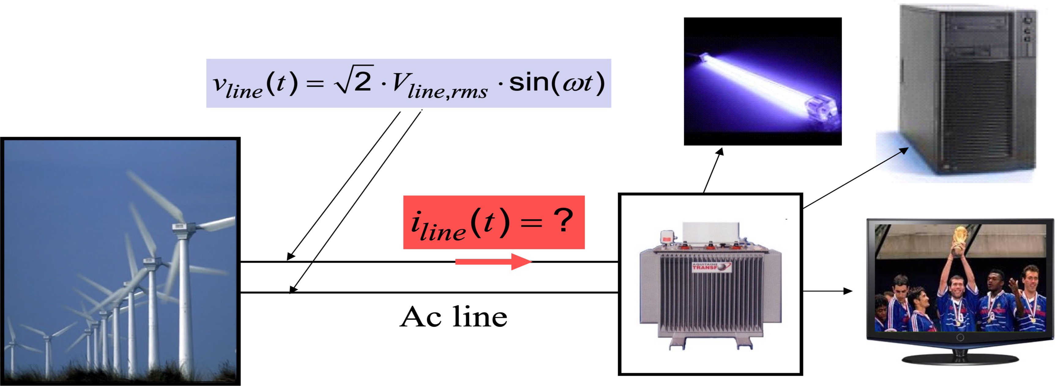
Basic PFC Definitions - Off-line Applications
The mains utility provides a sinusoidal voltage v_{line}(t).
The shape and phase of i_{line}(t) depend on the load.

Slide 5
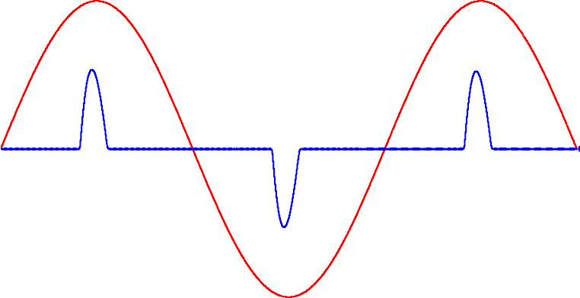
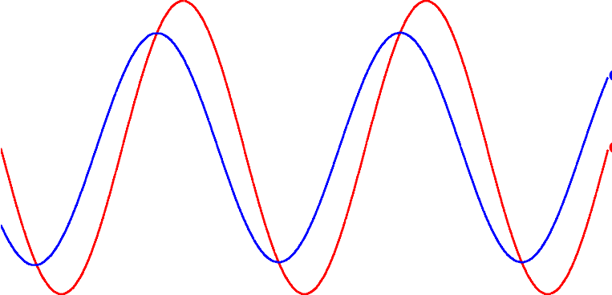
^{= V}line,rms ^{× I}line,rms ^{× cos} (⁸ ) ^{× cos} (� )
Basic PFC Definitions - Generalized
^{P}in,avg
v_{line}(t)
v_{line}(t)
i_{line}(t)
i_{line}(t)
cos(8) is the distortion factor
cos(�) is the displacement factor
The line rms current is inversely proportional to PF:
Low PF ➔ large peak and rms currents
PF = cos(ε ) × cos(�)
^{P}in,avg
^{I}line,rms
=
V
× PF
line,rms

Slide 6
Some Detrimental Effects of Poor PF
High peak and rms currents
− High peak currents cause component ratings to go up
− High peak currents can cause the line to sag at sinusoid peak
− High rms currents increase dissipation in the line and circuit
− High rms currents limit available load delivery from a socket
− What power can I draw from a 16 A outlet?
PF = 1.0 | 230 . 16 . 1.0 = 3680 W | about 12 loads of 300 W
PF = 0.6 | 230 . 16 . 0.6 = 2208 W | only 7 loads of 300 W
□ Circulating currents can heat up neutral wire in 3-ɸ circuits
− Only fundamental gets cancelled, harmonics don’t
Degradation of the power quality
− Possible malfunction of other equipment on the line
− Noise and interference

Slide 7
Power Factor Standards
EN61000-3-2: max. is specified for harmonics up to 40 (only odd ones for classes C and D)
Class C
Class B
EN61000-3-2
YES
YES
Lighting
Equipment?
NO
Portable Tool?
NO
Three Phase
Equipment?
NO
YES
PC/Monitor or TV?
YES
Motor Equipment?
YES
Class A
NO
Mandatory for PC, TV sets Monitors
P > 75 W
NO
Class D
In the 2000s, PF requirement included in other standards (e.g. Energy Star 4.0 for Computers, Climate Savers, etc.)

Slide 8
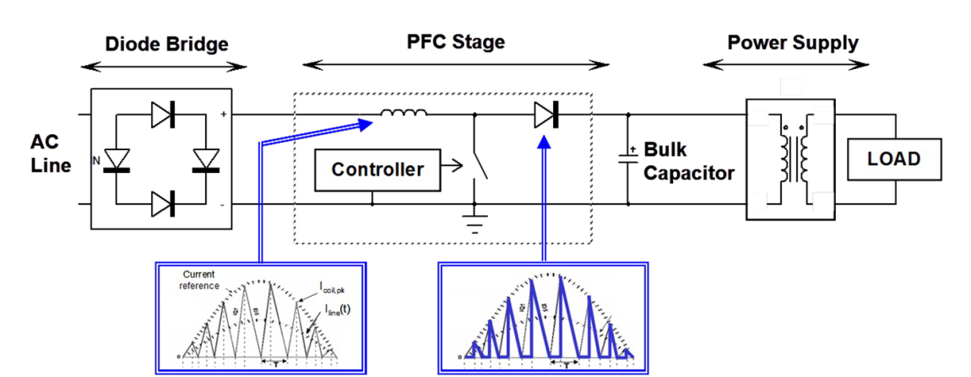
Active Power Factor Correction (APFC)
Inserted between the line and the main converter, a pre-converter draws a sinusoidal current from the mains and provides a dc voltage
Traditionally, this is a boost converter
The driver embeds a specific control law

Slide 9
Typical Efficiency Curves
99
98
97
96
95
94
93
92
91
90
Switching losses!
Efficiency (%)
Conductio n losses!
115 V
230 V
0
20
40
60
Load (%)
80
100
120
Efficiency curves on performance of the NCP1654 evaluation board (NCP1654PFCGEVB) reported in application note AND8324
Switching losses dominate at light load
Conduction losses dominate at full load, low line

Slide 10
Minimizing Losses
Reducing conduction losses:
− Using low-resistance components
− Minimizing the current rms level (ripple)
− Increasing the switching frequency
Reducing the switching losses
− Using fast switches
− Implementing soft-switching techniques
− Lowering the switching frequency
! !
!

Slide 11
Agenda
Introduction
Upgraded Control Algorithms
Interleaving Channels
The Bridgeless Option
Conclusions

Slide 12
Operating Modes Overview
Three modes for 1-phase PFC boost converters
 | Operating Mode | Main Features
i_{L}(t) | Continuous Conduction Mode (CCM) | Always hard-switching Inductor value is largest Minimized rms current
i_{L}(t) | Critical conduction Mode (CrM) | Large rms current Switching frequency is not fixed
i_{L}(t) ^{T}clamp ^{T}clamp | Frequency Clamped Critical conduction Mode (FCCrM) | Large rms current Frequency is limited Reduced coil inductance

Slide 13
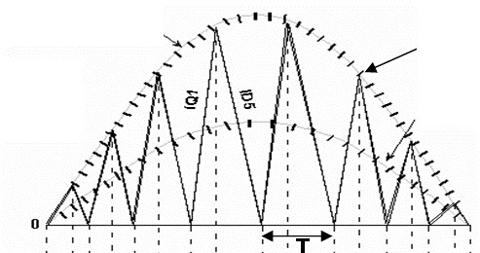
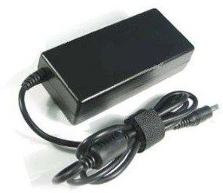
Critical Conduction Mode (CrM)
^{P}in,avg
=
I
in,rms
Current reference
(t )
^{V}in,rms
^{P}in,avg
2 ×
i
L, pk
i_{in} (t )
× sin (ροt )
i (t) =
line
^{V}in,rms
i (t ) = 2
^{P}in,avg
2 ×
× sin (ροt )
L, pk
^{V}in,rms
Most popular solution for low power applications
This scheme has several names:
− Critical Conduction Mode (“CrM”)
− Boundary Conduction Mode (“BCM”)
− BorderLine Conduction Mode (“BCM”)
− Transition Conduction Mode (“TCM”)
− Some vendors simply indicate “DCM” for Discontinuous Conduction Mode

Slide 14
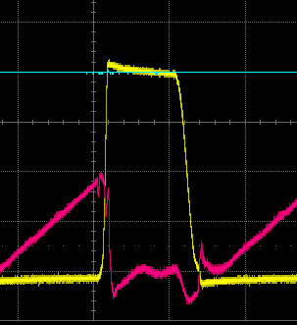
CrM Switching Sequences
Diodes Bridge
Diodes Bridge
i_{L}(t)
+
L
i_{L}(t)
+
L
v (t)
v (t)
V
out
IN
in
IN
in
-
-
v_{DS}(t)
i_{L}(t)
Inductor Current
^{I}L, pk
CrM: the next current cycle starts when the core is reset
v_{in} (t )
V_{out} − v_{in} (t )
i (t )
L
L
in
Valley turn on
time
_{(t ) =} v_{in}(t) × t_{on}
The peak inductor current is
I = i
proportional to v (t):
L, pk L, pk
L
in
The line current is the
iL, pk (t ) v (t) × t
₌ ₌ in on
2 2 × L
i (t ) = i
(t )
averaged inductor current:
in
L
T
sw

Slide 15
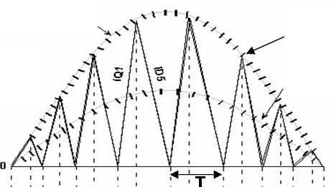
CrM PFC - Implementation
^{i}L, pk (^{t} )
Force a sinusoid reference for i_{L,pk}(t)
(current mode, e.g., NCL2801)
i_{in} (t ) =
2
_{i (t) =} v_{in} (t) × t_{on}
Force a constant on-time (voltage mode, e.g., NCP1611/2)
in
2 × L
^{P}in,avg
=
I
in,rms
Current reference
(t )
^{V}in,rms
^{P}in,avg
2 ×
i
L, pk
i_{in} (t )
× sin (χοt )
i (t) =
line
^{V}in,rms
i (t ) = 2
^{P}in,avg
2 ×
× sin (χοt )
L, pk
^{V}in,rms

Slide 16
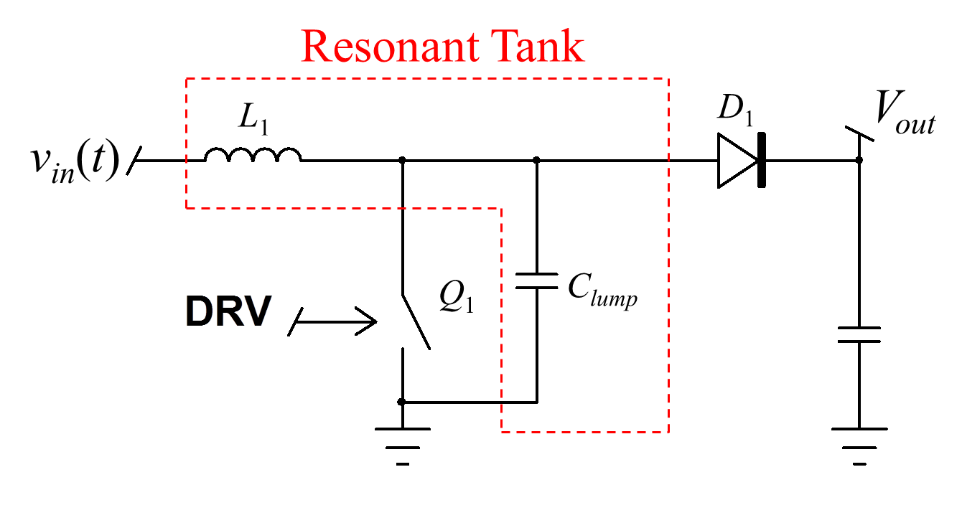
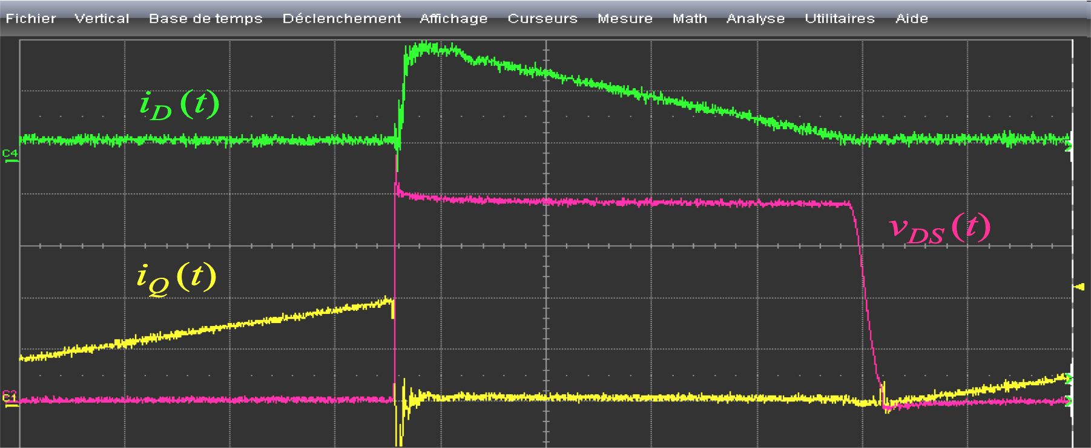
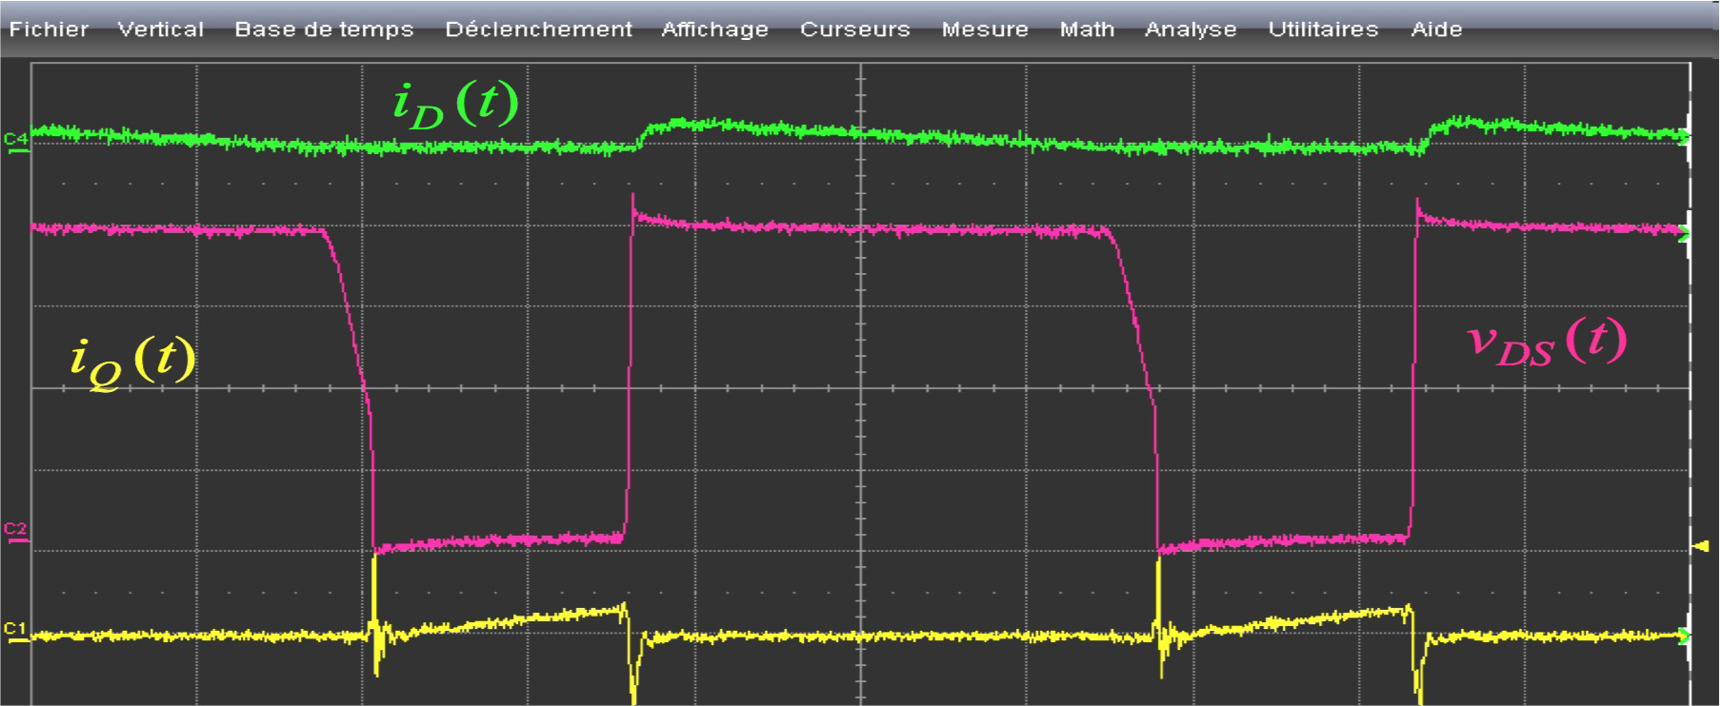
CrM – No or Low Turn-On Losses
Turning on at the valley:
ZVS when v_{in}(t)<V_{out} /2
Turn on at v_{DS}(t) = 2v_{in}(t)-V_{out} otherwise
Inductor current reaches zero
^{V}out
^{V}out
v_{in} (t)
v_{in} (t)
115 V rms / 50% Load
230 V rms / 50% Load
Tests made on NCP1612 evaluation board (NCP1612GEVB)

Slide 17
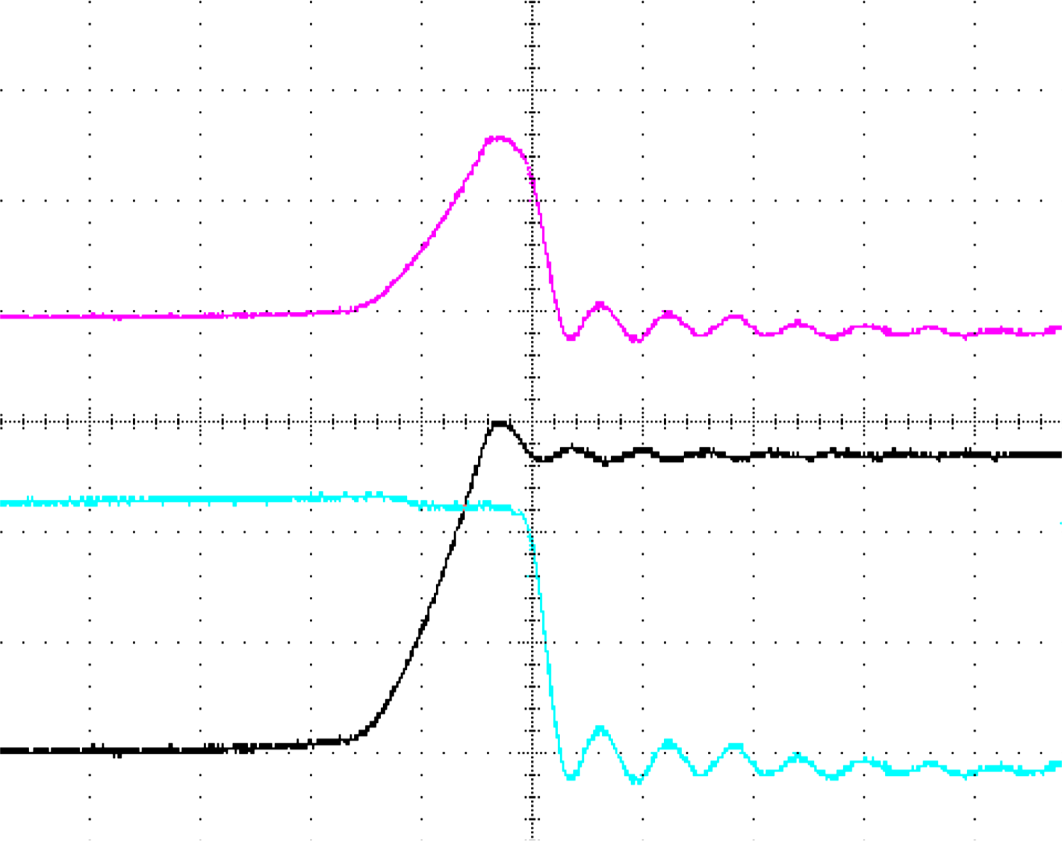
MOSFET Turn-Off in CrM
50 ns
p(t)
^{t}FR
v_{DS}(t)
i_{DS}(t)
Extracted from application note AND8123
(www.onsemi.com )
Hard-Switching Commutation
Diode t_{FR} causes losses and an overshoot

Slide 18
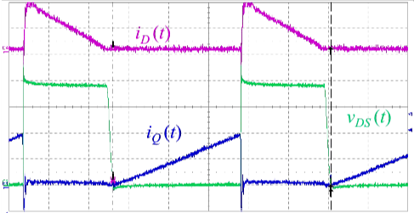
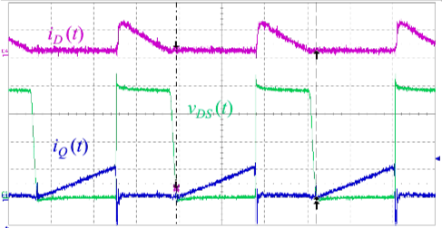
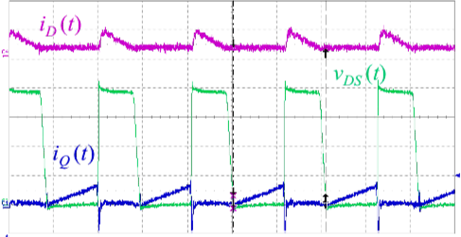
CrM Large Switching Frequency Range
□ f_{SW} varies as a function of the load and input voltage conditions
^{V}in,rms²
^{2 × L × P}in,avg
(
v_{in} (t ) ∴
f_{sw} (t ) =
× 1−
Ι
÷
∴
^{V}out
)
4 µs
4 µs
4 µs
115 V rms, 160 W ➔ 91 kHz
115 V rms, 80 W ➔ 152 kHz 115 V rms, 40 W ➔ 242 kHz
Tests made on NCP1612 evaluation board (NCP1612GEVB)

Slide 19
DCM Operation: A Good Idea?
(I
)
(^{I}L,pk )
DCM
L,pk
CrM
Cycle-by- cycle dead- time compensation
dead-time
^{t}on,CrM
^{t}demag,CrM
^{t}on,DCM
^{t}demag,DCM
^{t}SW ,CrM
^{t}SW ,DCM
DCM Operation:
(P_{sw} )
_{α =} SW ,DCM _{?: 1}
^{t}SW ,CrM
(P
)
₌ CrM
t
SW
DCM
α
− Lower switching losses
− Increased conduction losses
(^{P}COND ) ^{α ×} (^{P}COND )
=
DCM CrM
Ref: How2Power on-line magazine, Oct. 2012 issue (http://www.how2power.com/newsletters/1210/articles/ H2PToday1210_design_ONSemiconductor.pdf)

Slide 20
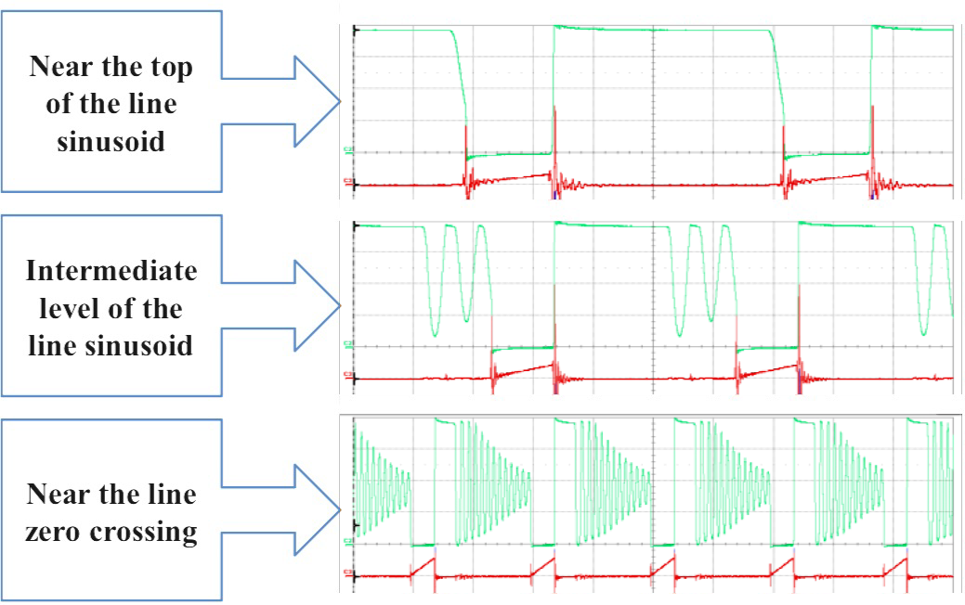
Current Control Frequency Foldback (CCFF)
CCFF (NCP1611/2/5)
CCFF adapts the operation mode to the instantaneous value of the line current

Slide 21
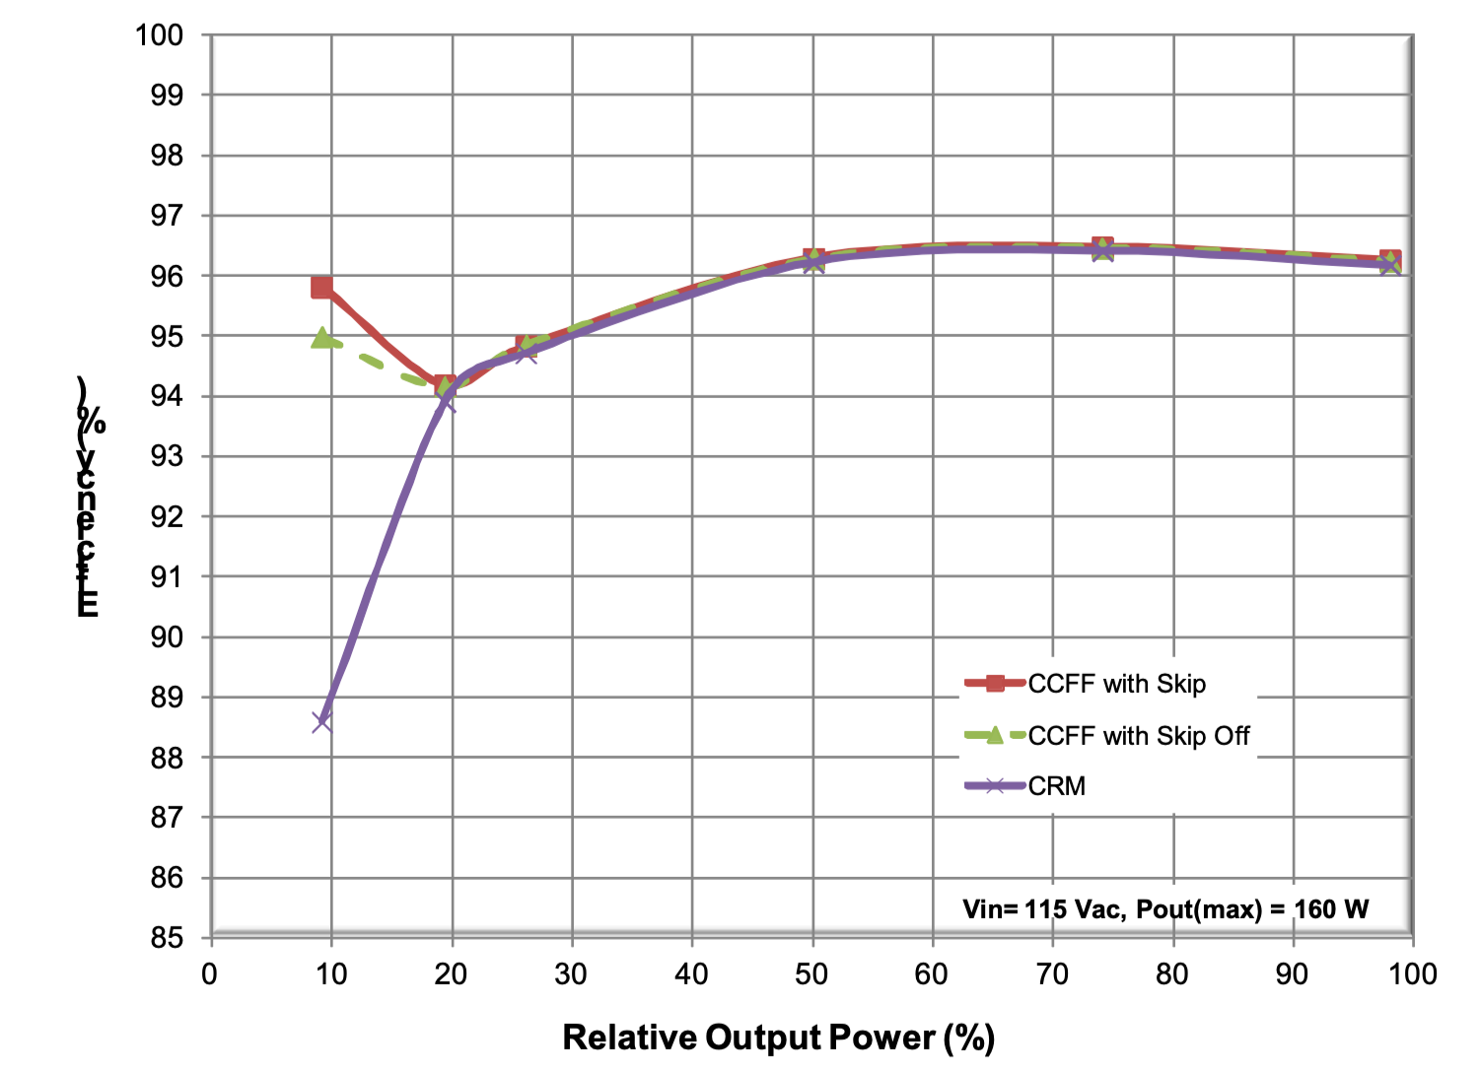
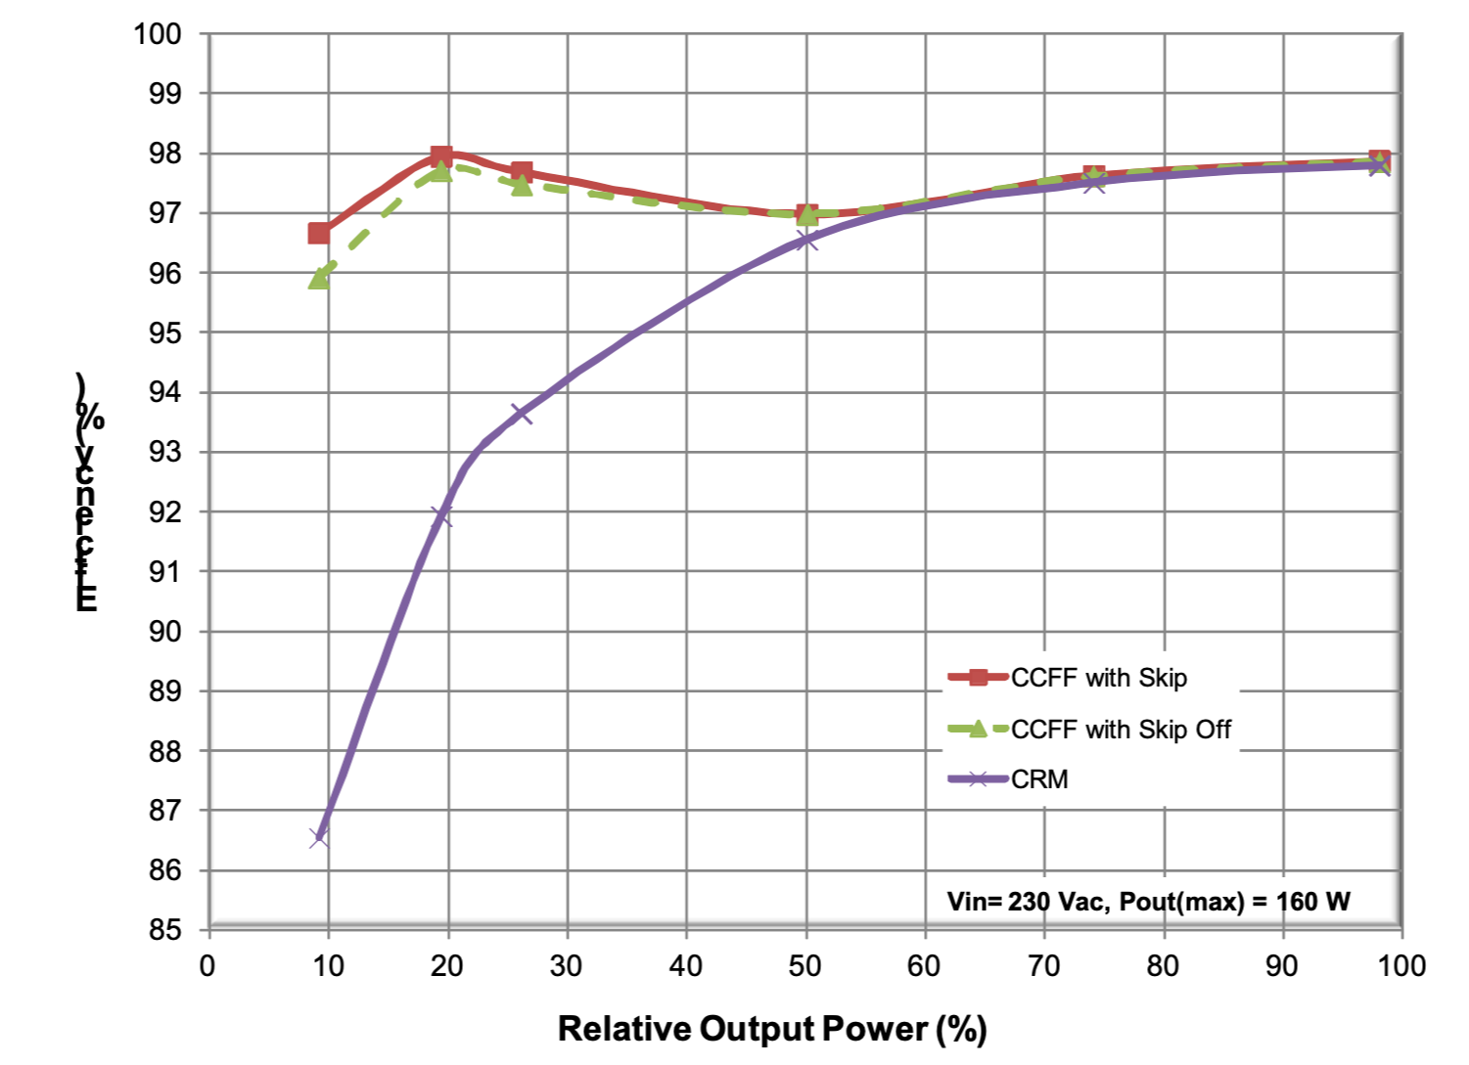
Frequency Clamped CrM Circuits
Frequency Foldback optimizes the light-load efficiency
Obtained with the NCP1612 160-W, wide-mains EVB. See http://www.onsemi.com/pub/Collateral/EVBUM2051-D.PDF for more details

Slide 22
FCCrM Optimizes The Inductor Size
FCCrM: no need for “over-dimensioning” L for light load
For similar performance:
CrM requires
FCCrM requires
L = 45 mH × W / (P_{in,avg} )
300 µH for a 150-W application
max
L ::; 30 mH × W / (P_{in,avg} )
max
150 µH for a 150-W application (e.g., NCP1631 evaluation board)
Conduction losses dominate
Switching losses dominate
Efficiency (%)
Increasing L
0
10 20 30 40 50 60 70 80 90 100
Load (%)
L
or FC

Slide 23
CrM – Too Large A Current Ripple For High Power
2.i_{in}(t)
i_{L}(t)
Large ripple of the inductor current
i_{in}(t)
Bulk capacitor high rms current
Need for differential-mode EMI filtering
i_{C}(t)
Large conduction losses
2.i_{in}(t)
CCM preferred above 300 W
-ILOAD

Slide 24
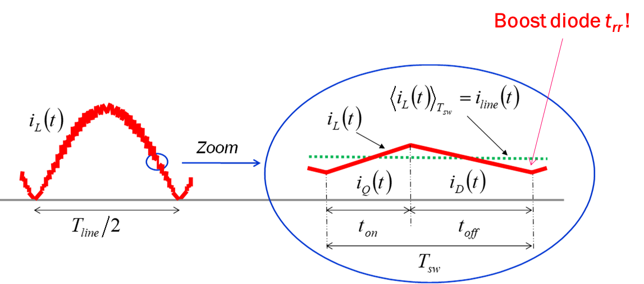
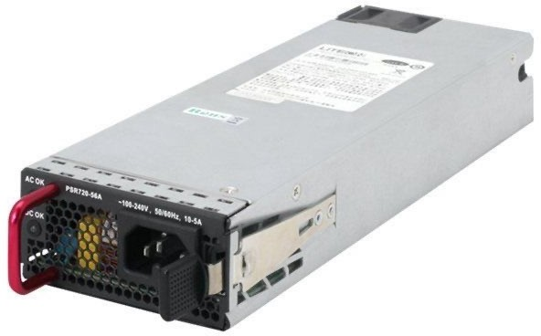
CCM PFC - Inductor Current
No ZCS ➔ Need for a low t_{rr} diode
The ratio i_{L}(t) over i_{in}(t) is small
The current ripple depends on L and v_{in}(t):
“Instantaneous”:
v_{in} (t ) ( v_{in} (t )∴
(!ιI_{L} )_{pk − pk} (t ) = ×11−
L × f V
÷
sw ∴ out )
At v (t) top:
in
(
λ
2 ×V 2 ×V
( I )
₌ in,rms _{×11−} in,rms ÷
L
pk − pk
L × f
1
V
÷
sw
out
)

Slide 25
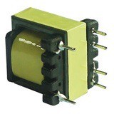
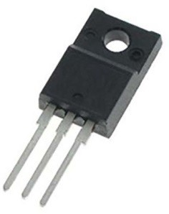
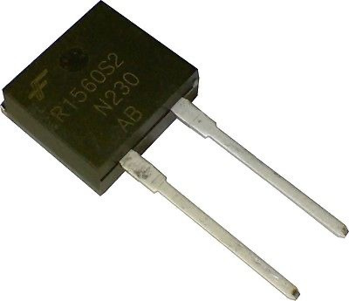
CCM vs CrM
□ 33% lower MOSFET and inductor conduction losses
Dc current most critical for the boost diode
 | CCM | CrM
^{I}L,rms | ^{P}in,avg ^{V}in,rms | × ^{P}in,avg ^{V}in,rms
^{I}Q,rms | ^{P}in,avg _{× 1−} ^{8 2 ×V}in,rms ^{V}in,rms ^{3ν ×V}out | 2 × ^{P}in,avg _{× 1−} ^{8 2 ×V}in,rms 3 ^{V}in,rms ^{3ν ×V}out
^{I}D,rms | ^{P}in,avg × 8 2 × ^{V}in,rms ^{V}in,rms ^{3ν V}out | 2 × ^{P}in,avg × 8 2 × ^{V}in,rms 3 ^{V}in,rms ^{3ν V}out

Slide 26
CCM Turn On Losses
^{V}OUT
^{V}KA
Diode losses during the switching event:
time
^{t}RR
⎛ V × I × t V × I × t V × I × t
⎞
p =
F L 1 ₊ F RRM A ₊ OUT RRM B
6
× f
I
L
t
D
2
2
÷ SW
I
A
⎝
⎠
D
t
B
^{I}RRM
time
MOSFET turn on losses:
t₁
⎛ I × (t + 2 × t + t ) I × (3 × t + 2 × t ) ⎞
p = V × /
⎝
L 1 A B
+
RRM
A B
6
÷ × f
⎠
I
Q,on OUT
2
SW
DS
^{I}RRM
I
L
time
^{V}OUT
Significant losses
Peter Haaf and Jon Harper, “Understanding Diode Reverse Recovery and its Effect on Switching Losses”, Fairchild Power Seminar 2007, https://www.fairchildsemi.com/technical- articles/Understanding-Diode-Reverse-Recovery-and-Its-Effect-on-Switching-Losses.pdf
V
DS
time

Slide 27
CCM, CrM and DCM Operation Modes
□ The cycle duration of the inductor current sets the operation mode
FCCrM: Frequency Clamped Critical Conduction Mode
i_{L}(t)
i_{L}(t) i_{L}(t)
^{V}DS
^{V}DS
^{V}DS
^{V}ramp,pk
Internal Ramp
^{V}clamp
Internal Ramp
^{V}clamp
Internal Ramp
^{T}clamp
^{T}clamp
^{T}CCM
^{T}cycle ^{< T}clamp ^{➔ DCM T}clamp ^{< T}cycle ^{< T}CCM
Automatic selection of the mode
CrM
^{T}cycle ^{> T}CCM
CCM

Slide 28
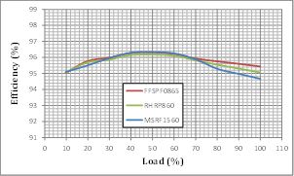
Why Multimode PFC?
Best conduction mode in all line/load conditions
DCM for light load
CrM for medium load
CCM for heavy load
The NCP1618 firmly controls the switching frequency:
65 kHz (with jittering) when in heavy load conditions (CCM)
58 kHz to 130 kHz in critical conduction
130 kHz to 25 kHz in DCM (with frequency foldback)
High efficiency over the load range
Eased EMI filtering
500-W EVB efficiency @ 115 V

Slide 29
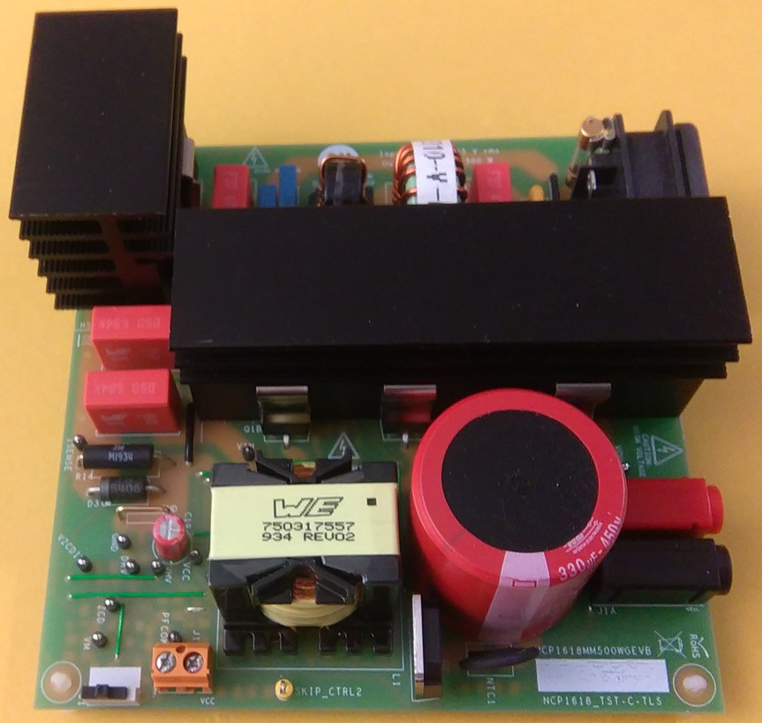
Wide-mains, 500-W EVB
Description | Value | Units
Input Voltage Range | 90-265 | V rms
Line Frequency Range | 45 to 66 | Hz
Output Power | 500 | W
Nominal Output Voltage | 390 | V
Minimum Output Load Current | 13 | mA
Maximum Output Load Current | 1300 | mA
Load Conditions For Efficiency Measurements (10%, 20%,..) | 10-100 | %
Minimum Efficiency Over Above Load Range, 115 V rms | 94 | %
Minimum PF Over The Line Range At Full Load | 95 | %
Hold-Up Time (the output voltage remaining above 300 V) | > 10 | ms
Peak-To-Peak Low Frequency Output Ripple | < 8 | %
More details at: https://www.onsemi.com/pub/Collateral/EVBUM2716- D.PDF

Slide 30
Line Current @ 115 V rms
CCM
CrM
Frequency Clamped CrM
Frequency Foldback

Slide 31
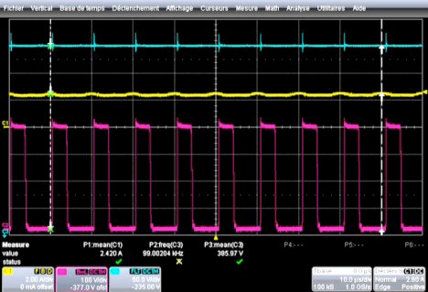
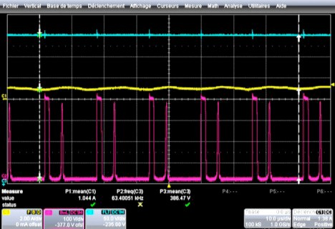
Operation modes at 115 V rms, 40% load
Vout
VDS
10 µs
I
Vout
10 µs
LINE
ILINE
VDS
a) Top of the sinusoid b) Near the line zero crossing
Critical conduction mode at the sine-wave top
The 130-kHz frequency clamp forces DCM near the line zero crossing
Valley turn on in both cases

Slide 32
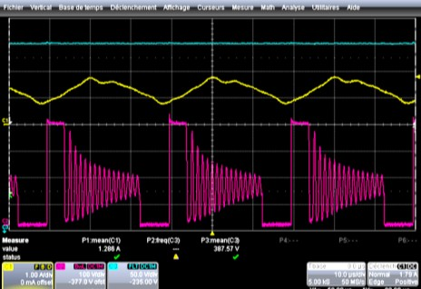
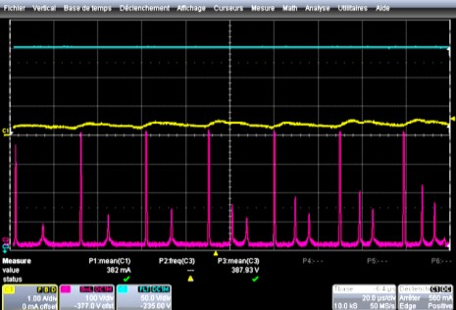
Operation modes at 115 V rms, 20% load
Vout
20 µs
ILINE
Vout
40 µs
ILINE
VDS
VDS
a) Top of the sinusoid b) Near the line zero crossing
Frequency foldback leads to low frequency operation (about 30 kHz)
The number of valleys adapts to the V_{DS} resonant period without repeated, unnecessary changes in the number of valleys (stable and silent operation)
Valley turn on in both cases
Efficient light-load operation

Slide 33
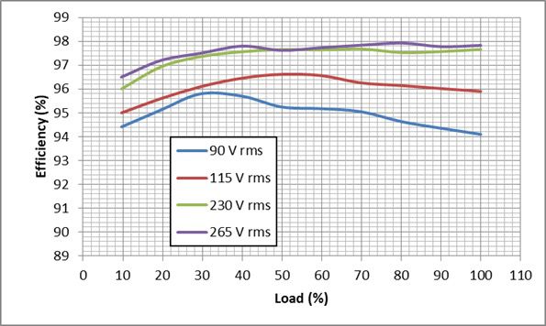
Efficiency over the load range
The efficiency is measured after a 30-mn warm-up time at full load. The load is decreased from 1.30 A down to 0.13 A by 0.13-A steps. The measure is made after 5 mn at the operating point under test.
The efficiency remains above 94% from 10% to 100% of the load at the 4 tested line levels (90 V rms, 115 V rms, 230 V rms and 265 V rms).

Slide 34
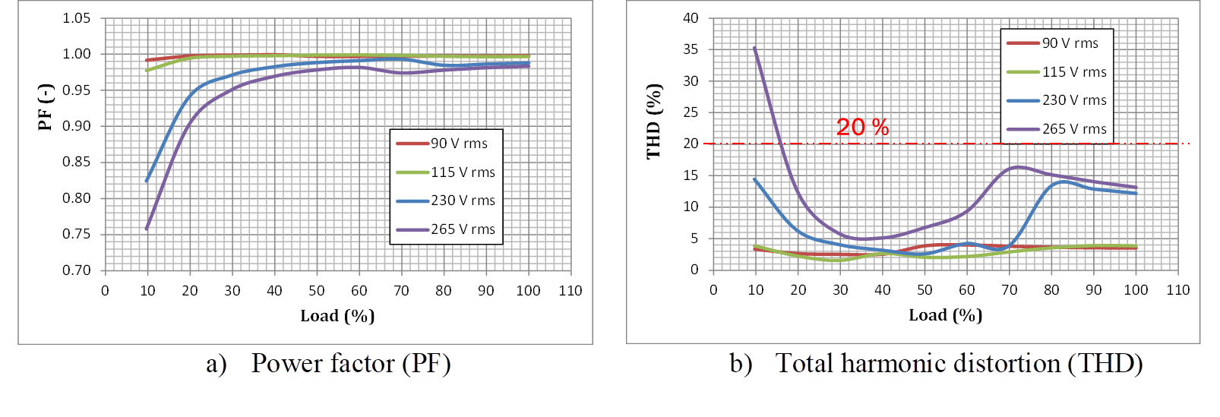
PF and THD Performance
On the 20% to 100% load range, the power factor remains higher than 0.9 and the THD well below 20% at the four tested line levels.

Slide 35
Agenda
Introduction
Upgraded Control Algorithms
Interleaving Channels
The Bridgeless Option
Conclusions

Slide 36
Interleaved PFC - Main Characteristics
Two small PFC stages in lieu of a single big one
I
Branch 1
I
^{V}in
I
L1
D1
L(tot )
^{V}aux1
Ac line
Branch 2
^{I}L2
^{I}D2
I |  |  | 1 2 | 31 | 16 15
 |  |  | 3 | 16 | 14
 |  |  | 4 | P | 13
 |  |  | 5 |  | 12
 |  |  | 6 | NC | 11
 |  |  | 8 |  | 9
in
NCP1631
V
V
aux2
^{I}D(tot )
cc
^{V}out
EMI
Filter
7
10
C
in
^{C}bulk
LOAD
^{R}sense
If the two channels are out-of-phase, the resulting currents (I_{L(tot)}) and (I_{D(tot)}) exhibit a dramatically reduced ripple.

Slide 37
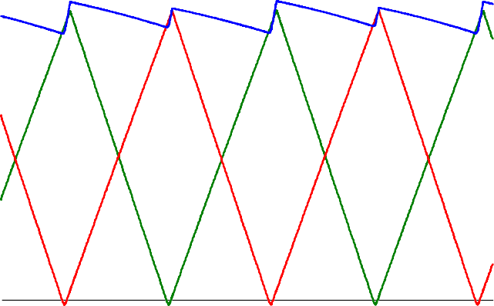
Interleaved PFC - Benefits
More components but:
− A 250-W PFC is easier to design than a 500-W one
− Modular approach
− Better heat distribution – easier cooling
− Smaller (more standard) components
− Two CrM PFCs look like a CCM PFC converter…
Interleaving allows for a reduced input current ripple
eased EMI filtering
Reduced output rms current
Lower stress on the bulk capacitor
Current ripple of each phase cancels!
^{I}L(tot)
^{I}L1
^{I}L2
time

Slide 38
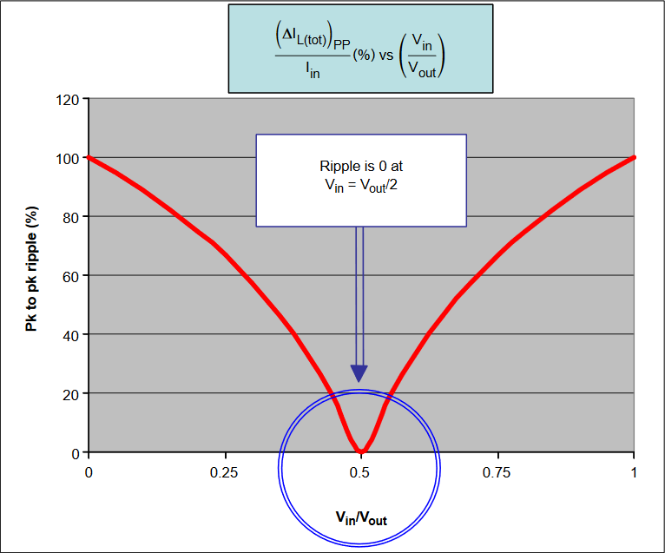
Interleaved PFC - Input Current Magnitudes
 | v (t) :Σ ^{Vout} in ₂ | v (t) � ^{Vout} in ₂
Averaged input | i_{in} (t) = i_{L(tot )} (t ) = ^{T}sw | ^{v}in (^{t} ) ₌ ^{v}in (^{t} ) ^{× P}in,avg ^{Rin V}in,rms²
current
(line current)
Peak to peak ripple | (τ:I ) = i (t ) × ⁽1− ^{vin (t ) ∴} L(tot ) _{pk − pk} in _{1 V − v (t ) ÷} ⎝ out in ⎠ | (τ:I ) = i (t ) × ⁽ 2 − ^{Vout ∴} L(tot ) _{pk − pk} in _{1 v (t ) ÷} ⎝ in ⎠
Peak Current | (I ) = 2 × i (t ) × ⁽1− ^{Vout ∴} L(tot ) ^{in 1 ÷} pk 1 4 × (V_{out} − v_{in} (t )) ÷ ⎝ ⎠ | (I ) = 2 × i (t ) × ⁽1− ^{Vout ∴} L(tot ) _{pk} ^{in} 1 _{4 × v (t )} ÷ ⎝ in ⎠
envelope
Valley Current | (I ) = i (t ) × ^{Vout} ^{L(tot )} v ^{in} 2 × (V − v (t )) out in | _{(I ( ) ) =} ^{P}in,avg ^{×V}out ^{L tot v 2 ×V}in,rms²
envelope
Current pk-pk ripple is independent from L
It is nearly i_{in}(t) /2 @ 90 V rms (top of the sinusoid)
See https://www.onsemi.com/pub/Collateral/AND8355-D.PDF

Slide 39
Interleaved PFC - Boost Diode Current
The boost diode(s) current depends on the mode:
2 × i_{in} (t )
Phase 1
Phase 2
i_{in} (t )
i_{in} (t )
i_{in} (t )
Single phase CCM
Single phase CrM
Interleaved CrM
rms value over T_{sw}
rms value over T_{sw}
rms value over T_{sw}
v_{in} (t )
^{V}out
v_{in} (t )
^{V}out
v_{in} (t )
^{V}out
i (t ) ×
² × i (t ) ×
¹ × ² × i
(t ) ×
in
3
in
2 3
in

Slide 40
Interleaved PFC - Capacitor Rms Current
Integration over the sinusoid leads to (resistive load):
 | Single-phase CCM PFC |  | Single-phase CrM / FCCrM* PFC |  |  | Interleaved CrM / FCCrM* PFC
Diode(s) |  | P ² _{8 2 × /} out ÷ ∴ ^{Ψ]} ) ^{3ν ×V}in,rms ^{×V}out
rms current | I₁ = |  | ² × I₁ 3 |  |  | ² × I₁ 3
^{(I}D,rms⁾
^{C}BULK rms current | (I )² − (I )² 1 out |  | 4 × (I )² 1 3 | ⁻ (^{I}out ) | 2 | 2 × (I )² 1 3 | ⁻ (^{I}out ) | 2
^{(I}C,rms⁾
300-W, V_{out} = 390 V ^{V}in,rms ^{= 90 V} | I_{D,rms} = 1.9 A I_{C,rms} = 1.7 A |  | I_{D,rms} = 2.2 A I_{C,rms} = 2.1 A |  |  | ^{I}D,rms(tot) ^{= 1.5 A} I_{C,rms} = 1.3 A
Interleaving dramatically reduces the rms currents
reduced losses, lower heating, increased reliability
* Frequency Clamped CrM

Slide 41
Interleaved reduces the conduction losses
□ MOSFET and Inductance conduction losses are divided by the number of channels
 | One-phase CrM | CCM | Interleaved CrM
^{I}L,rms | 2 × ^{P}in,avg 3 ^{V}in,rms | ^{P}in,avg ^{V}in,rms | 1 × ^{P}in,avg 3 ^{V}in,rms
^{I}Q,rms | 2 × ^{P}in,avg _{× 1−} ^{8 2 ×V}in,rms 3 ^{V}in,rms ^{3ν ×V}out | ^{P}in,avg _{× 1−} ^{8 2 ×V}in,rms ^{V}in,rms ^{3ν ×V}out | 1 × ^{P}in,avg _{× 1−} ^{8 2 ×V}in,rms 3 ^{V}in,rms ^{3ν ×V}out
^{I}D,rms | 2 × ^{P}in,avg × 8 2 × ^{V}in,rms 3 ^{V}in,rms ^{3ν V}out | ^{P}in,avg × 8 2 × ^{V}in,rms ^{V}in,rms ^{3ν V}out | 1 × ^{P}in,avg × 8 2 × ^{V}in,rms 3 ^{V}in,rms ^{3ν V}out
 | One-phase CrM | CCM | Interleaved CrM
( ^{p}COND ) L | 2 4 _{× r ×} ⁽ ^{P}in,avg ⁾ ₃ ^{L} 1 _{V} ÷ ⎝ in,rms ⎠ | ( P )² _{r × 1} in,avg ÷ ^{L} ⎝ ^{V} ⎠ in,rms | 2 2 _{× r ×} ⁽ ^{P}in,avg ⁾ ₃ ^{L} 1 _{V} ÷ ⎝ in,rms ⎠
^{I}Q,rms | 2 ⁴ _{× R ×} ^{( P}in,avg ⁾ × ⁽₁₋ ^{8 2 ×V}in,rms ⁾ 3 ^{DS (on) 1} V ^{÷ 1} 3ν ×V ÷ ⎝ in,rms ⎠ ⎝ out ⎠ | ( P )² ⁽ 8 2 ×V ⁾ _{R × 1} in,avg _{÷ × 11−} in,rms ÷ DS (on) 1 _{V} ÷ _{1 3ν ×V ÷} ⎝ in,rms ⎠ ⎝ out ⎠ | 2 ² _{× R ×} ^{( P}in,avg ⁾ × ⁽₁₋ ^{8 2 ×V}in,rms ⁾ 3 ^{DS (on) 1} V ^{÷ 1} 3ν ×V ÷ ⎝ in,rms ⎠ ⎝ out ⎠

Slide 42
Interleaved Benefits (CrM or CCM)
□ Like if the MOSFET and inductors were simply paralleled, conduction losses are divided by the number of phase
In addition, the current ripple is dramatically reduced
− Less EMI filtering required, eased use of low-resistance components
− Lower magnetic losses
Comparable switching losses compared to single-phase PFC operating in same mode

Slide 43
Agenda
Introduction
Upgraded Control Algorithms
Interleaving Channels
The Bridgeless Option
Conclusions

Slide 44
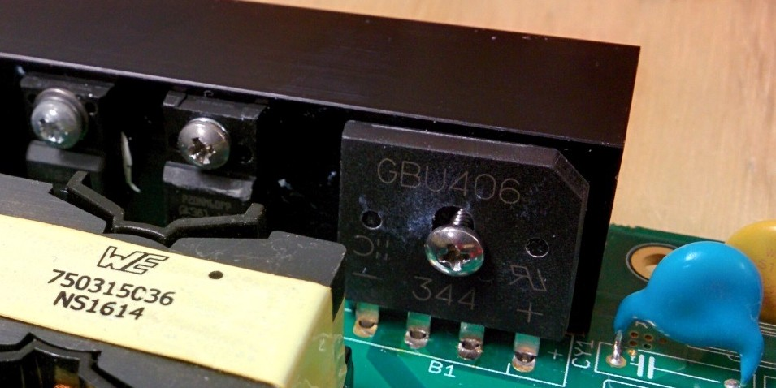
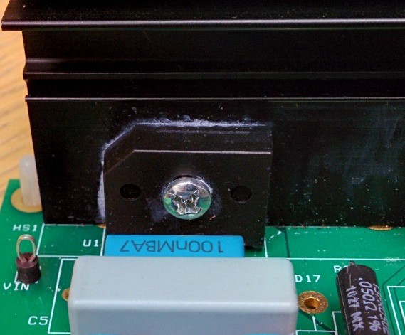
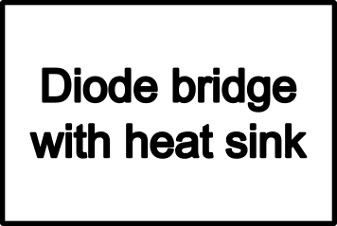
Bridgeless PFC - Introduction
The diodes bridge rectifies the ac line voltage
Two diodes conduct simultaneously
Two diodes in the current path
240 AIO EVB
EMI
filter
PFC
stage
D₁
+
D₂
NCP1631 PFC EVB
Ac line
+
D₃
D₄

Slide 45
Input Bridge Losses
Average current flowing through the input diodes:
2 2 ×
^{P}out
^{ρι ×V}in,rms
I
bridge _{Tline}
= I (t) =
line
^{T}line
ρε
Dissipation in the diodes bridge:
× 2 2 × P_{out}
P
bridge
= 2 ×V × I
f bridge
:: 2 ×V
f
^{ρι ×ν ×V}in,rms
If V_{f} = 0.85 V and (V_{in,rms})_{LL} = 90 V:
In low mains applications (@ 90 V rms),
the diodes bridge wastes about 1.7% efficiency!
P
bridge
� 1.7% × ^{Pout}
ρι

Slide 46
Bridgeless Benefit
90 V rms
265 V rms
Efficiency (%)
Bridgele ss
Efficiency (%)
Bridgele ss
1.7%
0.6%
Convention
Convention al
al
0
10 20 30 40 50 60 70 80 90 100
Load (%)
0
10 20 30 40 50 60 70 80 90 100
Load (%)
Nearly constant benefit over the load range
Reduced gain in light load due to lower V_{F}
Mainly line-dependent benefit

Slide 47
Two-Boost Bridgeless PFC
« PH1 » PFC
stage
« PH2 » PFC
stage
PH1
Ac Line
PH2
DRV
D₂
D₁
Two PFC stages but:
Reference: Alexandre Ferrari de Souza and Ivo Barbi, “High Power Factor Rectifier with Reduced Conduction and Commutation Losses”, Intelec, 1999
− One driver with no need for detecting the active half-wave
− Improved thermal performance
− As with conventional PFC stages, the negative phase is always attached to ground.
EMI issue is solved.

Slide 48
Equivalent Schematics for the Half-Line Cycles
PH1 PFC stage
-
PH1
₊ PH1
PH2 PFC stage
Ac Line
PH2
Ac Line
PH2
DRV
-
+
D₁
DRV
D
2
Terminal PH1 is the high one
Terminal PH2 is the high one
Only one diode on the current path

Slide 49
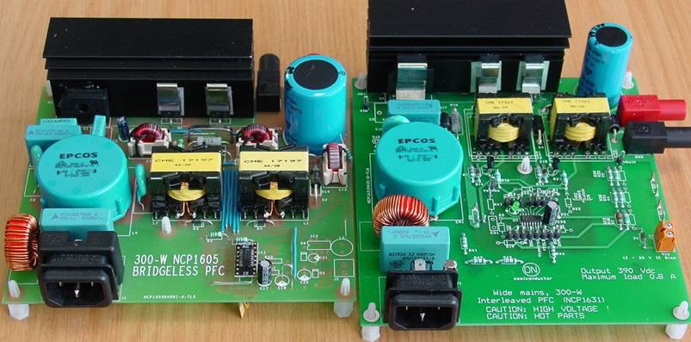
Two-Boost Bridgeless vs Interleaving - Boards
220 µF / 450 V
100 µF / 450 V
Current Sense Transformers
Controllers:
PQ32/20 (115 µH / 10 A pk) PQ26/20 (150 µH / 5 A pk)
NCP1605 for Bridgeless PFC (clamp frequency set to 130 kHz)
NCP1631 for interleaved PFC (clamp frequency set to 130 kHz per branch)

Slide 50
Two-Boost Bridgeless vs Interleaving - Efficiency @ 90 V
97.0
96.5
96.0
95.5
95.0
94.5
97.0
96.5
96.0
95.5
95.0
94.5
94.0
93.5
93.0
R_{DS(on)} = 99 mΟ @ 25°C
92.5
92.0
0 10 20 30 40 50 60 70 80 90 100 110
Load (%)
97.0
96.5
96.0
95.5
95.0
94.5
94.0
93.5
93.0
92.5
92.0
0 10 20 30 40 50 60 70 80 90 100 110
Load (%)
Efficiency (%)
Efficiency (%)
Efficiency (%)
Blue: Bridgeless Red: Interleaved
94.0
93.5
93.0
R_{DS(on)} = 250 mΘ @ 25°C
Solid lines: r_{DS(on)} = 99 mΘ @ 25°C Dashed lines: r_{DS(on)} = 250 mΘ @ 25°C
92.5
92.0
0
10
20
30
40
50 60
Load (%)
70
80
90
100
110
Light-Load Management Functions being disabled in both circuits (soft-skip mode for NCP1605 and Frequency Foldback for NCP1631)

Slide 51
Two-Boost Bridgeless vs Interleaving – High Line Data
99.0
99.0
98.5
98.5
Bridgeless
Bridgeless
98.0
0.2 %
98.0
97.5
Efficiency (%)
97.5
97.0
96.5
Efficiency (%)
0.4 %
97.0
96.5
96.0
Interleaved
96.0
95.5
95.0
Interleaved
r_{DS (on )} = 250 mΔ. @ 25 °C
95.5
_{95.0} r_{DS (on )} = 99 mΔ @ 25 °C
94.5
0 10 20 30 40 50 60 70 80 90 100 110
Load (%)
94.5
0
10
20
30
40
50 60
Load (%)
70
80
90
100 110
At high-line, the bridgeless advantage reduces.
Low r_{DS(on)} does not improve. MOSFET parasitic capacitance degrades the performance particularly for interleaving
(2 times more switching events)

Slide 52
True Bridgeless - Rearranging classical boost converter
Move the inductor in series with ac line
L O A D
AC
Low-Frequency Leg
High-Frequency Leg. WBG switches needed for CCM,
SJ FETs w. low QRR viable for CrM.

Slide 53
Totem Pole PFC
Slow Leg Line Frequency
Fast Leg PWM Frequency
SRH
PWMH
L
O A D
AC
SRL
PWML
Totem Pole is an elegant 4-switch boost solution that reduces number of components in the current path.
1 FET in the “diode” section (Low-Freq leg) and 1 FET in the boost section conducting.

Slide 54
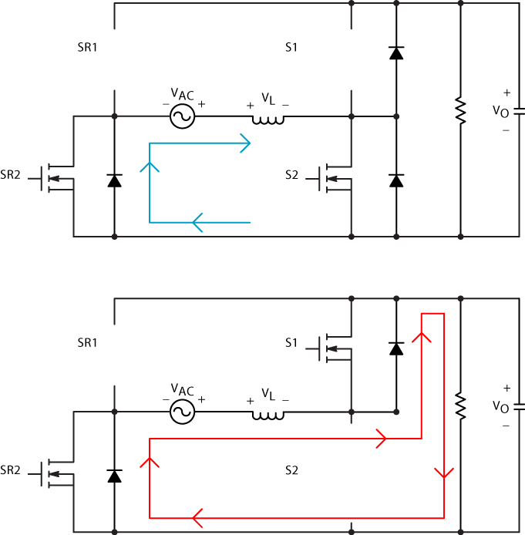
Positive Half Cycle Operation
S2 is the duty cycle (d) controlled device and S1 is the (1-d) device
When S2 is on, V_{L} = V_{AC} and current (blue path) circulates through S2 and SR2
When S2 turns off, V_{L} = V_{AC} - V_{O} and current free wheels through S1 and SR2 (red path). S1 can be turned on for increased efficiency
SR2 is returning current to the source for the entire positive line cycle

Slide 55
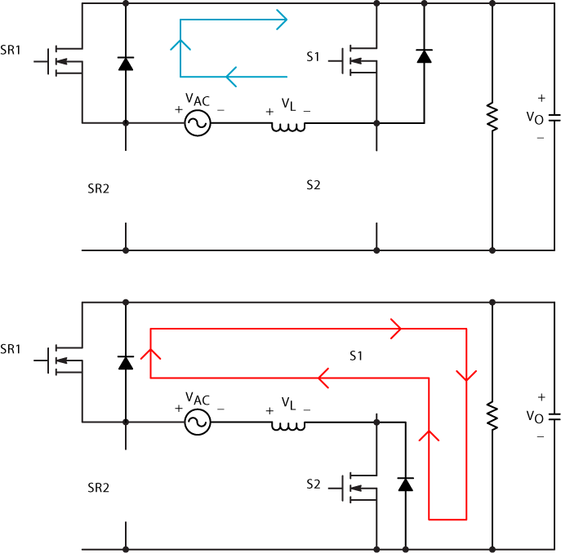
Negative Half Cycle Operation
S1 is the duty cycle (d) controlled device and S2 is the (1-d) device
When S1 is on, V_{L} = - V_{AC} and current (blue path) circulates through S1 and SR1
When S1 turns off, V_{L} = V_{AC} - V_{O} and current free wheels through S1 and SR2 (red path). S2 can be turned on for increased efficiency
SR1 is returning current to the source for the entire negative line cycle

Slide 56
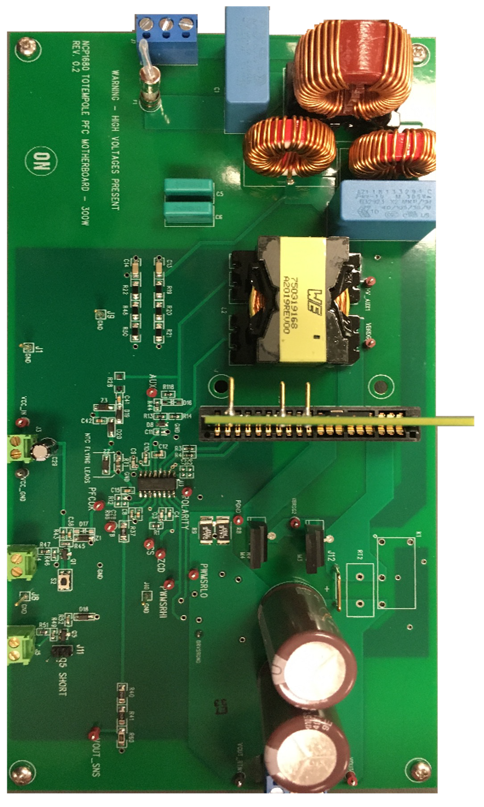
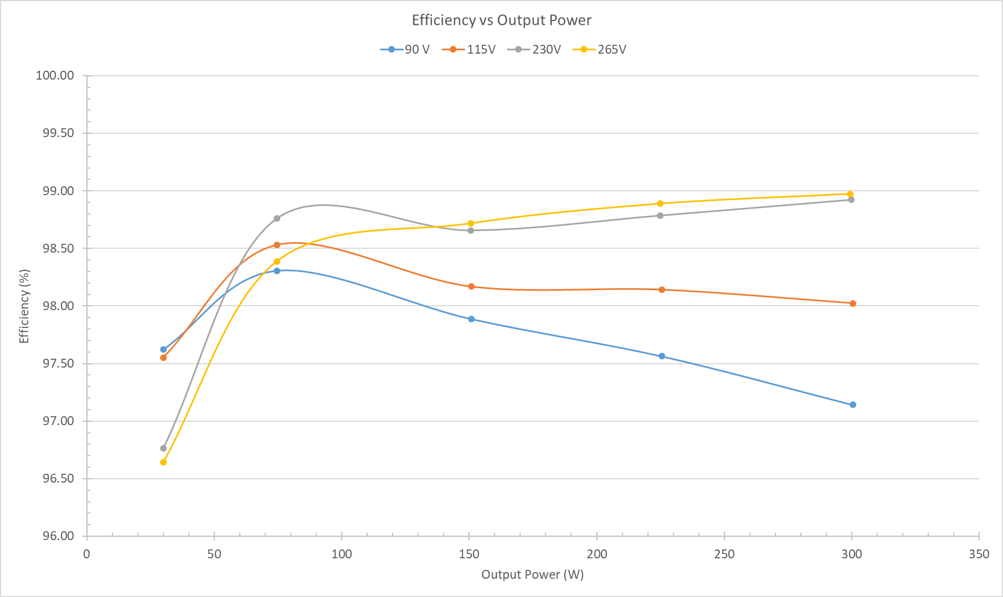
300-W NCP1680 Evaluation Board
97%
A high efficiency over the entire load/line range !

Slide 57
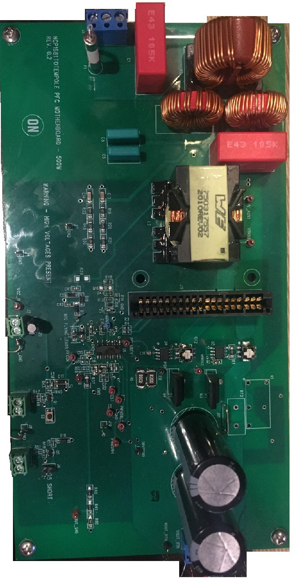
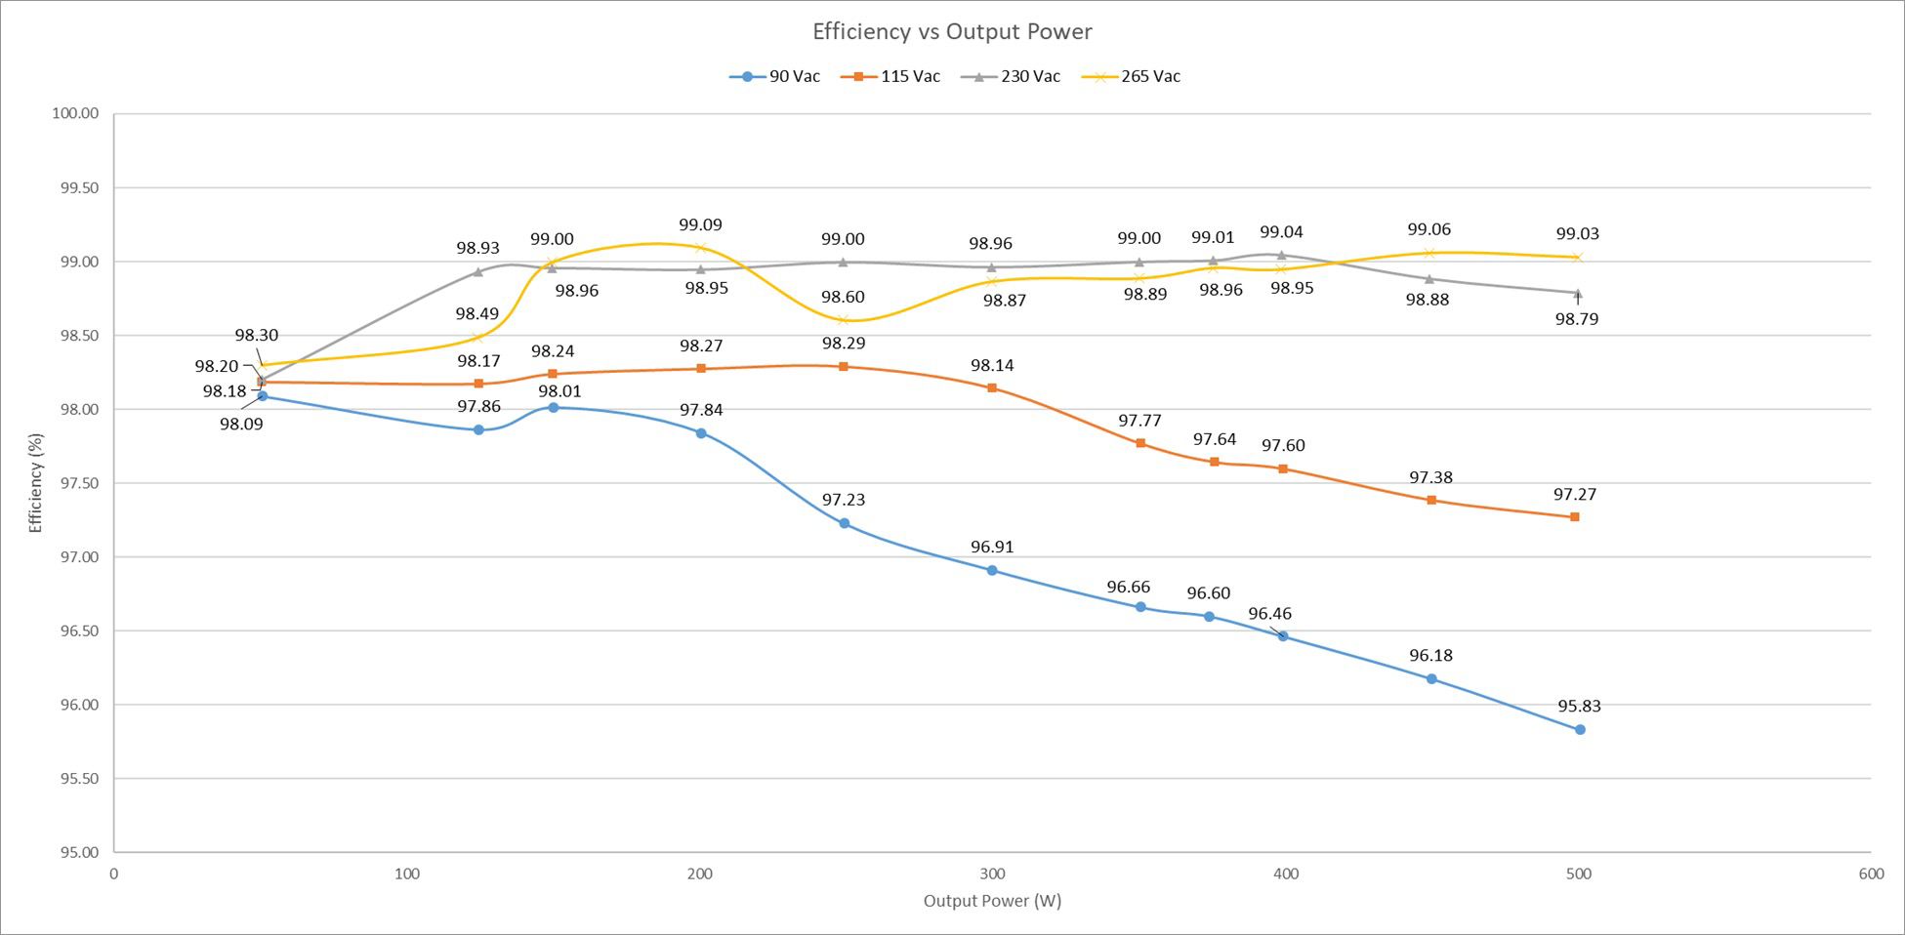
500-W NCP1681 Evaluation Board
96%
A high efficiency over the entire load/line range !

Slide 58
Totem Pole vs. Standard Boost - Efficiency Comparison on a 500 W PFC
500 W
Totem Pole vs. Standard Boost Efficiency @ 90 Vac
100,00
99,00
Totem Pole Eff
Std. Boost Eff
98,00
Efficiency (%)
97,00
96,00
95,00
1.8% efficiency gain 30% reduction in losses
~ 9 W savings
94,00
93,00
92,00
0
10
20
30
40
50
Load (%)
60
70
80
90
100
Totem Pole utilizes 2 eGaNs & 2 SJ FETs
Standard boost uses 2 SJ FETs & 1 SiC diode

Slide 59
Agenda
Introduction
Upgraded Control Algorithms
Interleaving Channels
The Bridgeless Option
Conclusions

Slide 60
Conclusions – Take-Aways
CrM is a popular and efficient solution for low power
Frequency clamp helps optimize the inductor size and cost
Frequency reduction techniques necessary for light-load efficiency
CCM is the most practical solution for high-power operation
Multimode PFCs automatically select the best conduction mode
Multimode PFCs provide optimized performance over the line/load range
Interleaving requires more components but dramatically reducing the current ripple
Interleaving increases the CrM power range
Bridgeless further improves the low-line efficiency over the entire load range
Totem Pole PFC provides superior performance

Slide 61
Follow Us @onsemi
www.onsemi.com

