Slide 1
FPF3382 EvB user guide

Slide 2
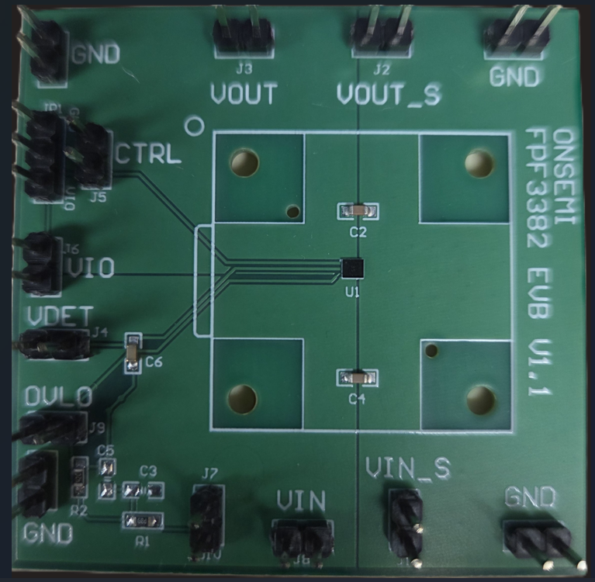
FPF3382 EvB user guide
Overview
The FPF3382 Evaluation Board is designed to demonstrate and validate the performance of the FPF3382 hot-swap power switch. It supports input voltages up to 25 V and includes features for over-voltage lockout (OVLO), controlled turn-on, and fault detection.
Key Features
Input voltage range: up to 25 V
Integrated OVLO and VDET functionality
External control via CTRL pin
Sense outputs for VIN and VOUT
Test points for all major signals
Compact layout with standard 0603/1206 components

Slide 3
FPF3382 EvB user guide (Setup Instructions)
Power Supply
Connect up to 25 V to J8 (VIN).
Connect GND to the corresponding ground terminals.
Logic Supply
Apply VIO (typically 3.3 V or 5 V) to J6 for logic-level control.
Control and Monitoring
Use J5 (CTRL) to enable or disable the switch by using JP1 to jumper CTRL to either GND (enabled) or VIO (disabled).
Monitor VOUT at J3, and VIN at J8.
Use J1/J2 for precision sensing of VIN and VOUT.
OVLO threshold can be adjusted via R1/R2.
  Default resistors of R1=500k Ω and R2=26.3k Ω provide OVLO of ≈24 V if J7 has jumper.
  OVLO can be adjusted by changing R1/R2 values according to datasheet. J7 jumper must be present.
  OVLO will default to ≈12.4 V when J7 jumper is not present.

Slide 4
FPF3382 EvB user guide (Testing)
Functional Testing
Power On the board with VIN and VIO connected.
Toggle CTRL to observe switching behavior through JP1.
Monitor VDET and OVLO signals to verify fault detection.
Measure VOUT to confirm proper regulation and switching.
Test under load to evaluate current handling and protection features.
Notes
Capacitors C1, C3, C5, C7 are marked NC (Not Connected) and can be populated for custom filtering.
Ensure proper grounding across all test points.
General Tips
Use an oscilloscope to monitor VIN, VOUT, CTRL, and VDET for dynamic behavior.
If using external logic signals, confirm they are referenced to the same ground as the board.
Always power down the board before making component changes or jumper adjustments.

Slide 5
FPF3382 EvB (Trouble Shooting)
Troubleshooting Tips
If the FPF3382 Evaluation Board is not functioning as expected, use the following checklist to diagnose and resolve common issues:
Power Issues
No output voltage (VOUT):
  Verify that VIN is properly connected and within the 2.8 V to 25 V range.
  Ensure CTRL is pulled low (enabled) or left floating.
  Confirm that the FPF3382 IC (U1) is properly soldered and powered.
Board not powering up:
  Check for shorts between VIN and GND.
  Measure voltage at J7 (VIN) and J6 (VIO) to confirm supply presence.
  Inspect for damaged components, especially capacitors and resistors.
Signal and Control Issues
CTRL not responding:
  Ensure the signal at J5 (CTRL) is within valid logic levels.
  If using JP1 jumper, verify it is securely placed and not floating.
  Check continuity between CTRL pin and U1.
OVLO triggering unexpectedly:
  Measure the voltage at J9 (OVLO).
  Verify resistor values R1 (500k Ω) and R2 (26.3k Ω) are correct and properly soldered.
  Adjust OVLO threshold if needed using the formula from the datasheet.

Slide 6
FPF3382 EvB (Trouble Shooting continued)
Output Problems
VOUT is unstable or noisy:
  Check decoupling capacitors C2, C4, C6 for proper placement and values.
  Ensure load is within the current rating of the FPF3382.
  Use a clean ground reference when probing VOUT.
VOUT stuck low:
  Confirm that the switch is enabled via CTRL (active low).
  Check for excessive load or short circuit at the output.

Slide 7
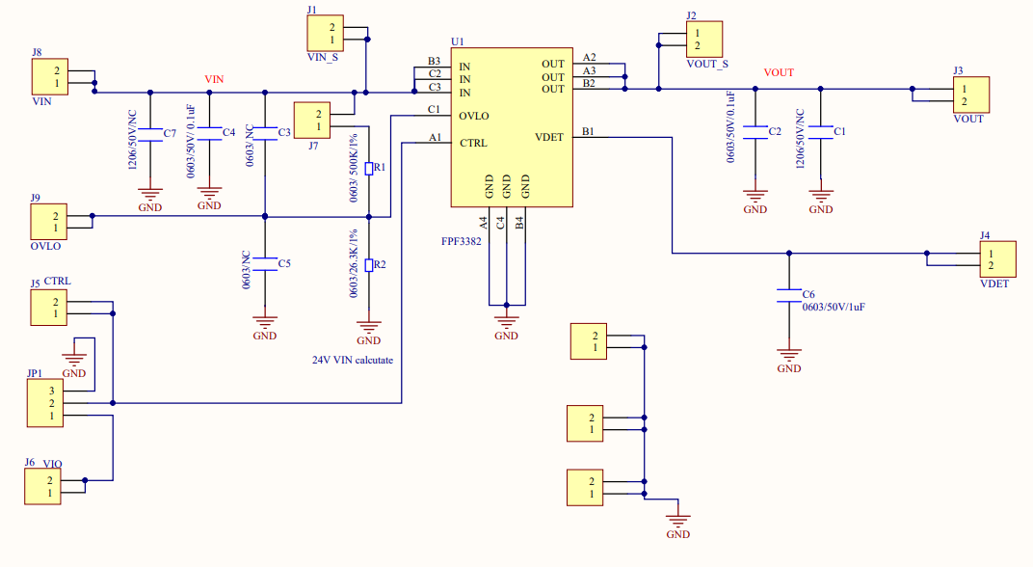
FPF3382 EvB Schematic

Slide 8
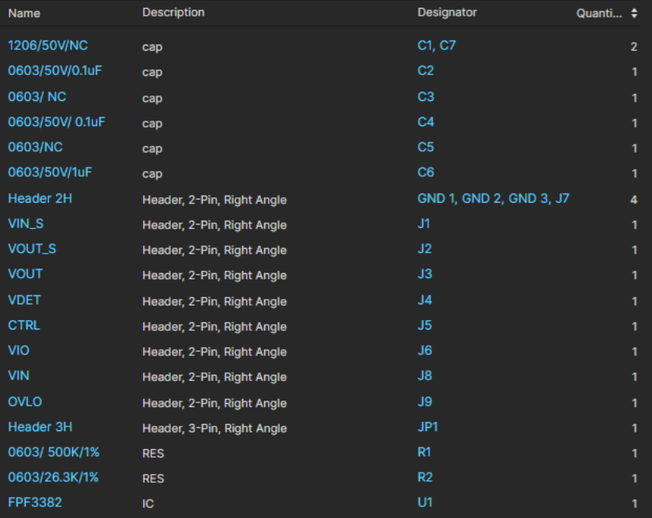
FPF3382 EvB (Bill of Materials)

