Slide 1
The Quest for High Power Density
Welcome to the GaN Era

Slide 2
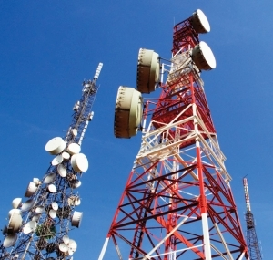
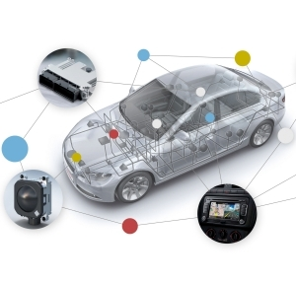
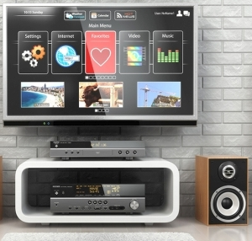




Power Conversion Technology Drivers
Wireless
Automotive
Consumer
Mobile
Lighting
Computing
Industrial
Key design objectives across all applications:
        High power density
        High efficiency
        High reliability
        Low cost
2/36
Notes:
The problem is achieving all of them at the same time.

Slide 3
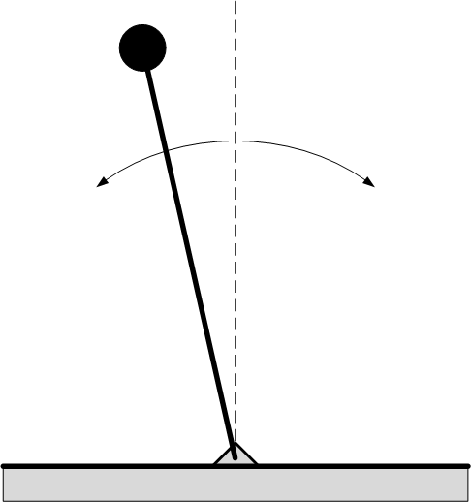
The Challenge – Balancing The Trade Offs
We can satisfy the high power density OR the high efficiency OR the high reliability OR the low cost requirements.
How to satisfy all four at the same time? → Biggest challenge today.
LOW COST SOLUTION
Component / Material price reductions
Optimization knowledge
Cost pressure
Time – to – Market
Risk
HIGH PERFORMANCE
Performance requirements
Customer expectations
Innovation
Differentiation
Competition
3/36

Slide 4


Power Management Trends
Slowly improving, continuing trends:
Few new topologies, focus on (quasi-) resonant solutions
System level optimization
High frequency passive components
Discrete device and Control implementation trends:
Semiconductor technologies (not just WBG!)
Advanced control; Accuracy
Protection and fault tolerance;
Connectivity and Sensors
4/36
Notes:
System architectures & power converter topologies are continuously evaluated for optimum performance.
Paralleling, modularity -- vicor’s success story
System level optimization -- dynamic voltage scaling, partitioning
Smart control --- continuously adapts to load and operating conditions
Connectivity -- configuration, control, telemetry
Sensors -- integrated or interface provided

Slide 5
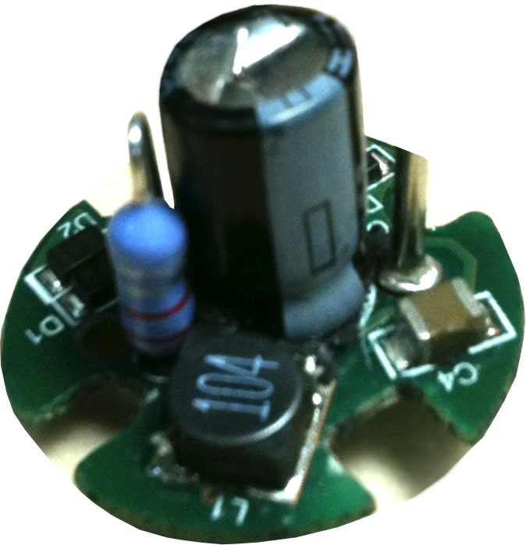


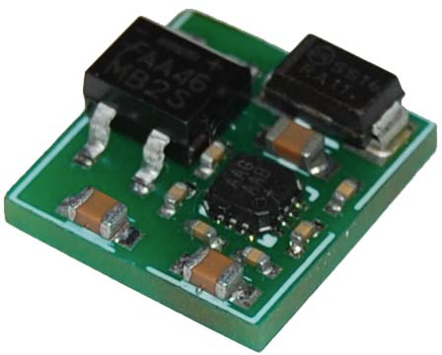
Understanding the Focus on Power Density
Why do we care about high power density:
Miniaturization → enabling technology for new applications
Less material → lower cost
Less board space → more room for fundamental value adding features
Smaller installation footprint → lower facilities cost
Less weight → convenience, fuel savings
Power density is only important when its
impact on the system is considered →
5/36

Slide 6
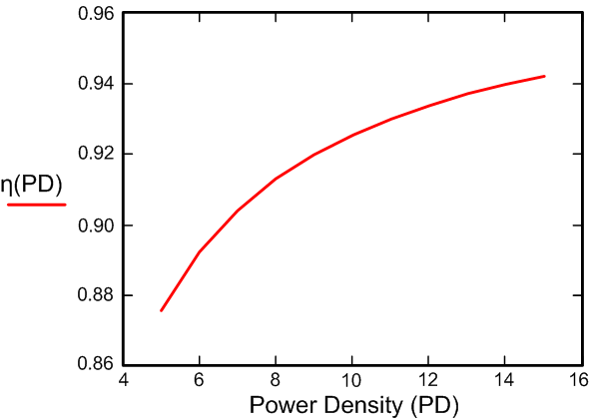
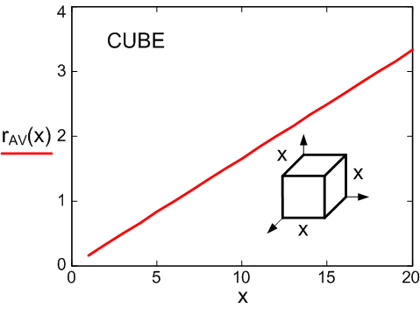
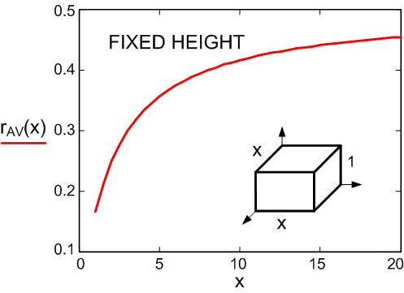
Enabling High Power Density
Newton’s law of cooling says → →
r_{AV}(V) is a function of shape!
Notes:
h – heat transfer coefficient; A – surface area; ΔT – temperature rise; r_{AV}(V) – surface to volume ratio; P – rated power; V – volume
6/36

Slide 7
The Power Density Pyramid
High efficiency → lower losses (heat dissipation) → reduces cooling requirements
Soft-switching or resonant power conversion → allows efficient, high frequency operation → allows smaller size passive components
Fast switching Devices → reducing switching losses which can yield higher efficiency OR high frequency operation (or both = optimization)
Low parasitic packaging and PCB technologies → imperative for fast switching, minimizes EMI, improves efficiency in high current loops
Advanced control algorithms → minimizes component peak stresses and over design requirements (addresses light load efficiency, topology flexibility, etc.)
Communication capability → allows system level integration, intelligent power management, increased up-time, remote access, etc.
7/36

Slide 8
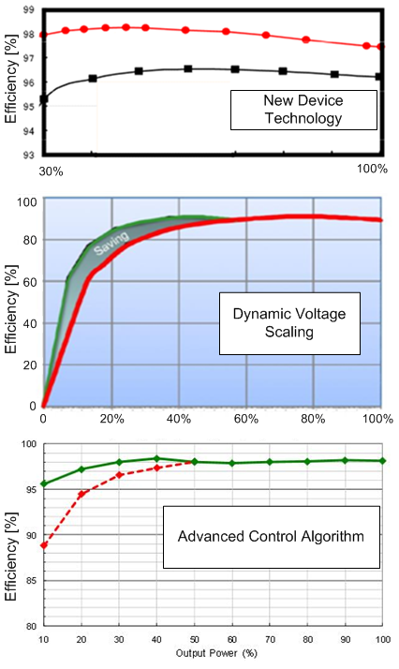
High efficiency
The gate keeper for denser integration
Energy prices, government regulations
Market differentiation, higher $/W
The trends:
  Full load efficiency is plateau-ing at 96% - 99%
  Strict enforcement of efficiency and power quality guidelines
  no-load, light load and average efficiency is regulated; inching higher
  Adaptive, optimized control algorithms
  Intelligent, on-demand power delivery
8/36
Notes:
Example TOP: 4kW solar inverter redesigned with GaN
Example MIDDLE: 1.5kW telecom power supply with DC link as a function of load
Example BOTTOM: 400W PFC with topology and operating frequency change as a function of load

Slide 9
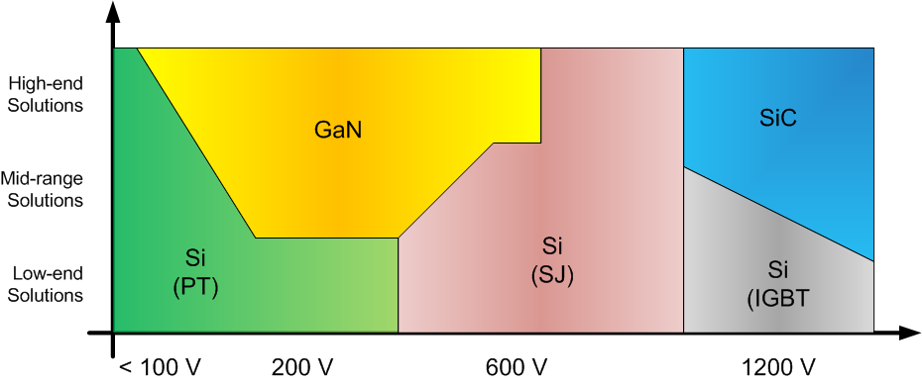
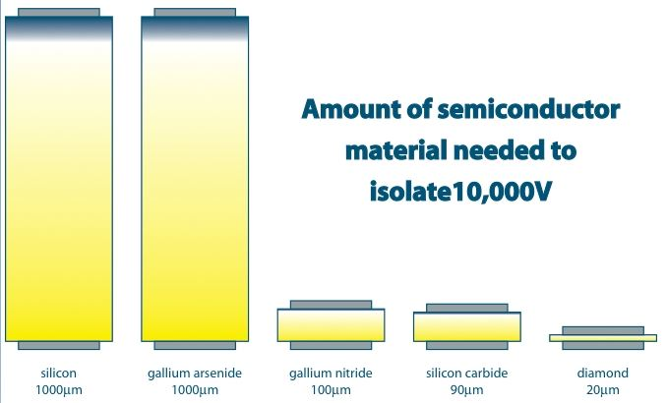
Fast Switching Devices
  Switching loss reduction
  MHz range switching frequency
    Without efficiency degradation
    Independent of the voltage rating
Requires device technology, drive circuit and power stage optimization
New device developments:
  Improvements in MOSFET technology
  GaN → eMode (nomally OFF)
  SiC → High Voltage and Temperature
  WBG reliability and cost are improving
9/36

Slide 10
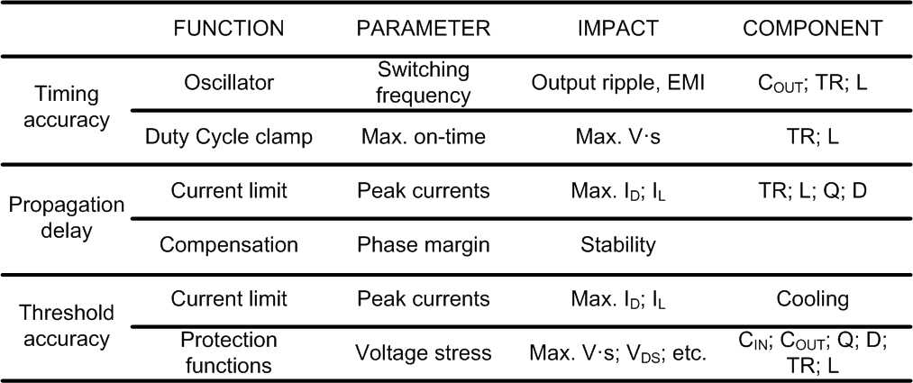
Control Accuracy vs. Power Density
Wide tolerances lead to “over design”
  Increased component ratings
  Increased passive component sizes
  Increased cooling requirements
10/36

Slide 11
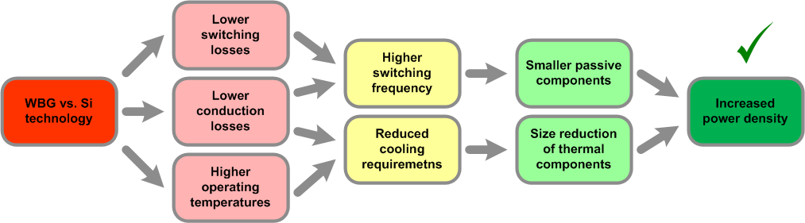
Wide Band Gap Devices
GaN has the potential to take over Si in the 650V space based on power density
GaN offers lower conduction losses and significantly lower switching losses (650V)
SiC will compete well with Si MOSFETs and IGBTs in the 1kV+ segment
SiC can be a game changer in the 2kV+ application space
For both technologies better high frequency and high temperature packaging needed
11/36

Slide 12
GaN Device Basics
GaN Epi is grown on substrate (Si, SiC, saphire, etc.) – source of defects; getting much better
Free electrons form a 2DEG at the AlGaN/GaN boundary surface (current flow mechanism)
GaN HEMT is normally ON device (depletion mode)
Normally OFF is a trade off – lose some benefits
Lateral Structure → extremely low capacitances
No minority carriers → no stored charge
Notes:
2DEG – 2 dimensional electron gas; GaN buffer – undoped; AlGaN – doped GaN layer; HEMT – high electron mobility transistor
12/36

Slide 13
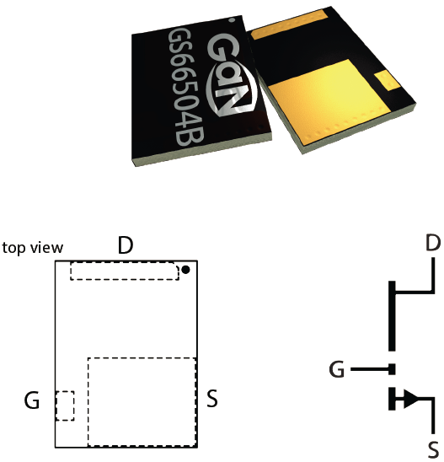
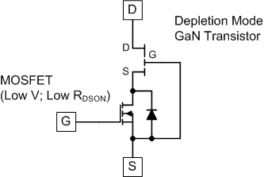
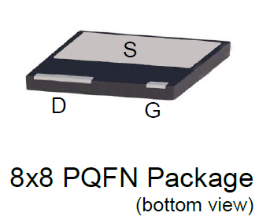
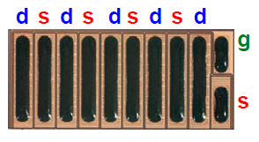
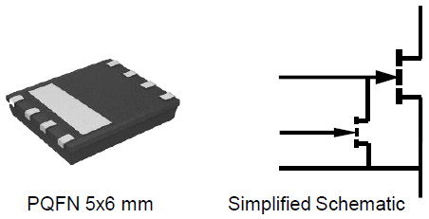
GaN Device Types
JFET (normally ON)
eMode (normally OFF)
< 200 V & 650 V family of voltage ratings
RF like packages to eliminate source inductance
Monolithic integration of the driver is possible
High speed, low R_{DSON}, high gain
13/36

Slide 14
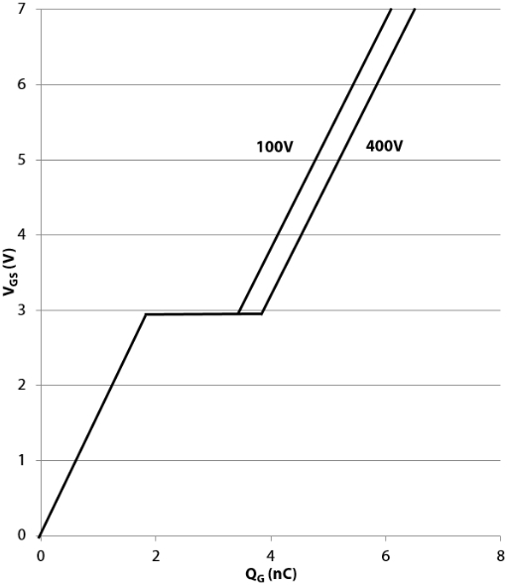
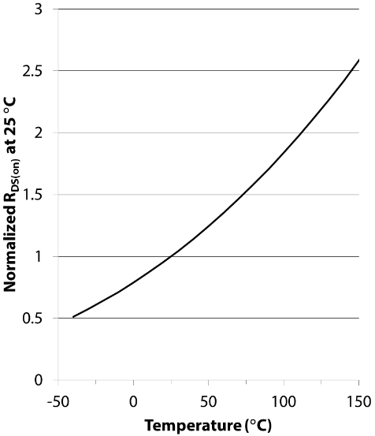
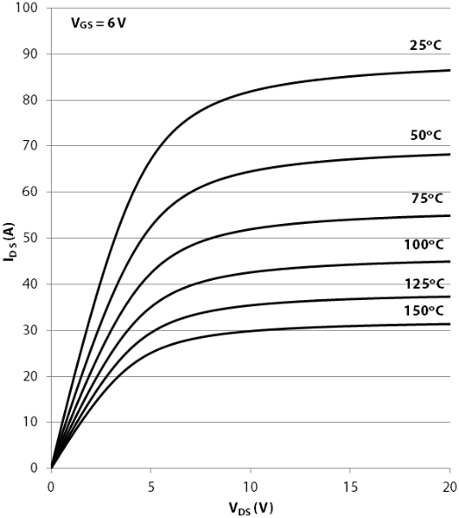
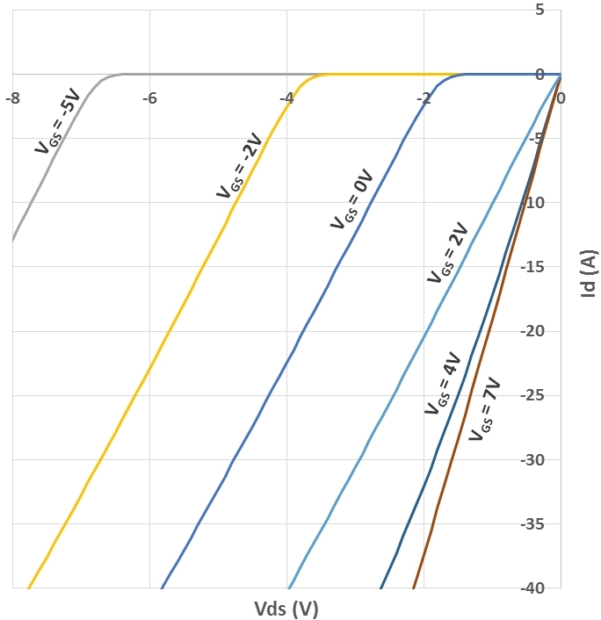
GaN Device Characteristics (GS66508P)
Low Q_{G}
“Miller” plateau
Low V_{TH} TC
High gain
Natural current limiting
Highest R_{ON} TC
Easy paralleling
“Dynamic” R_{ON}
Same R_{ON} in both direction
Negative OFF bias increases reverse voltage drop!
14/36

Slide 15
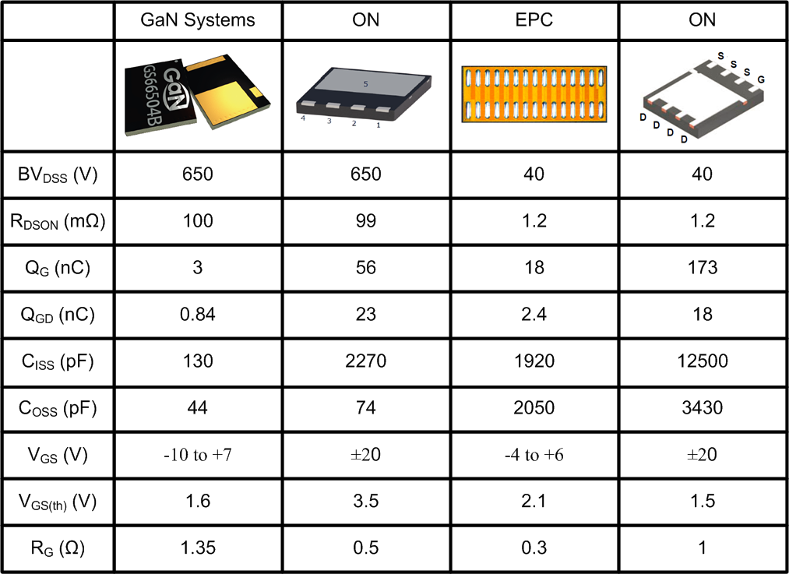
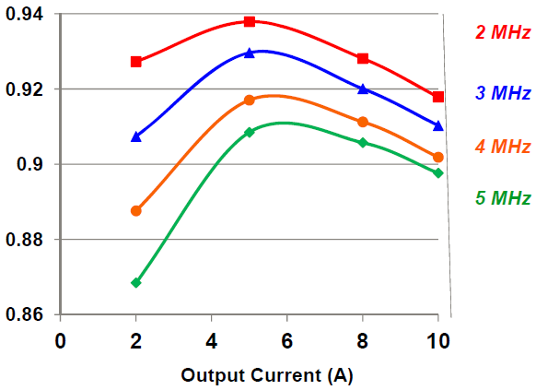
GaN vs. Si Comparison
Huge reduction in capacitances
Frequency is still a factor (hard sw.)
Sensitivity to over voltage
(very limited avalanche capability)
15/36

Slide 16
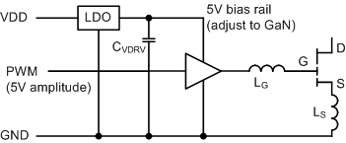
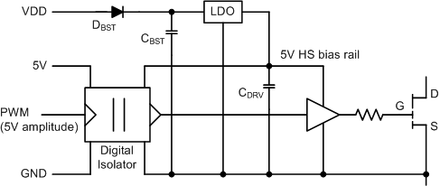
Gate Drive Requirements
In general:
PWM signal amplitude compliance
(typ. 5 V_{MAX})
Locally regulated driver bias power desired
Clamped bias rail to avoid over voltage
Minimize trace inductances
(wide, short, no via)
Adjust V_{DRV} and driver strength
to GaN device
Floating drive:
Bootstrap at VDD rather than V_{DRV}
or Use isolated supply with low C
Select signal isolator with appropriate CMTI rating (150+ V/ns)
16/36

Slide 17
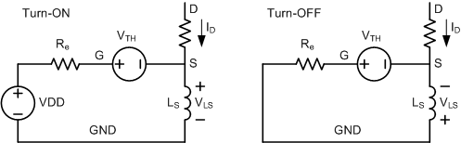
Source Inductance – Negative Feedback
Turn-on: hard switching and
soft switching are different
Turn-off: always 1st quadrant
operation
During current ramp interval:
  I_{G} ~ 0 A: dV_{DS}/dt ~ 0 V/µs
Maximum dI/dt is limited
Turn-off dI/dt is usually less
Larger L_{S} yields to more losses and signal integrity issues at the driver’s input
Larger L_{S} values can cause I_{DS} and V_{DS} oscillations during switching
17/36

Slide 18
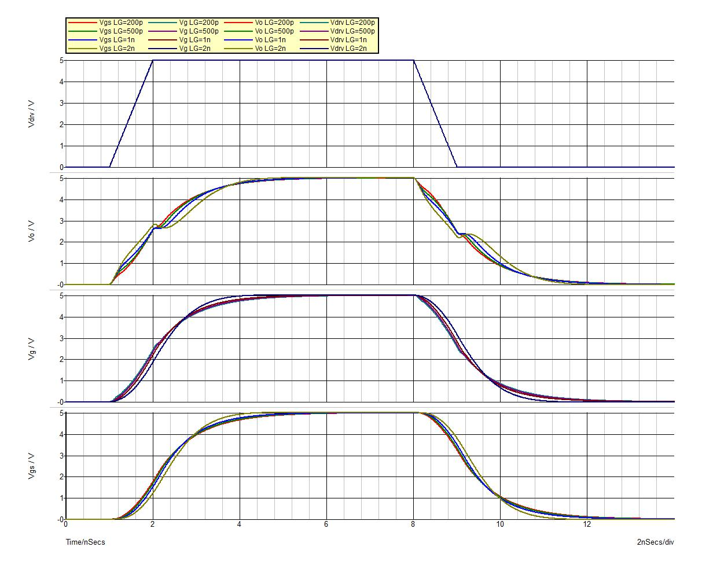
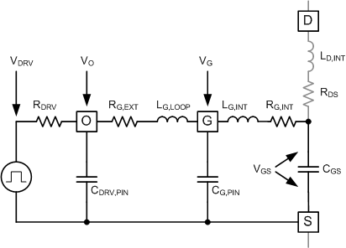
Gate Inductance Effect
HV GaN vs. L_{G,LOOP}:
  Small input capacitance (~130 pF)
  R_{G,EXT} = 0.1 Ω
  1 A driver’s R_{DRV} (~5 Ω) provides
  sufficient damping
18/36

Slide 19
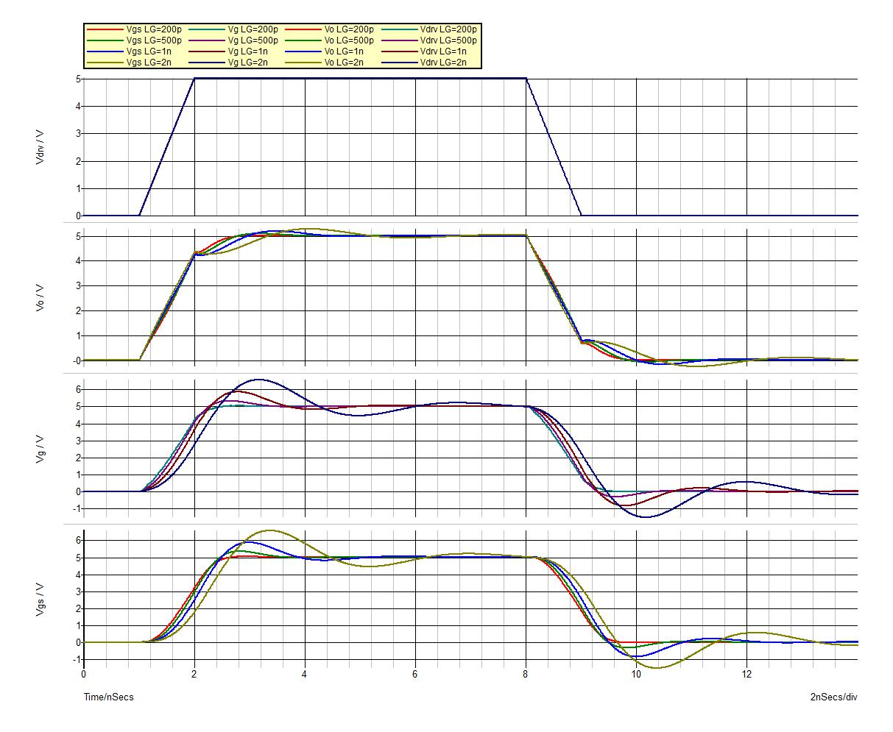
Gate Inductance Effect
HV GaN vs. L_{G,LOOP}:
  Small input capacitance (~130 pF)
  R_{G,EXT} = 0.1 Ω
  5 A driver’s R_{DRV} (~1 Ω) might not provide sufficient damping
  Make sure to select R_{G,EXT} appropriately
19/36

Slide 20
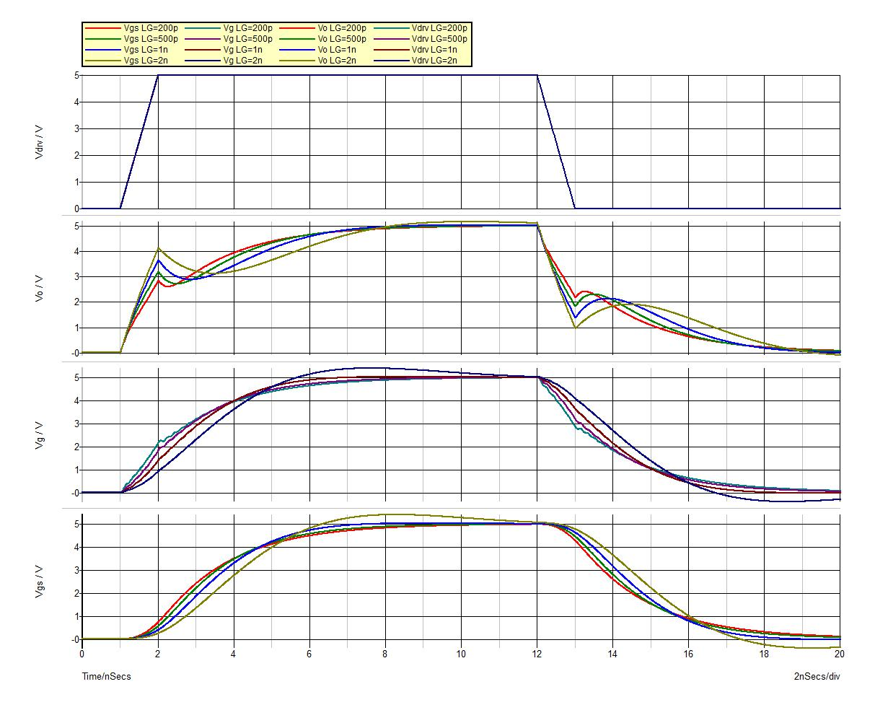
Gate Inductance Effect
LV GaN vs. L_{G,LOOP}:
  Larger input capacitance (~1.3 nF)
  R_{G,EXT} = 0.1 Ω
  Must use stronger driver to avoid delays
  5 A driver’s R_{DRV} (~1 Ω) provides
  sufficient damping even though external waveforms are not ideal
20/36

Slide 21
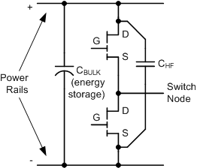
GaN & the Half-Bridge Structure
Half-Bridge is the most reliable, basic building
block using GaN power transistors
Effective in both, hard switching and soft switching
In hard switching, lack of reverse recovery makes
it very attractive (totem-pole PFC in CCM mode)
To provide adequate protection (clamping):
  Place a high frequency bypass as close as possible to the switches
  Minimize trace length in the switched current path
21/36

Slide 22
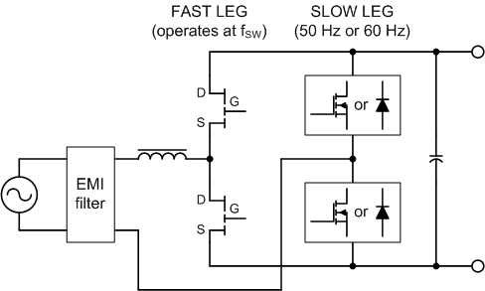
Totem-Pole Bridgeless PFC
Many topology variations
  Balanced input (two inductor)
  Interleaved (BCM)
In CCM GaN is preferred;
In BCM MOSFET can be used (soft switching) in the fast leg
Half-bridges are well clamped
Popular in high power applications
Frequency range up to MHz (watch for D_{MIN} & D_{MAX})
22/36

Slide 23
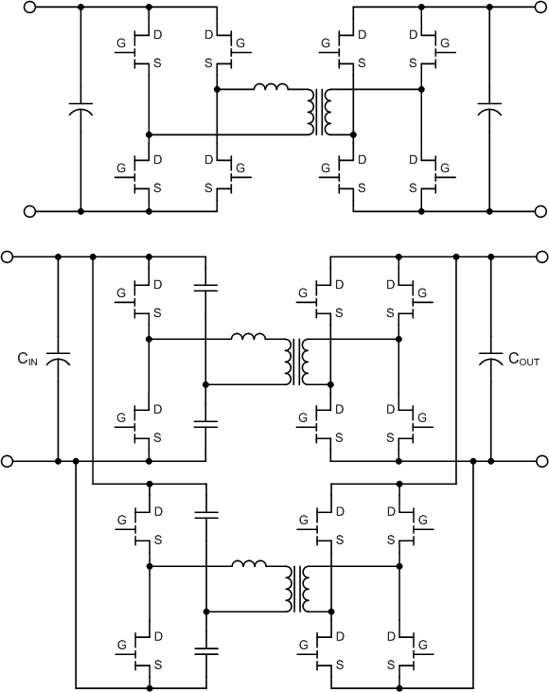
  Dual Active Bridge and Interleaved LLC
EV On-Board battery chargers:
Dual Active Bridge:
  Soft Switching above minimum load
  Very high efficiency
  Bi-directional power conversion possible
Interleaved LLC:
  Interleaving yields almost DC output current
  Need complex synchronization scheme and active current sharing due to component tolerances
  Unidirectional power flow
23/36

Slide 24
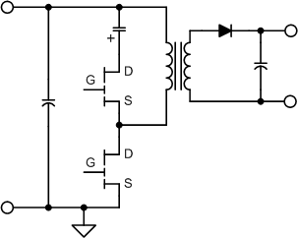
Active Clamp Flyback
Soft switching (ZVS) for both primary switches
  Might be difficult to maintain at light load
Fixed or variable frequency operation
V_{DS} voltage stress is limited to V_{IN}+V_{CLAMP}
Active Clamp Flyback switches are identical
Clamp capacitor voltage and transformer flux walking need to be managed actively (transients)
Efficient light load and burst mode operation requires complex control or mixed mode operation
Typical application: high power density adapters and chargers (P_{O} < 100 W)
24/36

Slide 25
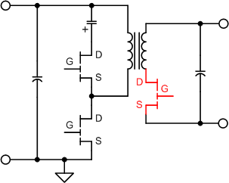
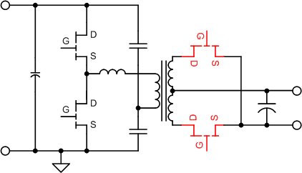
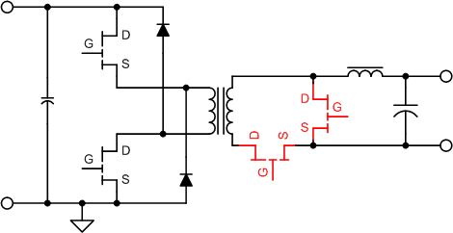
Synchronous Rectification
Synchronous rectifiers are not in a clamped environment!
Switching spikes are unpredictable under extreme conditions (start up, short circuit, etc.)
Impact on over shoot:
Topology and operating mode
Transformer construction / leakage inductance
Timing accuracy (GaN advantage?)
25/36

Slide 26
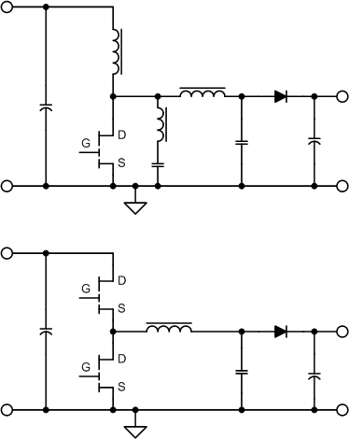
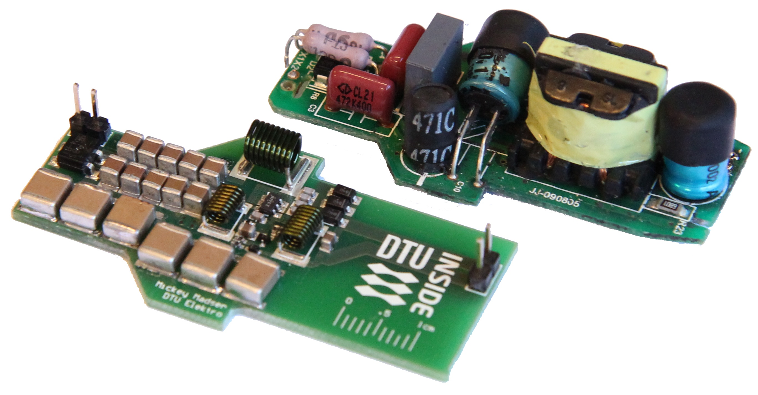
High Frequency, Resonant Power Conversion
Typical Applications:
Series & parallel resonant topologies:
  Phi2; Class E; Class DE
  Typical frequency range from 2MHz – 130MHz
All can be isolated or non-isolated
26/36

Slide 27
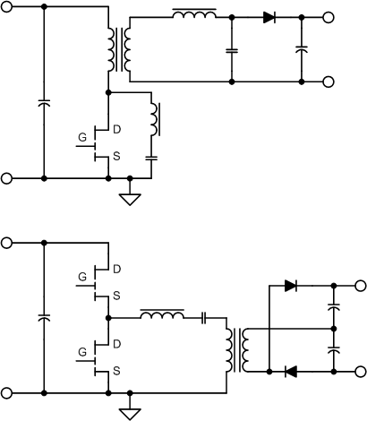
High Frequency, Resonant Power Conversion
Typical Applications:
Series & parallel resonant topologies:
  Phi2; Class E; Class DE
  Typical frequency range from 2MHz – 130MHz
All can be isolated or non-isolated
LLC → wide use across multiple applications
DC-DC power conversion
  LED drivers
  Wireless charging
  IoT
27/36

Slide 28
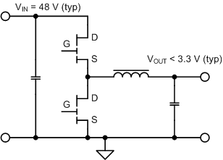
Synchronous Buck Converter
Typical Applications:
Low voltage, high frequency, large step down ratio → 48-to-1
High voltage, high frequency, large step down ratio → non-isolated bias supply
High voltage, high frequency PFC with medium output voltage → non-isolated LED drivers (can meet Class C requirements)
Typical frequency range from 300 kHz to several MHz
28/36

Slide 29
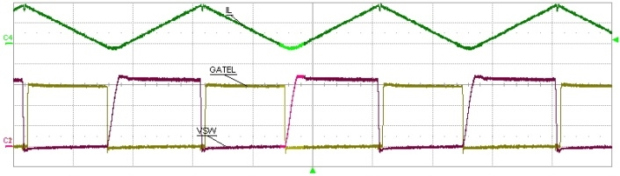
Layout Recommendations
Regulator and driver next to GaN transistors
HF bypass cap next to GaN transistors
Keep switch node small
Control signals are short, equal distance, shielded
Star connection between signal and power GND
Similar current path for all PWM states
SINGLE POINT GND
Example waveform:
f_{SW} = 1.5 MHz; V_{IN} = 165 V; V_{OUT} = 80 V; P_{OUT} = 100 W; η = 97% (full load)
29/36

Slide 30
Conclusion
Power density is emerging as the most important “measuring stick” due to:
  Encompasses all important performance attributes
  Implies meaningful economical values
We are witnessing an inflection point in power technology caused by the simultaneous impact of:
  Wide band gap semiconductors (WBG)
  New applications and Infrastructure changes
  (mobile computing; wireless power transfer; IoT; solid state, medium utility voltage level conversion; transportation electrification; etc.)
30/36

