Slide 1
Physically Based, Scalable SPICE Modeling Methodologies for Modern Power Electronic Devices
James Victory
Public Information © onsemi 2022

Slide 2
Outline
Introduction to Physical, Scalable SPICE Modeling for Modern Power Devices
SiC MOSFET Model
Trench IGBT Model
Conclusion

Slide 3
Introduction to Physical, Scalable SPICE Modeling for Modern Power Devices
Public Information © onsemi 2022

Slide 4
Power Device Modeling
Models developed for:
SuperFETs®
Trench IGBTs
Trench MOSFETs
HV (Si/SiC) Diodes
SiC MOSFET
GaN HEMT
Optimize performance within a mature
technology
Predict impact of new virtual technology changes
One model applies to the entire technology
platform
Link to TCAD
Physical, Scalable Models

Slide 5
Power SPICE Model Construction
Models are built as subcircuits.
Use SPICE primitives whenever possible for best speed and convergence.
Models are process and layout parameter dependent.
Use arbitrary behavioural sources to implement physical equations for currents, charges, capacitances, and intermediate voltage and temperature dependent variables.
Strong attention to numerical robustness
Electro-thermal
Package parasitics are included.
Ability to simulate operating conditions not covered in the datasheet with confidence.

Slide 6
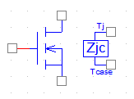
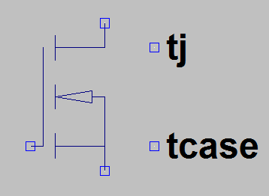
Multiple Simulator Support
SPICE Agnostic modeling is important
Only use least common denominator features, PSpice syntax
Verilog-A would be great, but not fully supported across the all simulators
The following simulators are supported:
PSpice (web)
LTspice (web)
Simetrix (web)
HSpice (on request)
Spectre (on request)
Eldo (on request)
SABER (on request)
Simplorer (on request)
Microcap (on request)
ADS (on request)

Slide 7
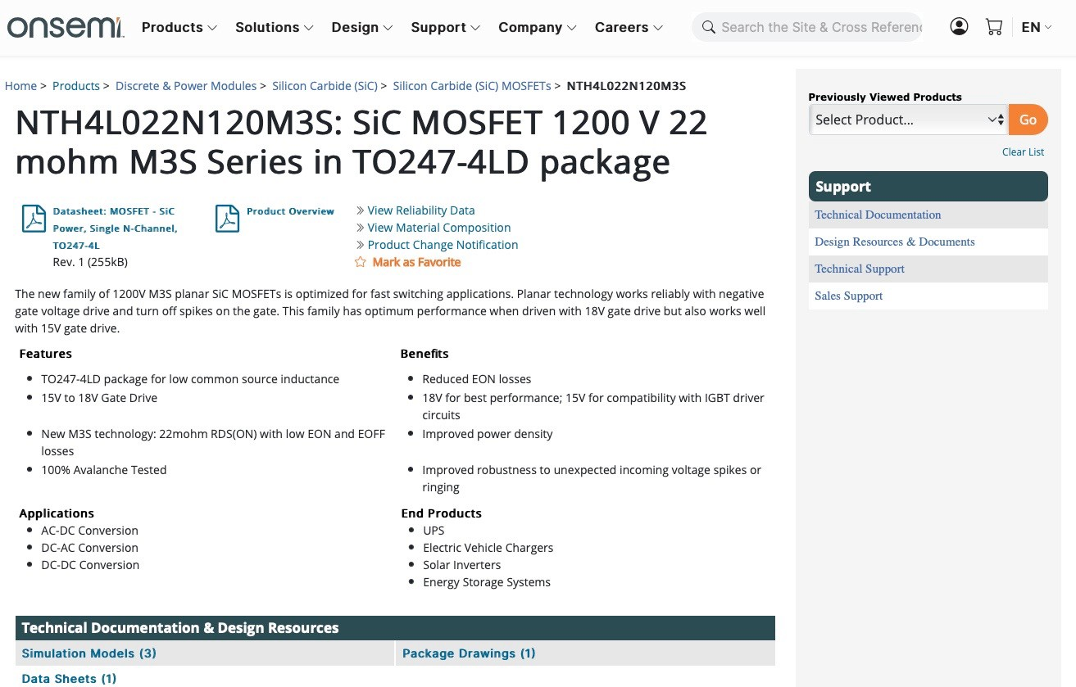
Website Model Download

Slide 8
Website Model Download
Ask your local Sales Representatives.
They will ask internally to have the model done and available.
0

Slide 9
SiC MOSFET Model
Public Information © onsemi 2022

Slide 10
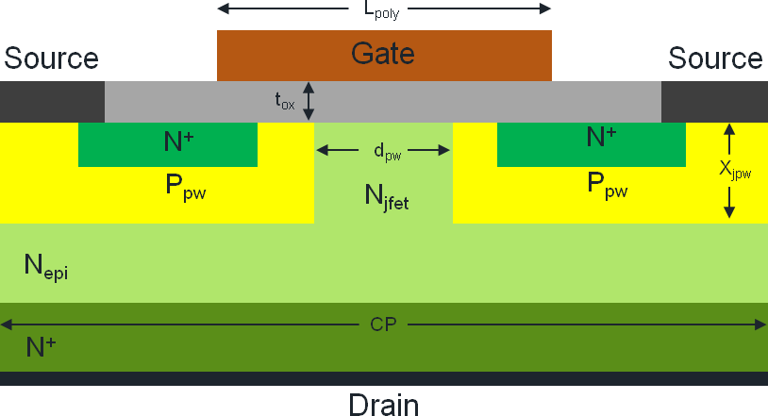
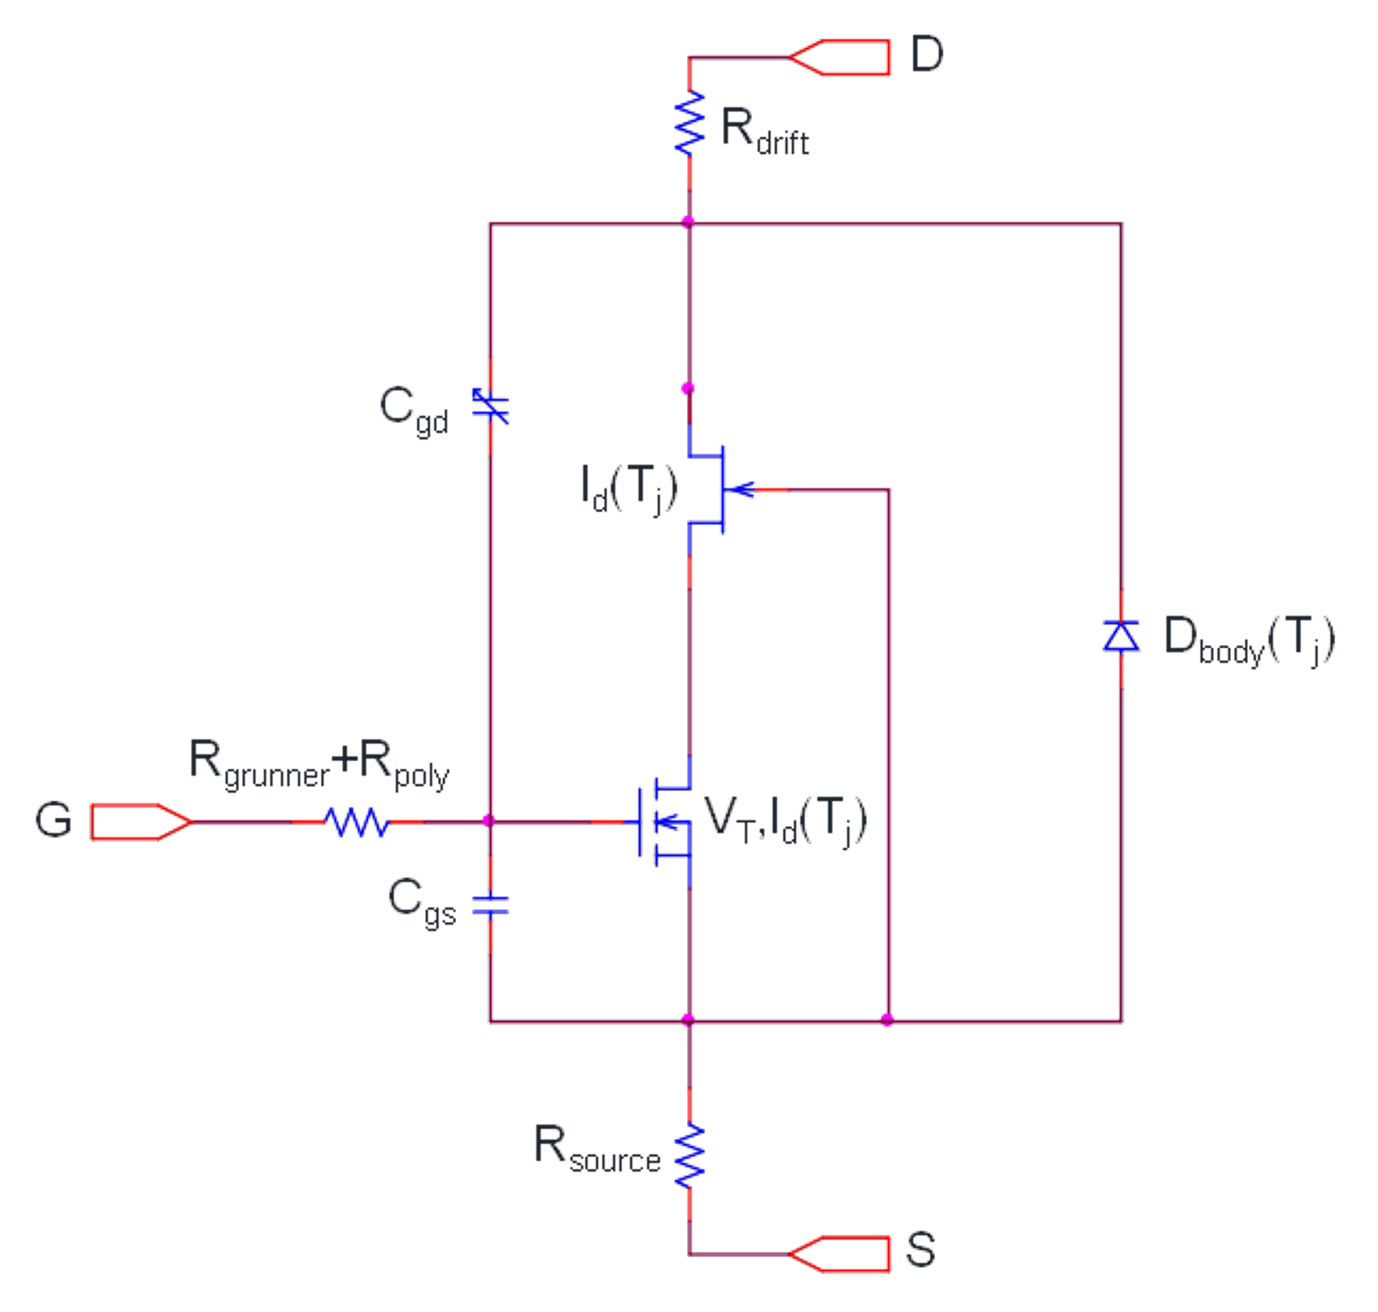
SiC MOSFET Model
BSIM3v3 :
Physically based, accurately captures the transitions through subthreshold, weak and strong inversions.
Widely available, excellent speed and convergence properties.
Published APEC 2017

Slide 11
SiC MOSFET Model
JFET :
Captures the linear and non-linear behavior of the drift region with modified equation for beta and vto.
Widely available, excellent speed and convergence properties.
Published APEC 2017

Slide 12
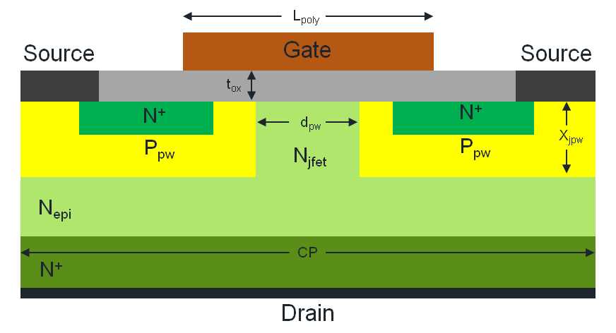
Physical Derivation of JFET Parameters
Conventional JFET Equation
Equate Depletion Spread to the half width between Pwells
Published APEC 2017

Slide 13
SiC MOSFET Model
Resistance of drift region:
Parameterized according to the epi and N⁺ doping, and cross sectional area.
Published APEC 2017

Slide 14
SiC MOSFET Model
Source Resistance:
Spreading resistance calculated from chip dimension and bond locations, and metal properties.
Includes package resistance
Typical values in the 100s of uΩ to 1-2 mΩ.
Published APEC 2017

Slide 15
SiC MOSFET Model
Behavioral MOS Capacitor CGD:
Oxide capacitor in series with depletion capacitor.
The depletion width of the depletion capacitor is a function of doping and JFET pinch off conditions.
Published APEC 2017

Slide 16
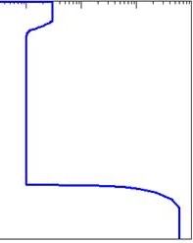
Physical Derivation of CGD (CRSS)
Cox Cdep
Doping
Wdep1
Wdep2
Wdep3
Wdep4
Wdep3 represents the drop of the bottom plate of the depletion region once the JFET region pinches off.
Wdep4 is post-pinchoff depletion controlled by Nepi and limited by the thickness of the Epi.
Published APEC 2017

Slide 17
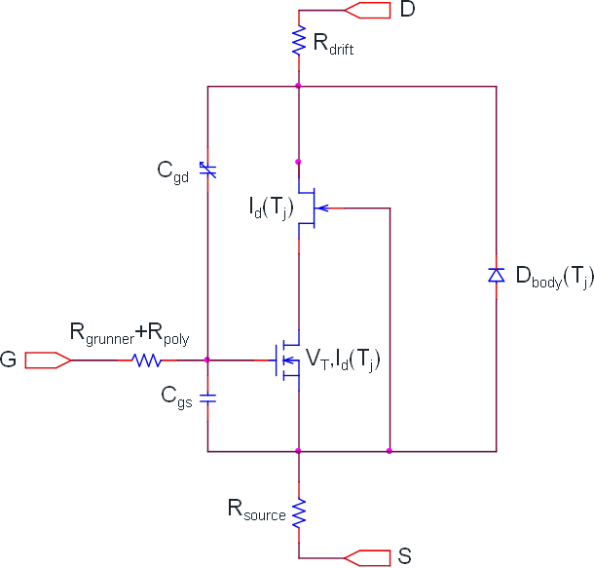
SiC MOSFET Model
Gate-to-Source parasitic Capacitance :
Gate poly overlap N⁺ source, source metal overlap gate poly, etc.
Parameterized to layout configuration and device process.
Published APEC 2017

Slide 18
SiC MOSFET Model
Gate Resistance :
Resistance from gate poly and metal buses.
Parameterized to layout configuration and device process.
Published APEC 2017

Slide 19
SiC MOSFET Model
Body Diode :
A physical diode model with reverse recovery effects proposed by P.O. Lauritzen, etc [10] has been extended to include layout scaling.
Published APEC 2017

Slide 20
SiC MOSFET Model
Thermal Effects:
Scalable Cauer network is implemented, including ambient and self-heating for the channel, drift region, and body diode.
Package parasitics
Included in the model for discrete packaged components.
Published APEC 2017

Slide 21
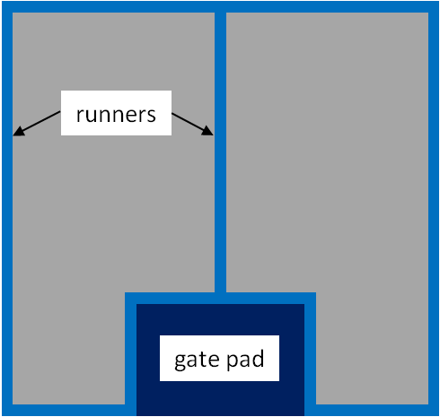
Sample Model Chip Floor Plan Parameters
Parameter | Description
^{W}chip | Chip Width
^{H}chip | Chip Height
^{N}grunner | Number of Gate Runners
^{W}gatepad | Gate Pad Width
^{H}gatepad | Gate Pad Height
GatePadLoc | Gate Pad Location
Wchip
Hchip
All parasitic capacitance, linear and nonlinear, from the non- active blue areas are accounted for:
Edge Termination area, Gate Pad,
Gate Runners
“W” MOSFET
“M” MOSFET

Slide 22
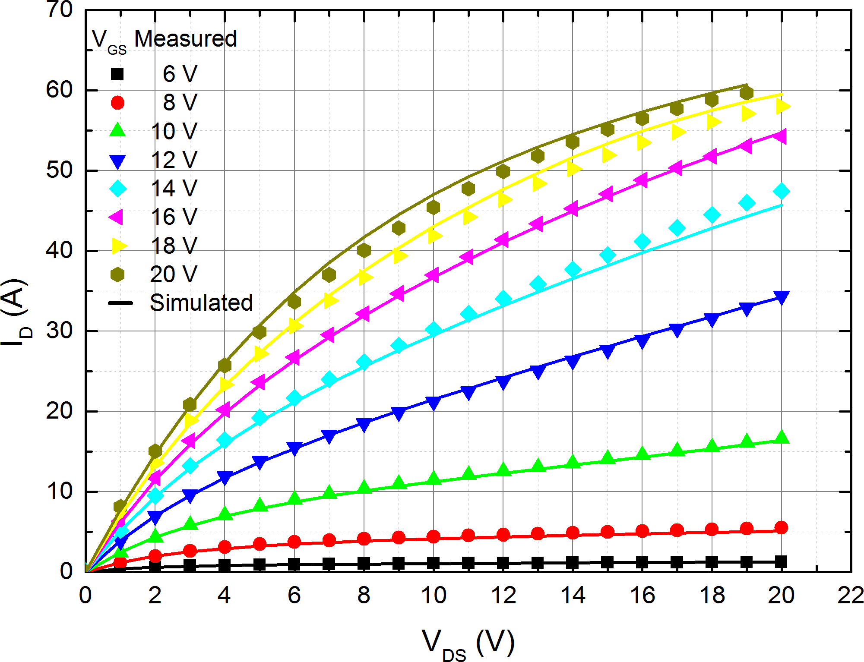
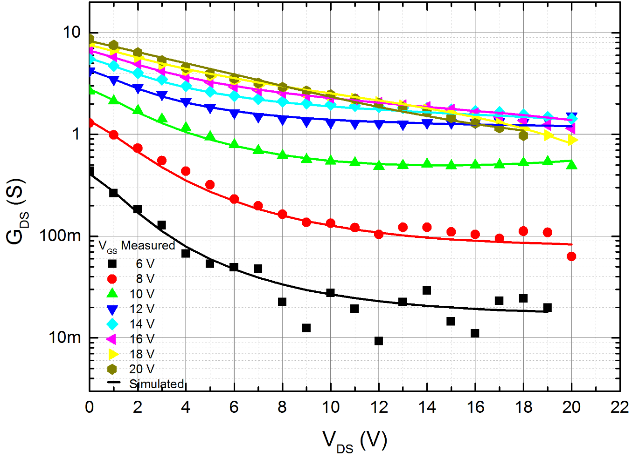
Model Verification – Output Characteristics
IDVD @ T=25 °C
GDS @ T=25 °C

Slide 23
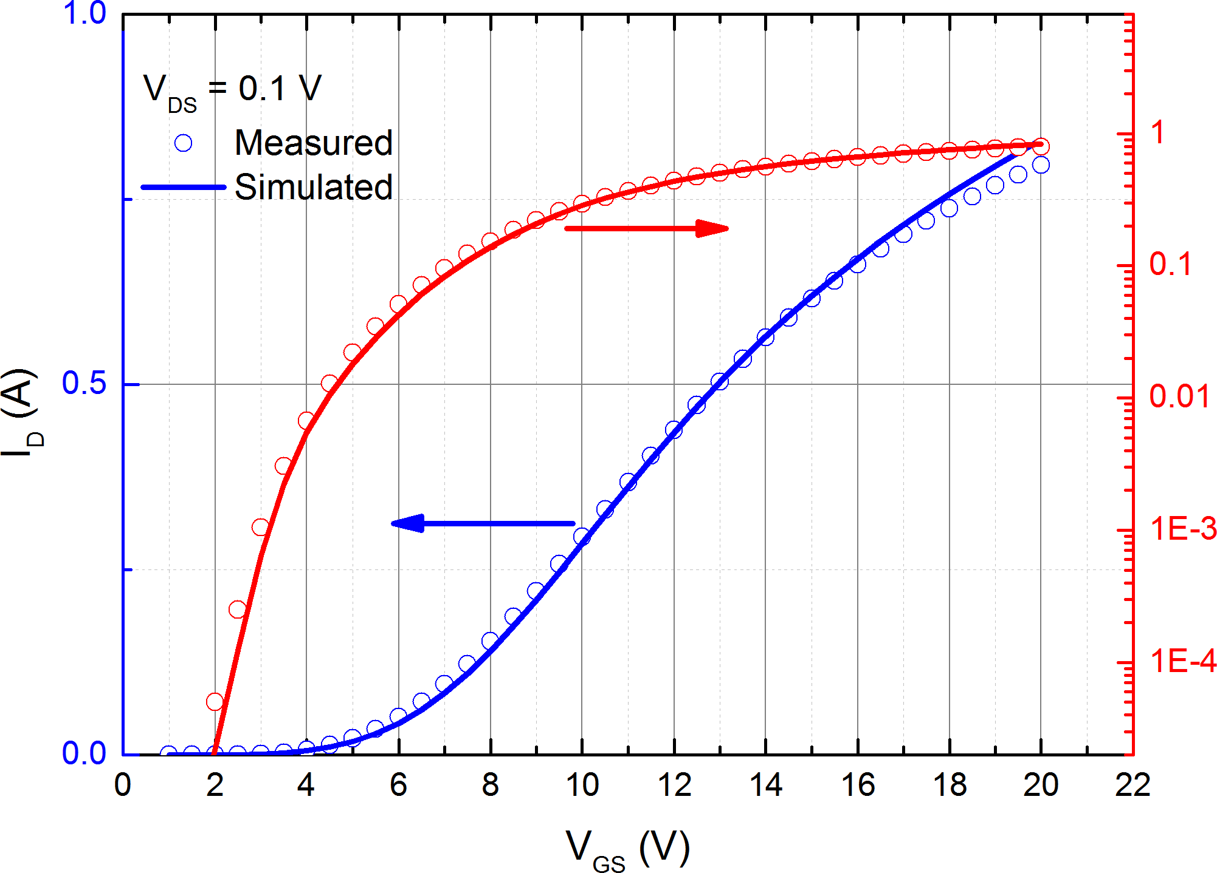
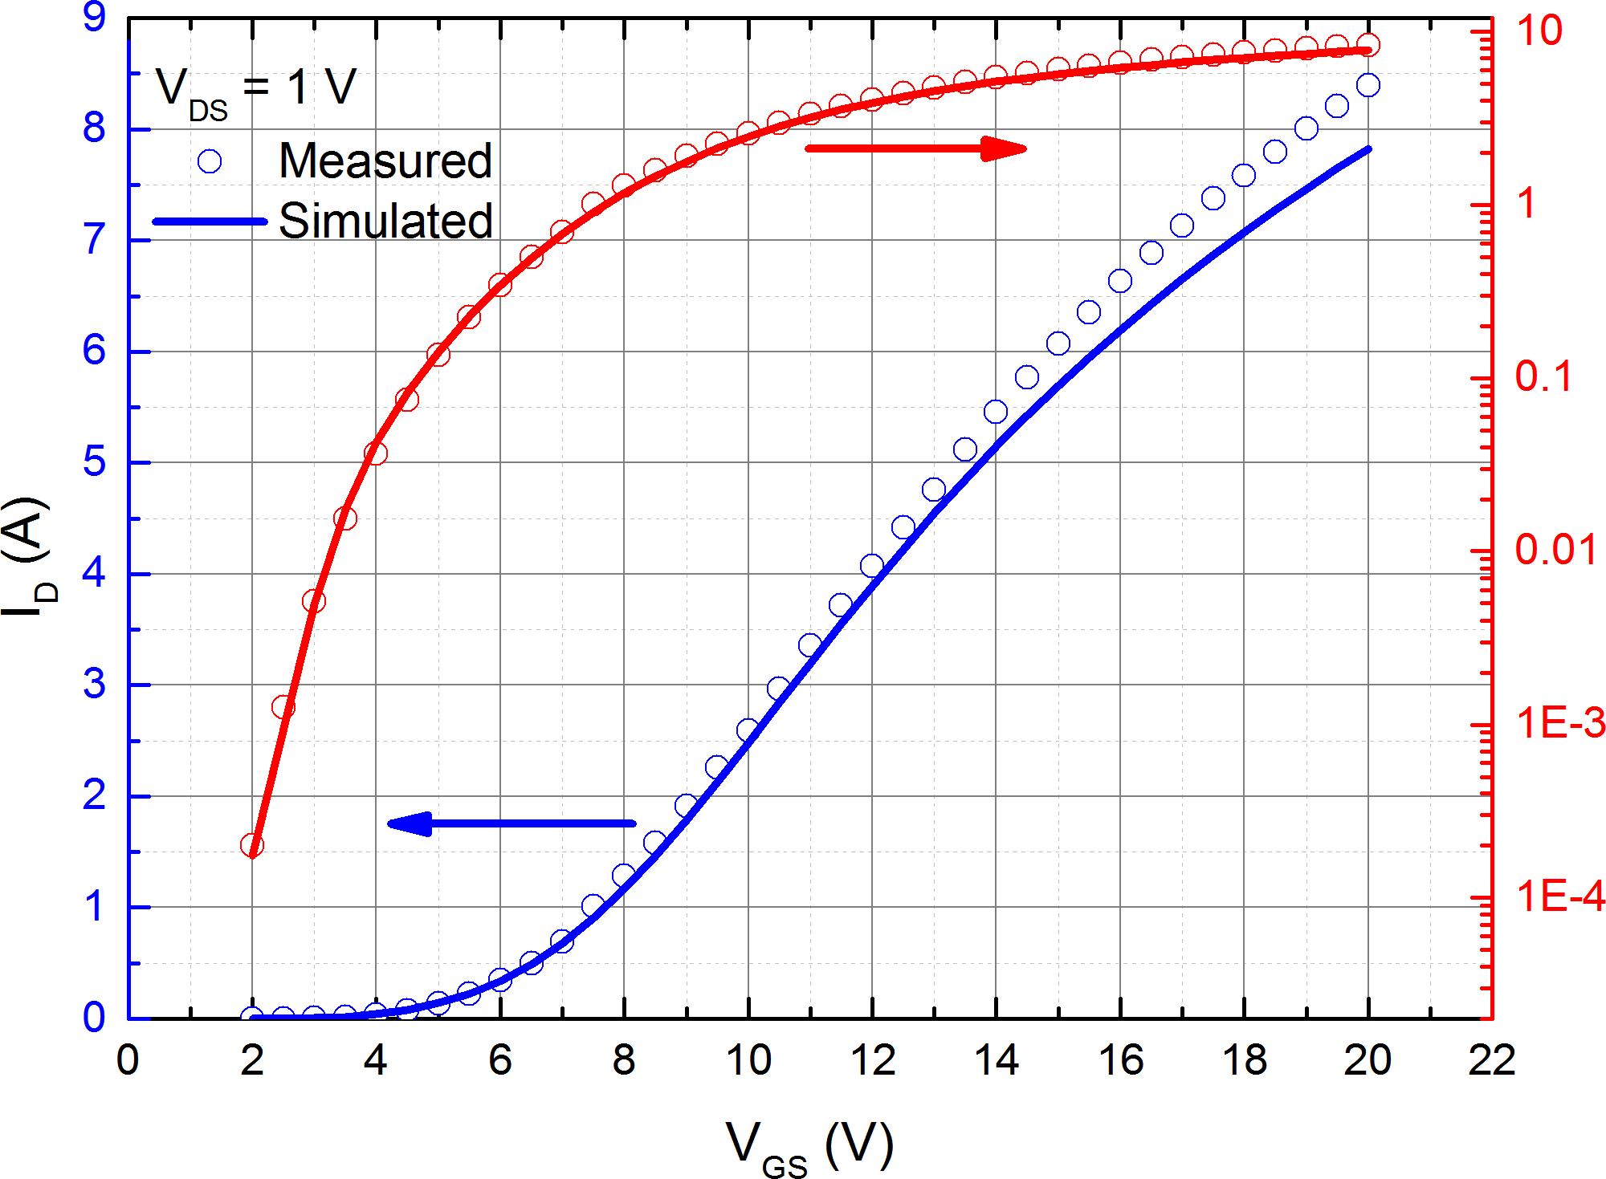
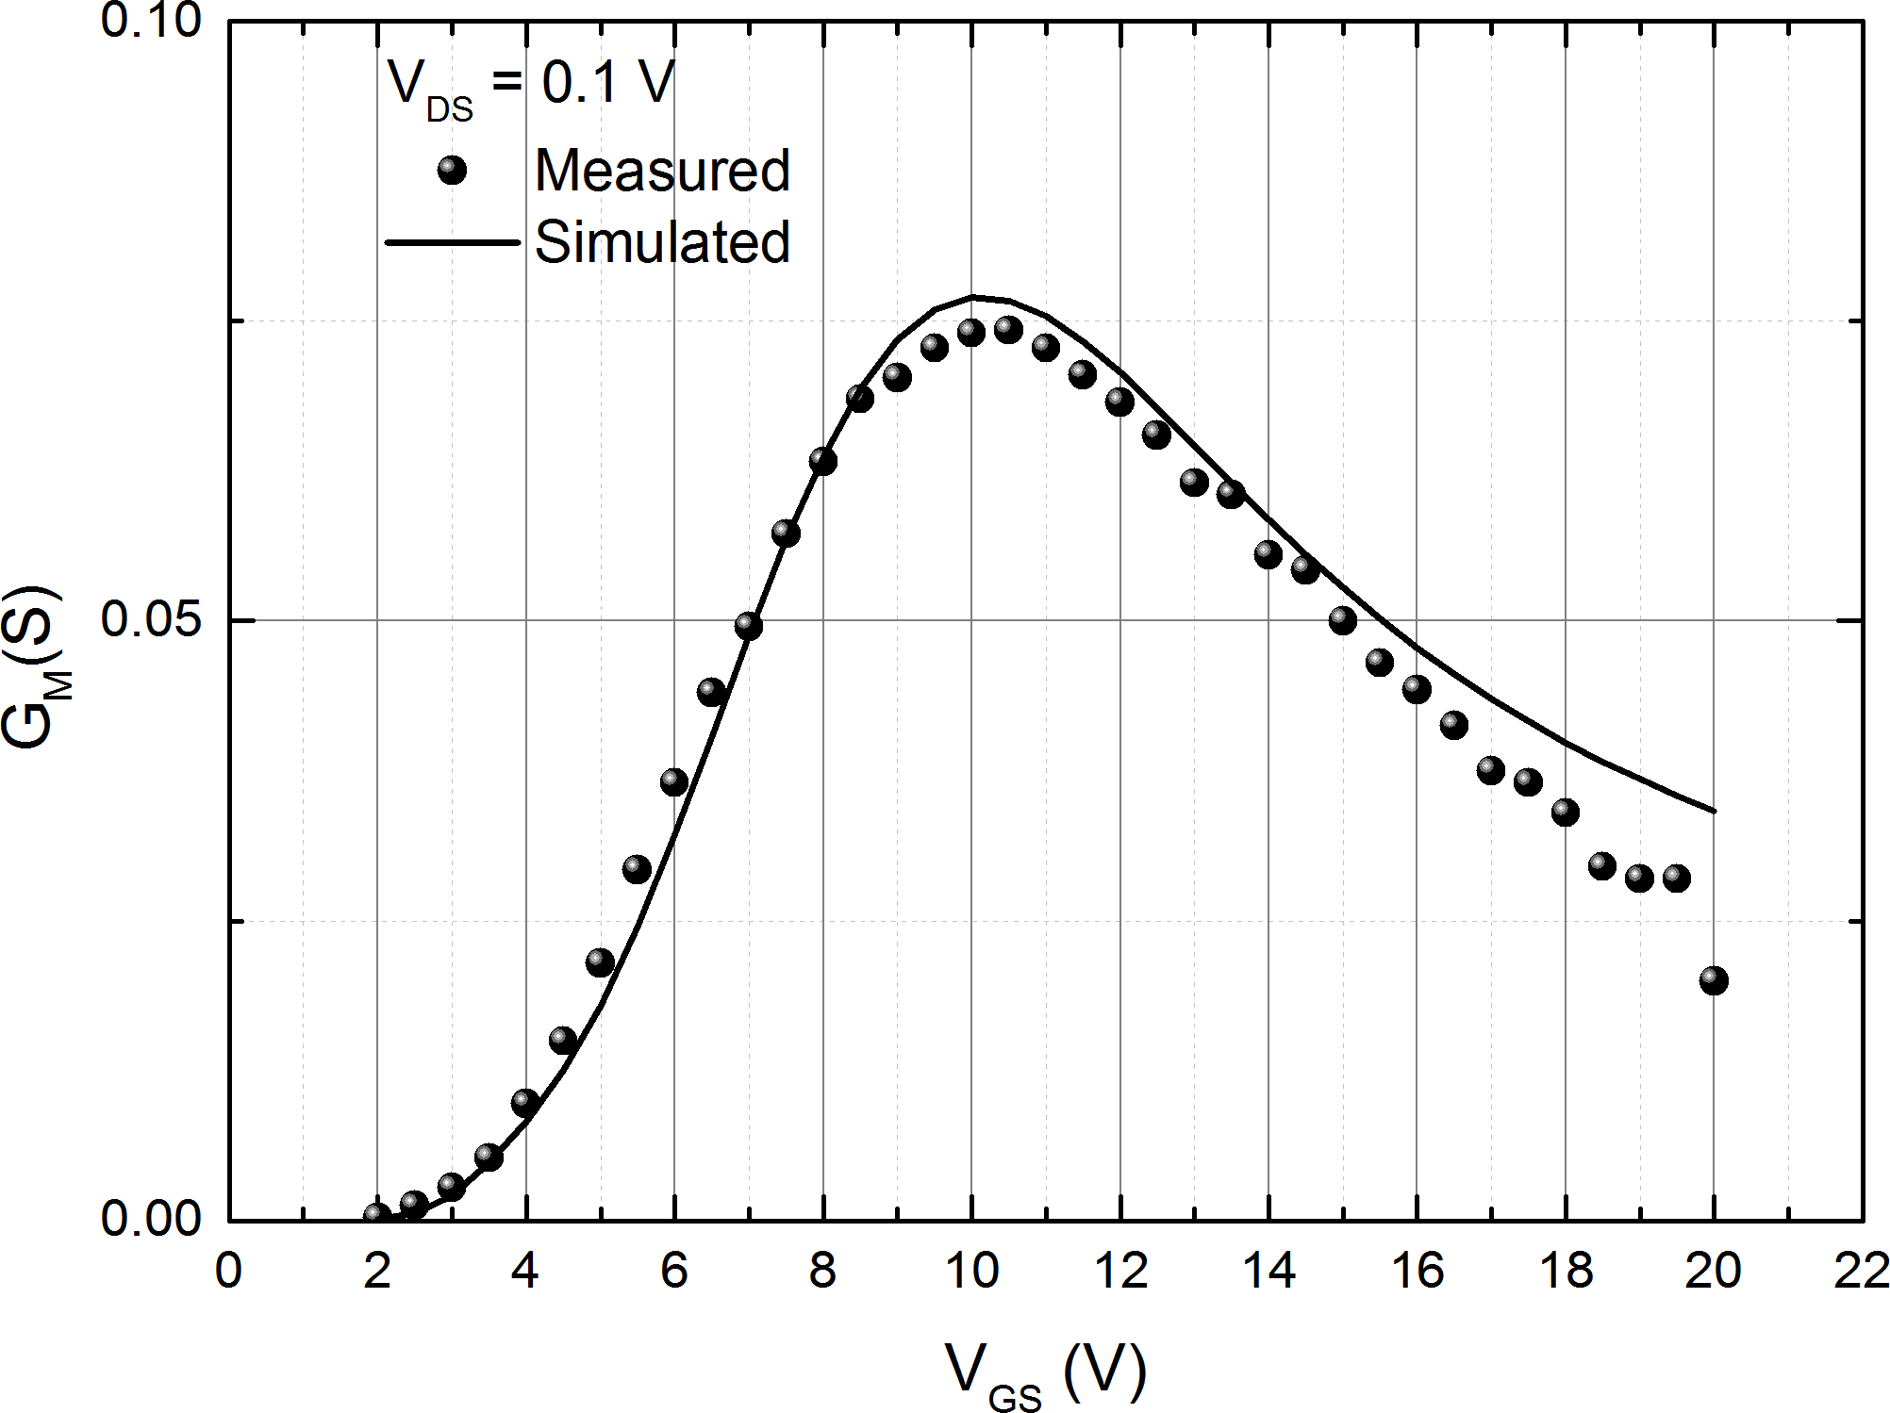
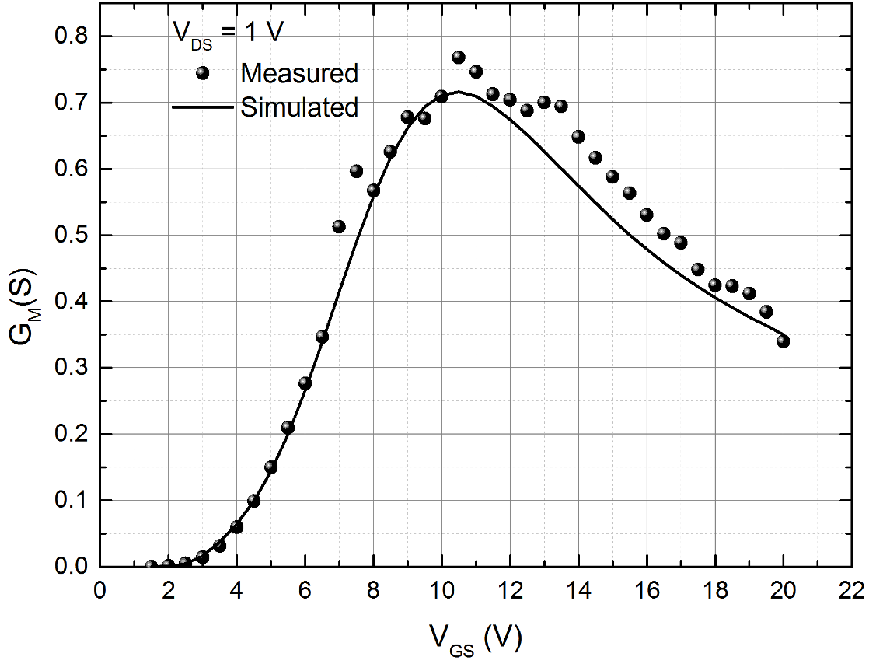
Model Verification – Transfer Characteristics
IDVG @ T=25 °C
GM @ T=25 °C

Slide 24
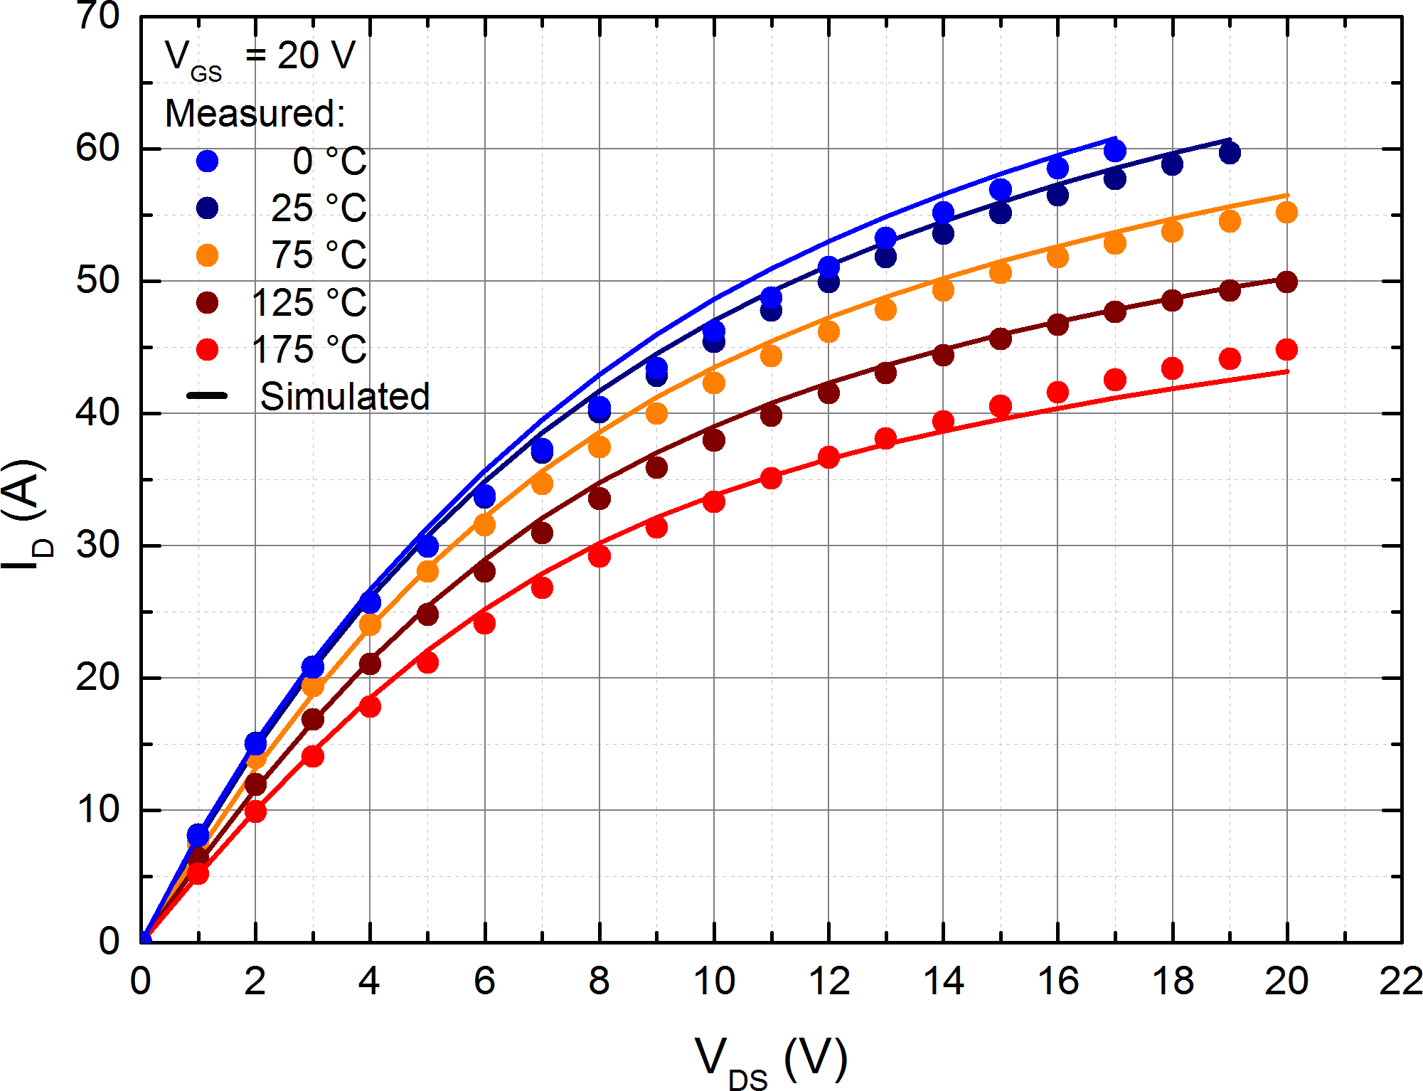
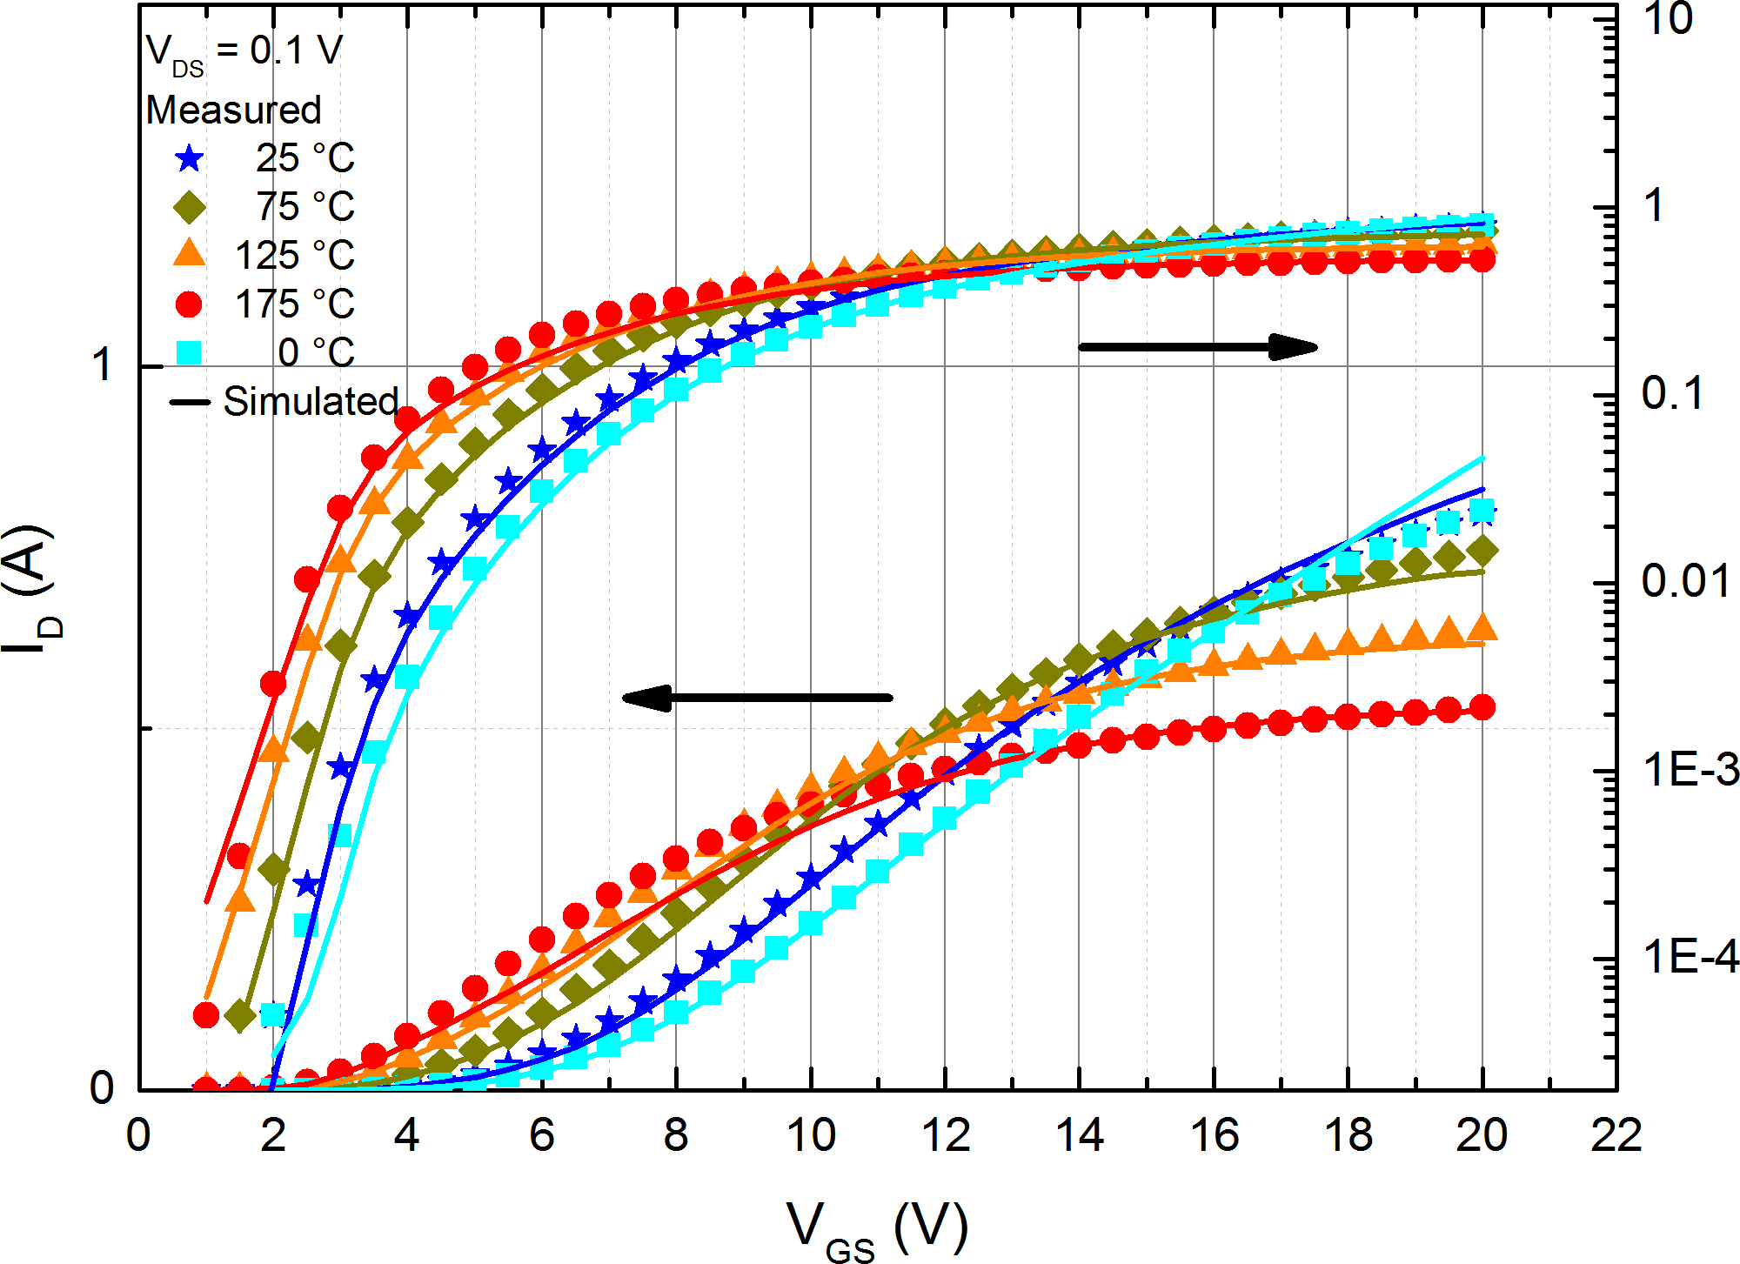
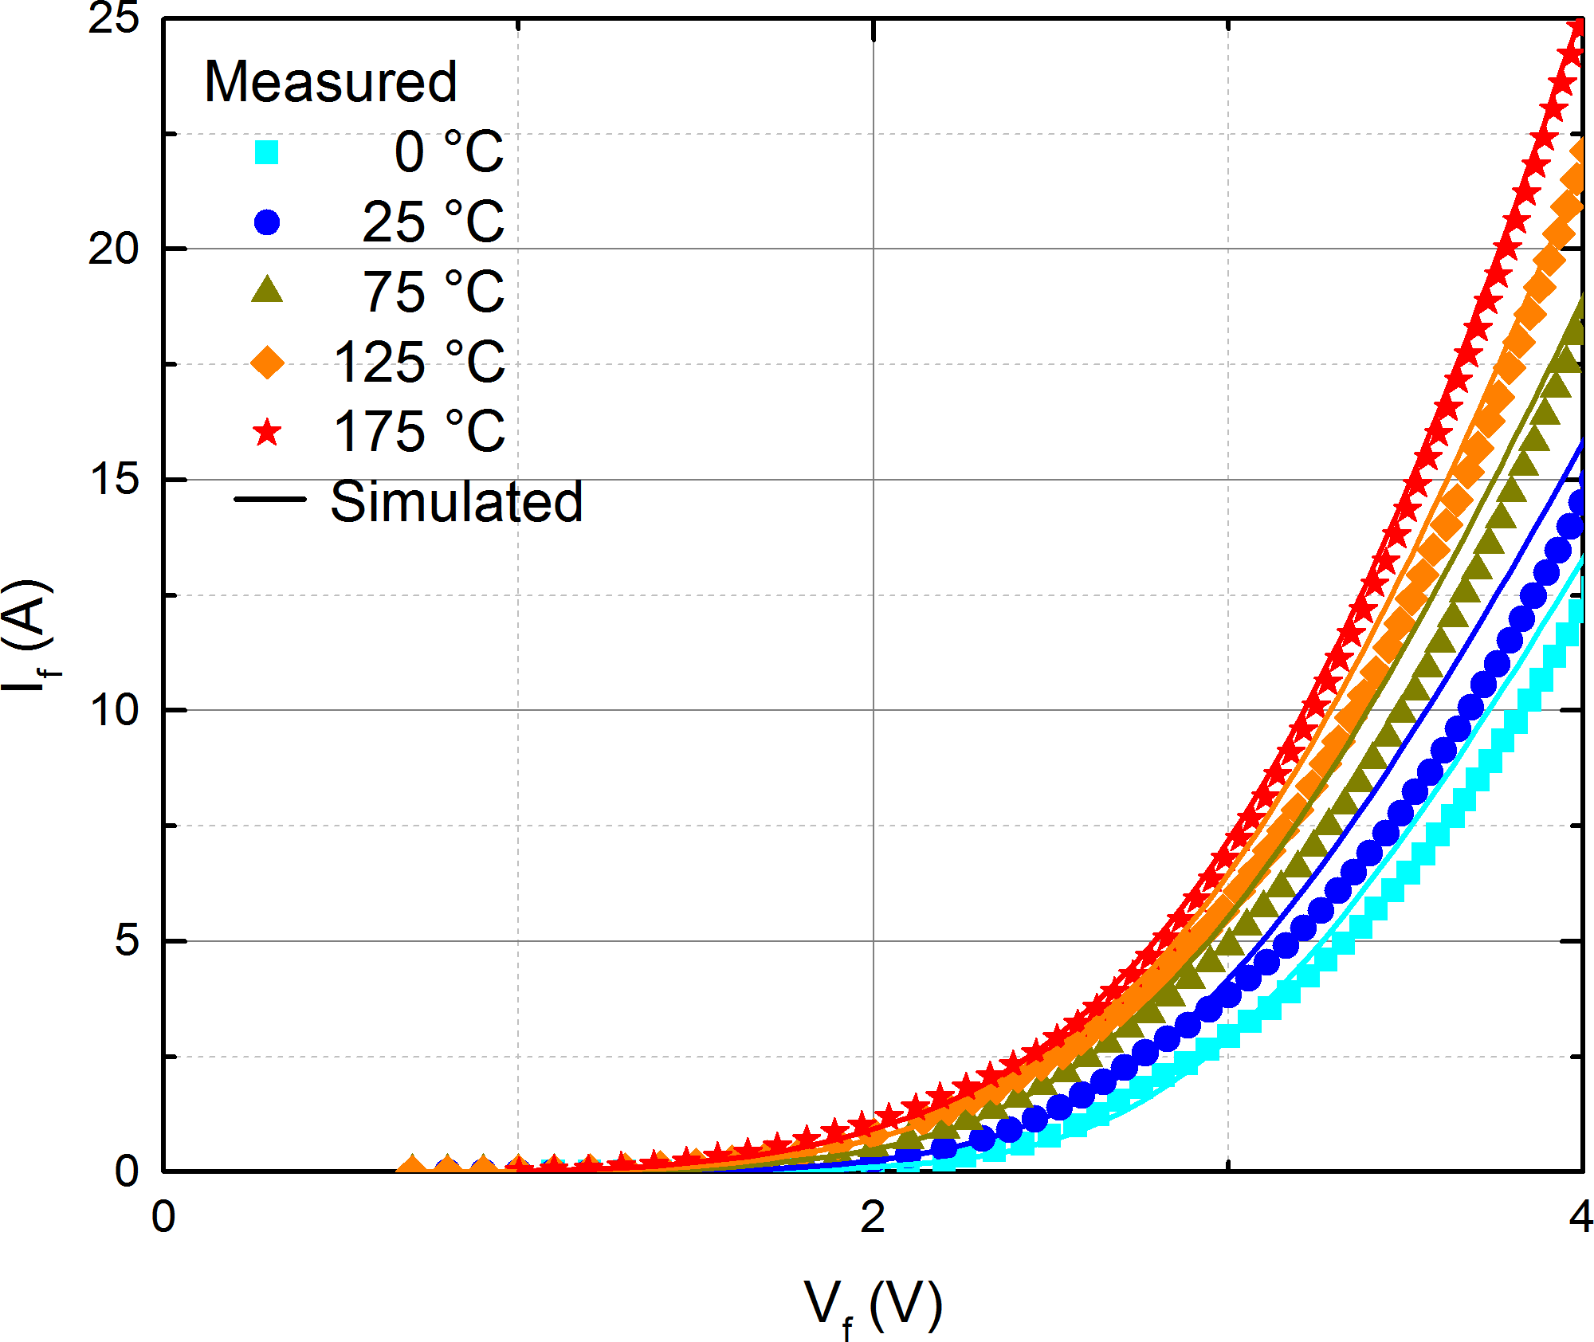
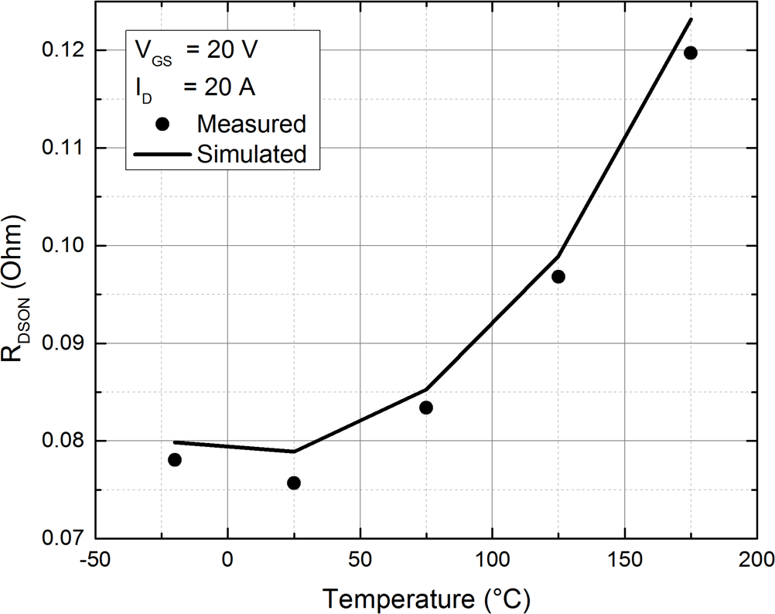
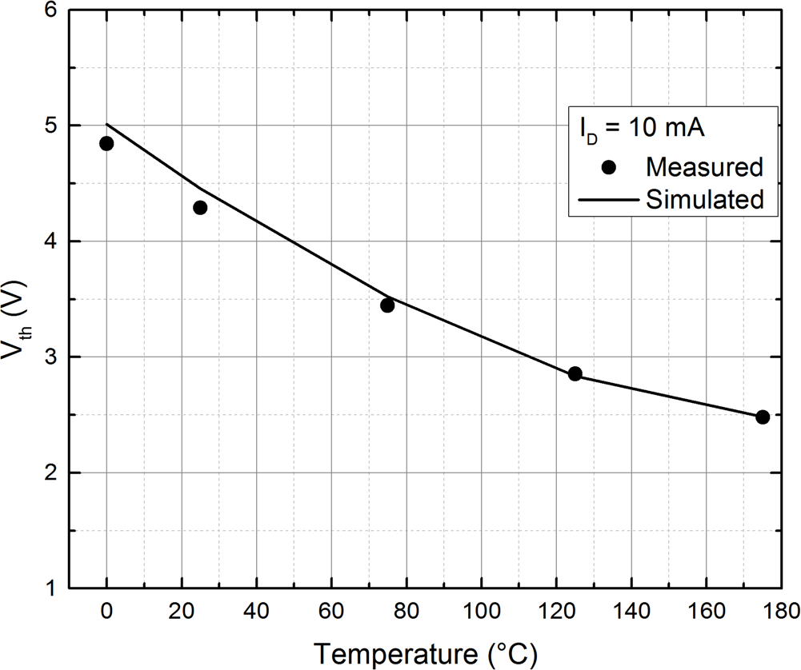
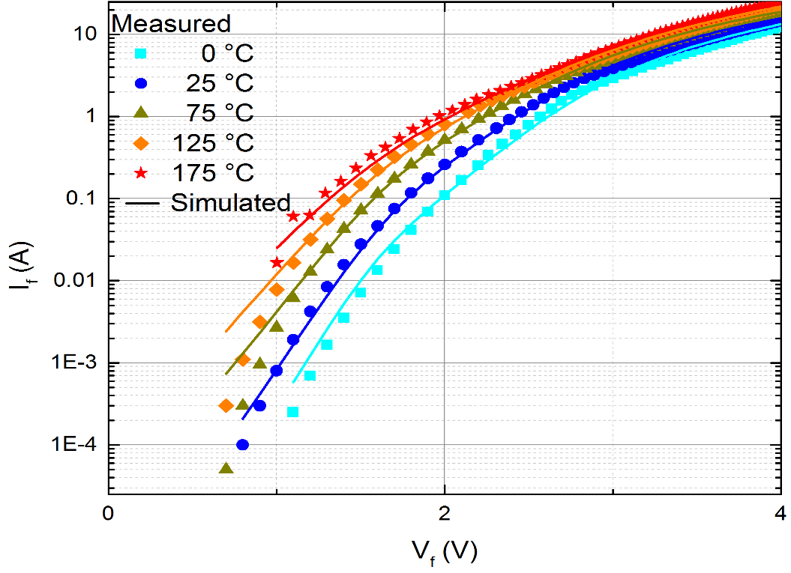
Model Verification – Temperature Behaviour
Body Diode
IDVD
IDVG
^{R}DSON
^{V}TH
Body Diode

Slide 25
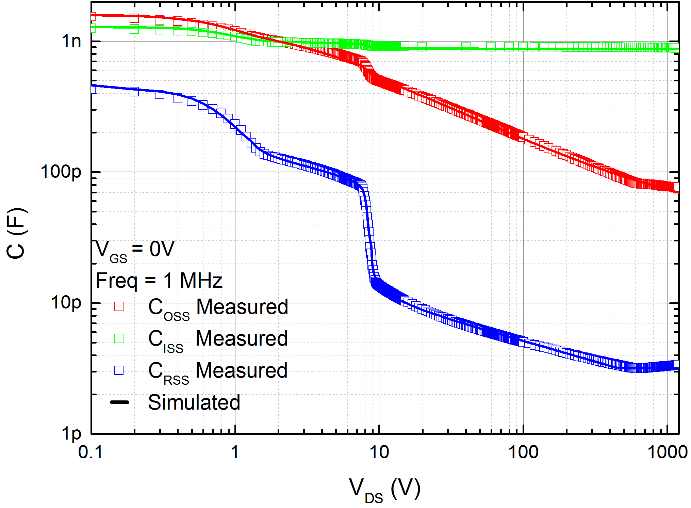
Model Verification – Capacitance

Slide 26
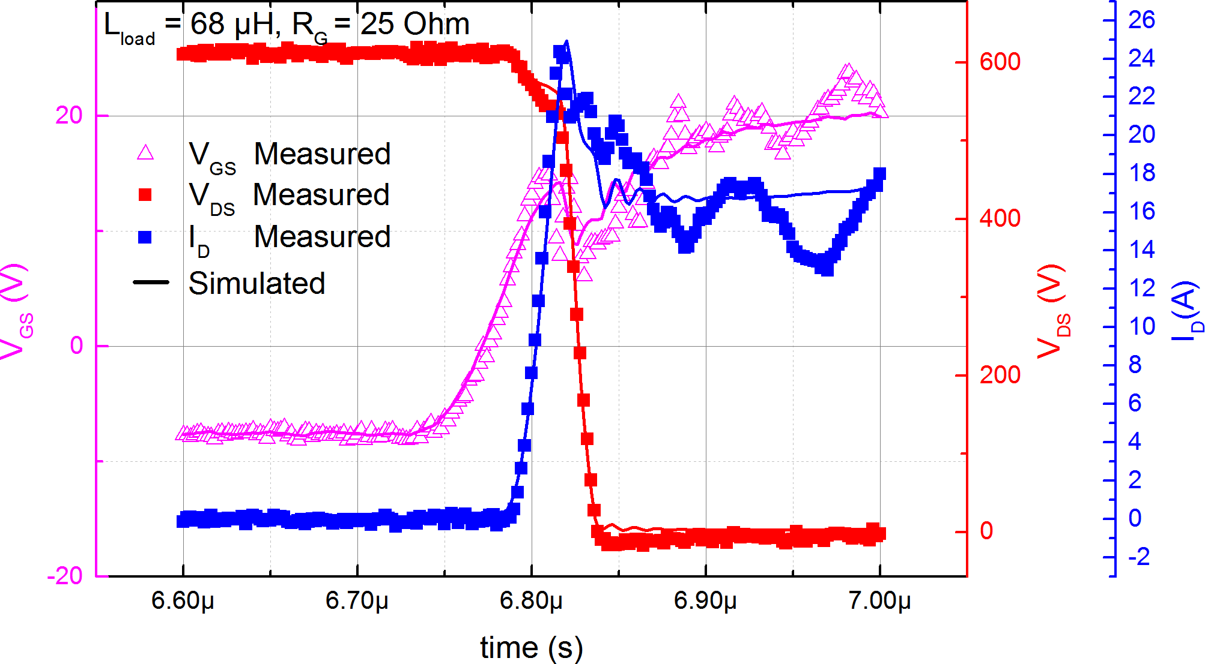
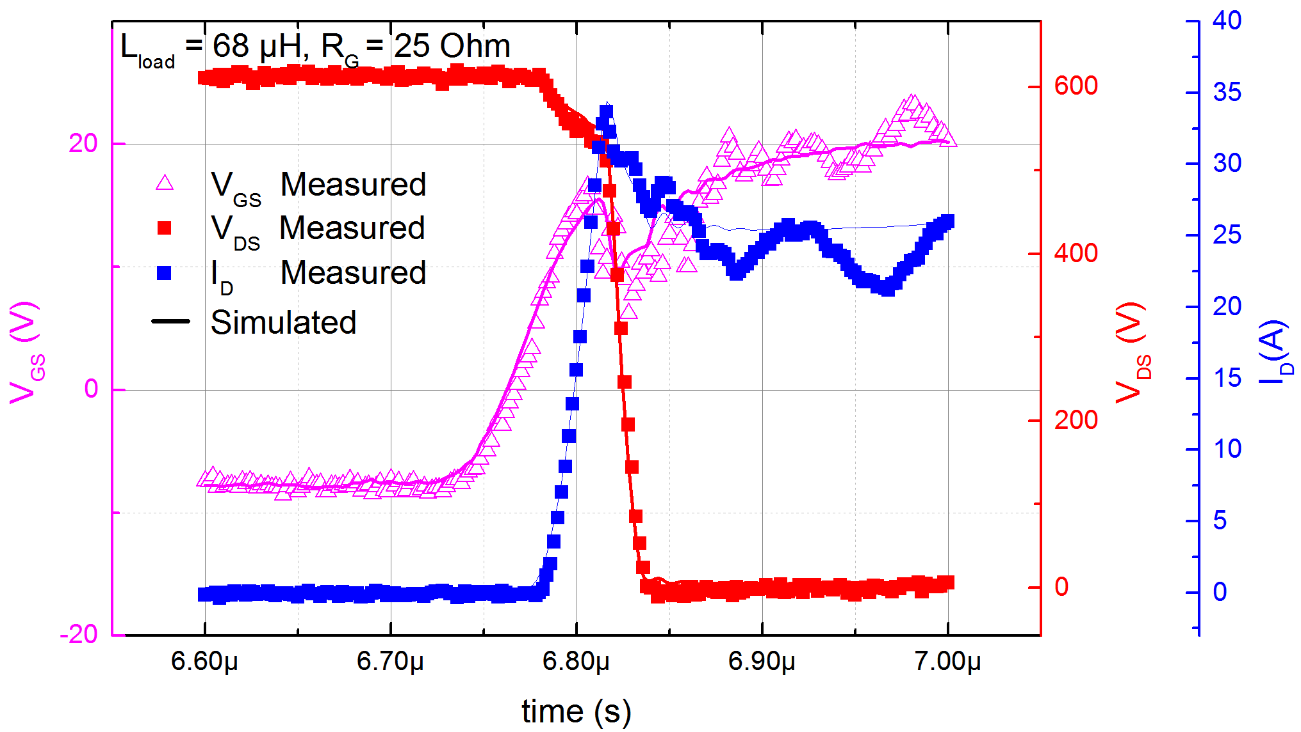
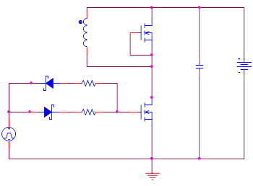
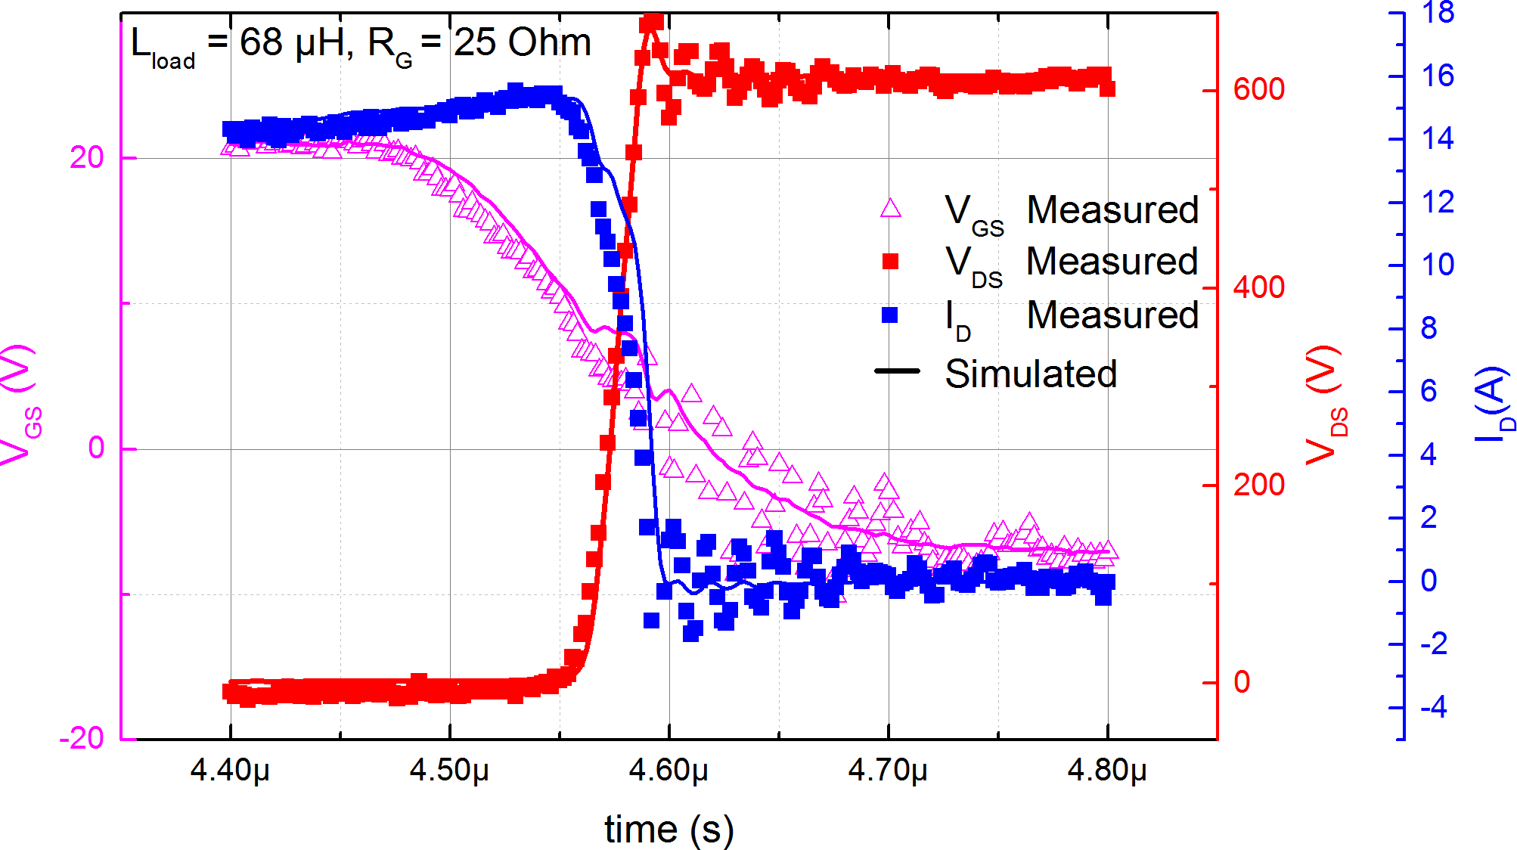
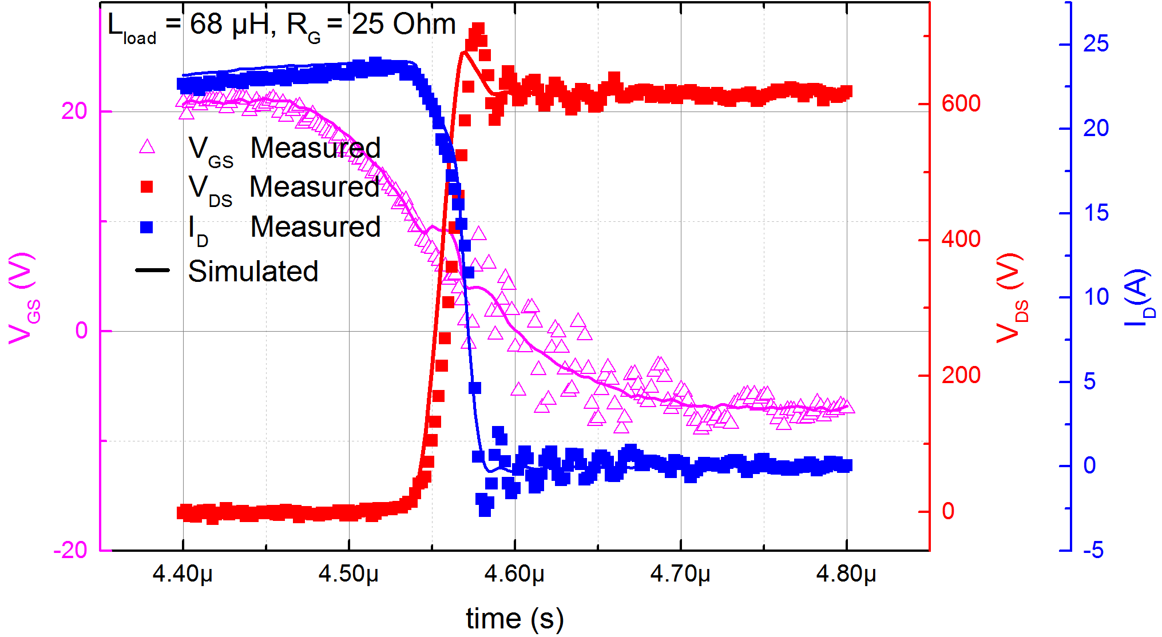
Model Verification – Double Pulse
Simplified Double Pulse Switching Circuit
ON
ON
ID=15 A
ID=24 A
OFF
OFF

Slide 27
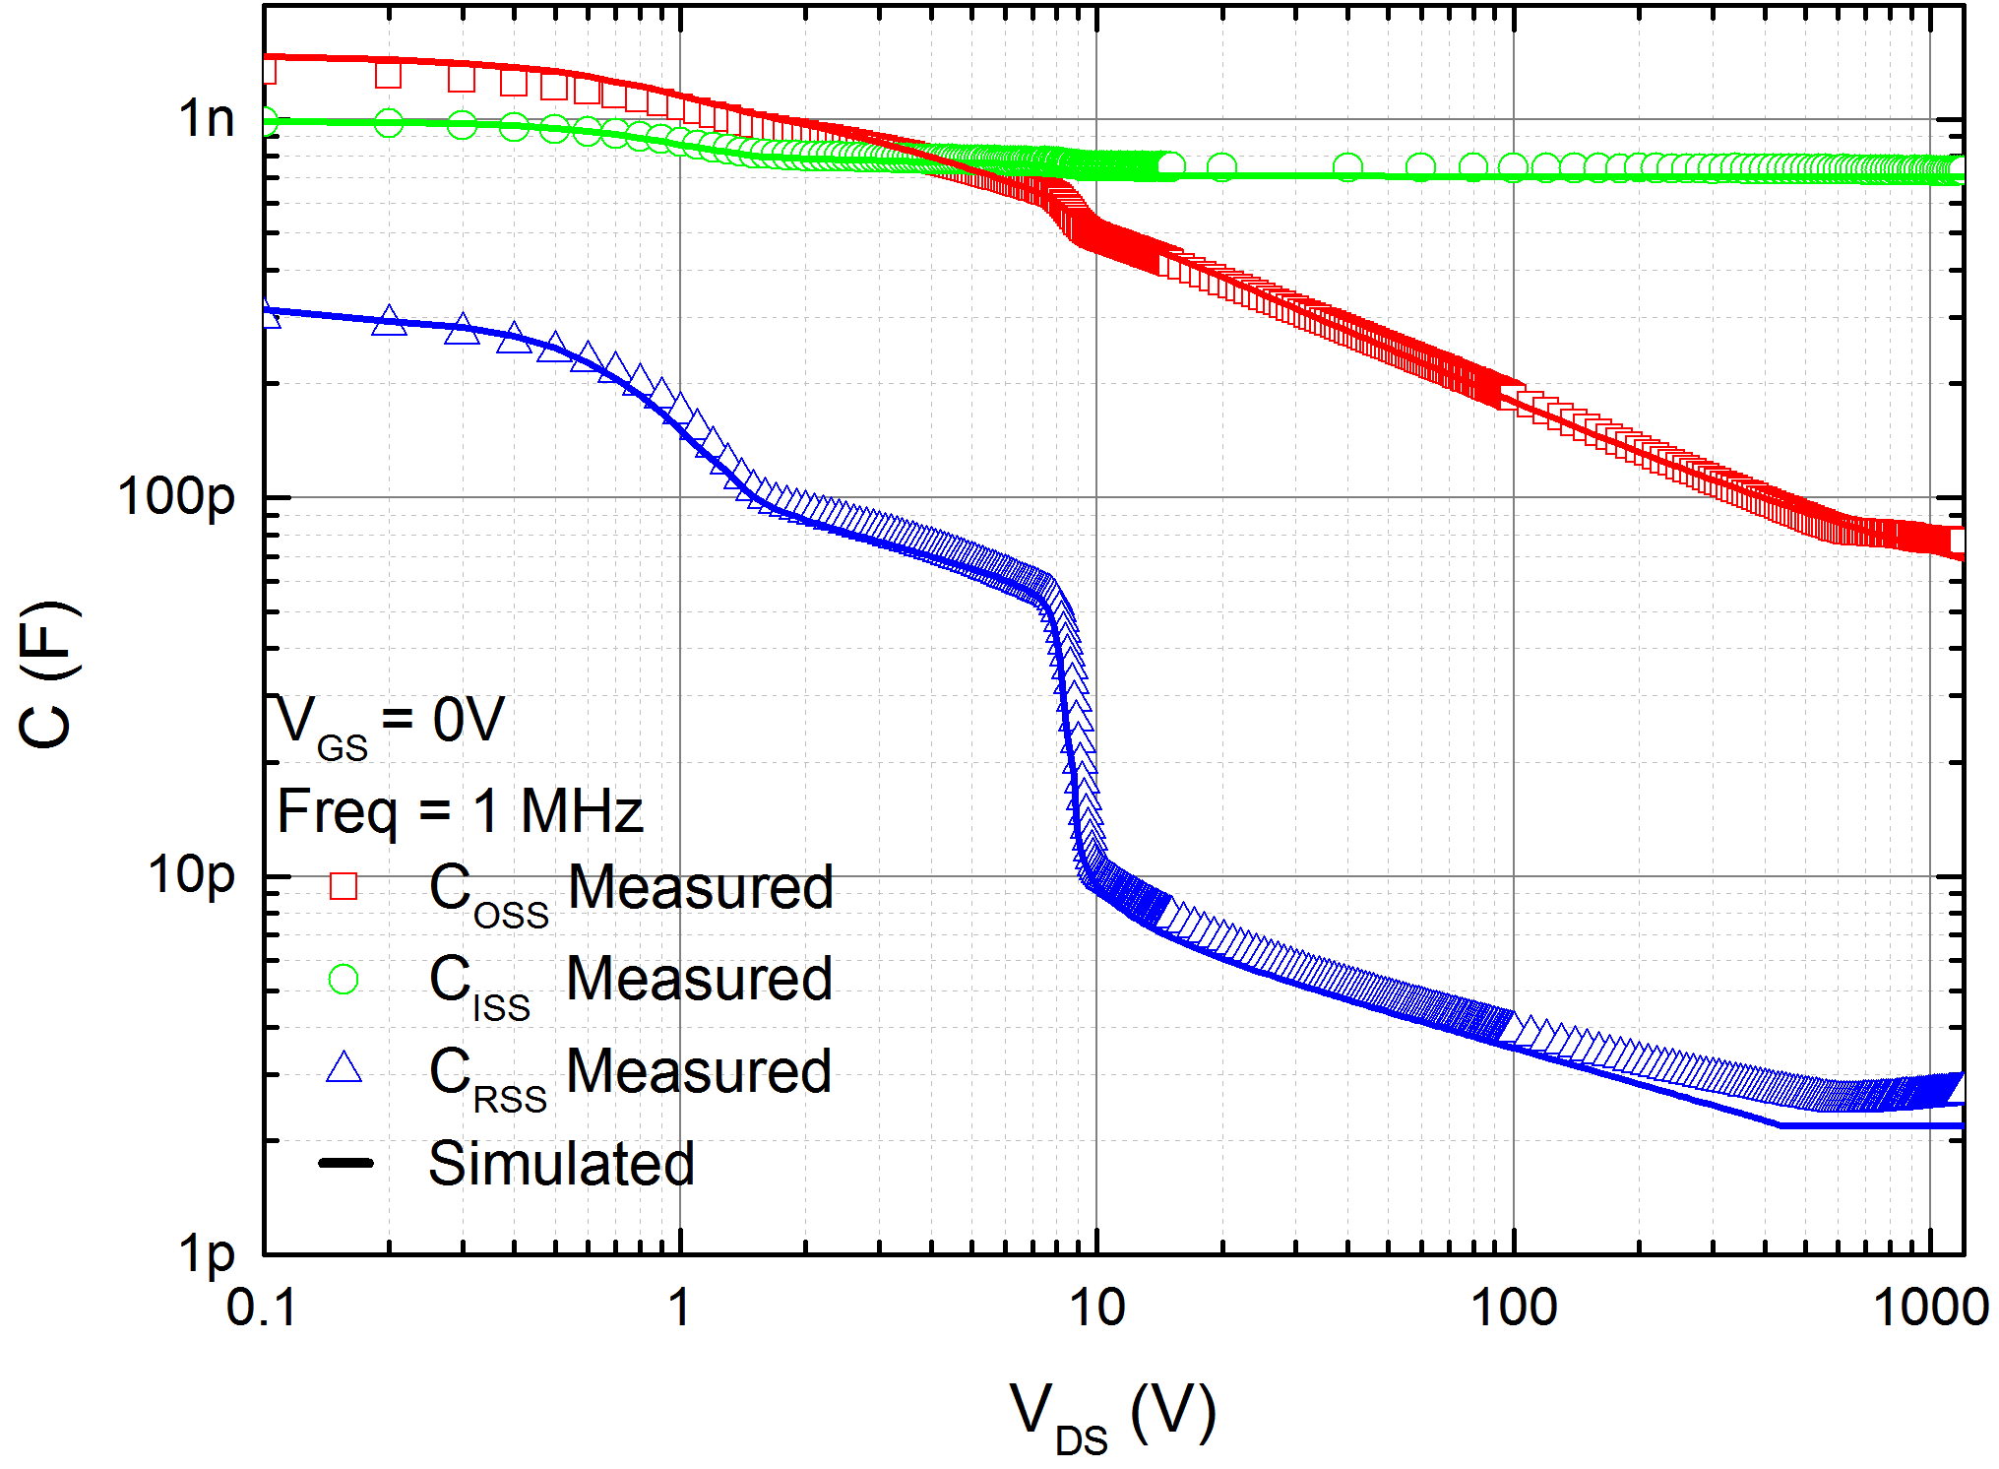
Model Verification – Layout Scaling
Device :
Same size / dimensions as the one
used to extract the base model, but with 42% increase in CP (Cell Pitch), and 12% increase in Lpoly.
Simulation:
Directly simulated with the new layout parameters with no further tuning.

Slide 28
Trench IGBT Model
Public Information © onsemi 2022

Slide 29
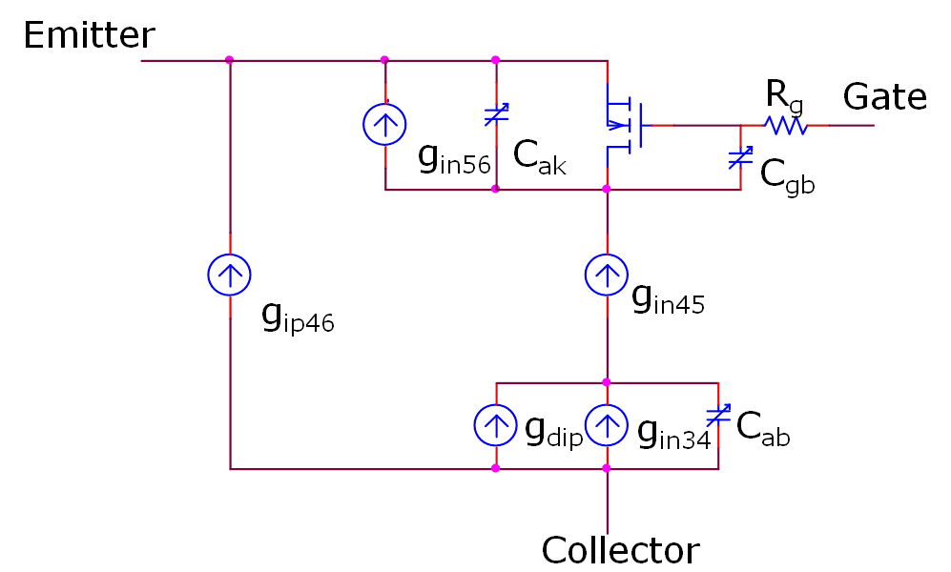
Trench IGBT Model
The ON IGBT model has it’s origins in the University of Washington (UW) lumped charge IGBT model. The UW model however is derived for planar devices, is not process parameter based, is not scalable, and is not temperature dependent. The ON model contains the following enhancements to the UW model:
Development of the physical/scaling equations for field stop (FS) trench IGBT process.
Replaced the empirical intrinsic MOSFET model with BSIM3v3 model, available in multiple simulators
Added physical/nonlinear dynamic capacitor models for trench technology
Added dead cell (emitter trench) and source blocking models
Added explicit physical models for the buffer region
Added full electro-thermal effects
Implementation in SPICE through arbitrary behavioral I/V sources.
Numerically robust, good convergence/speed performance

Slide 30
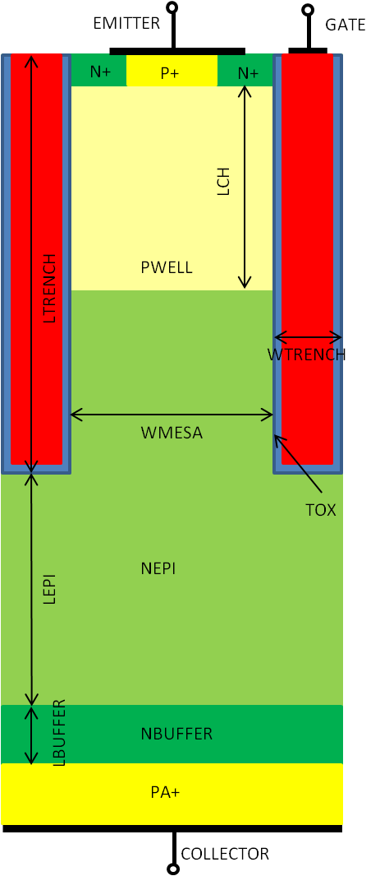
Sample IGBT Model Process Parameters
Parameter | Description
TOX | Gate Oxide Thickness
LCH | Channel Length
LTRENCH | Trench Depth
WMESA | Mesa Width
LEPI | Epi Depth
PWELL | Peak Channel Doping
NEPI | EPI Doping
PA+ | Anode Doping
..... | .....
Trench Pinch-off Voltage

Slide 31
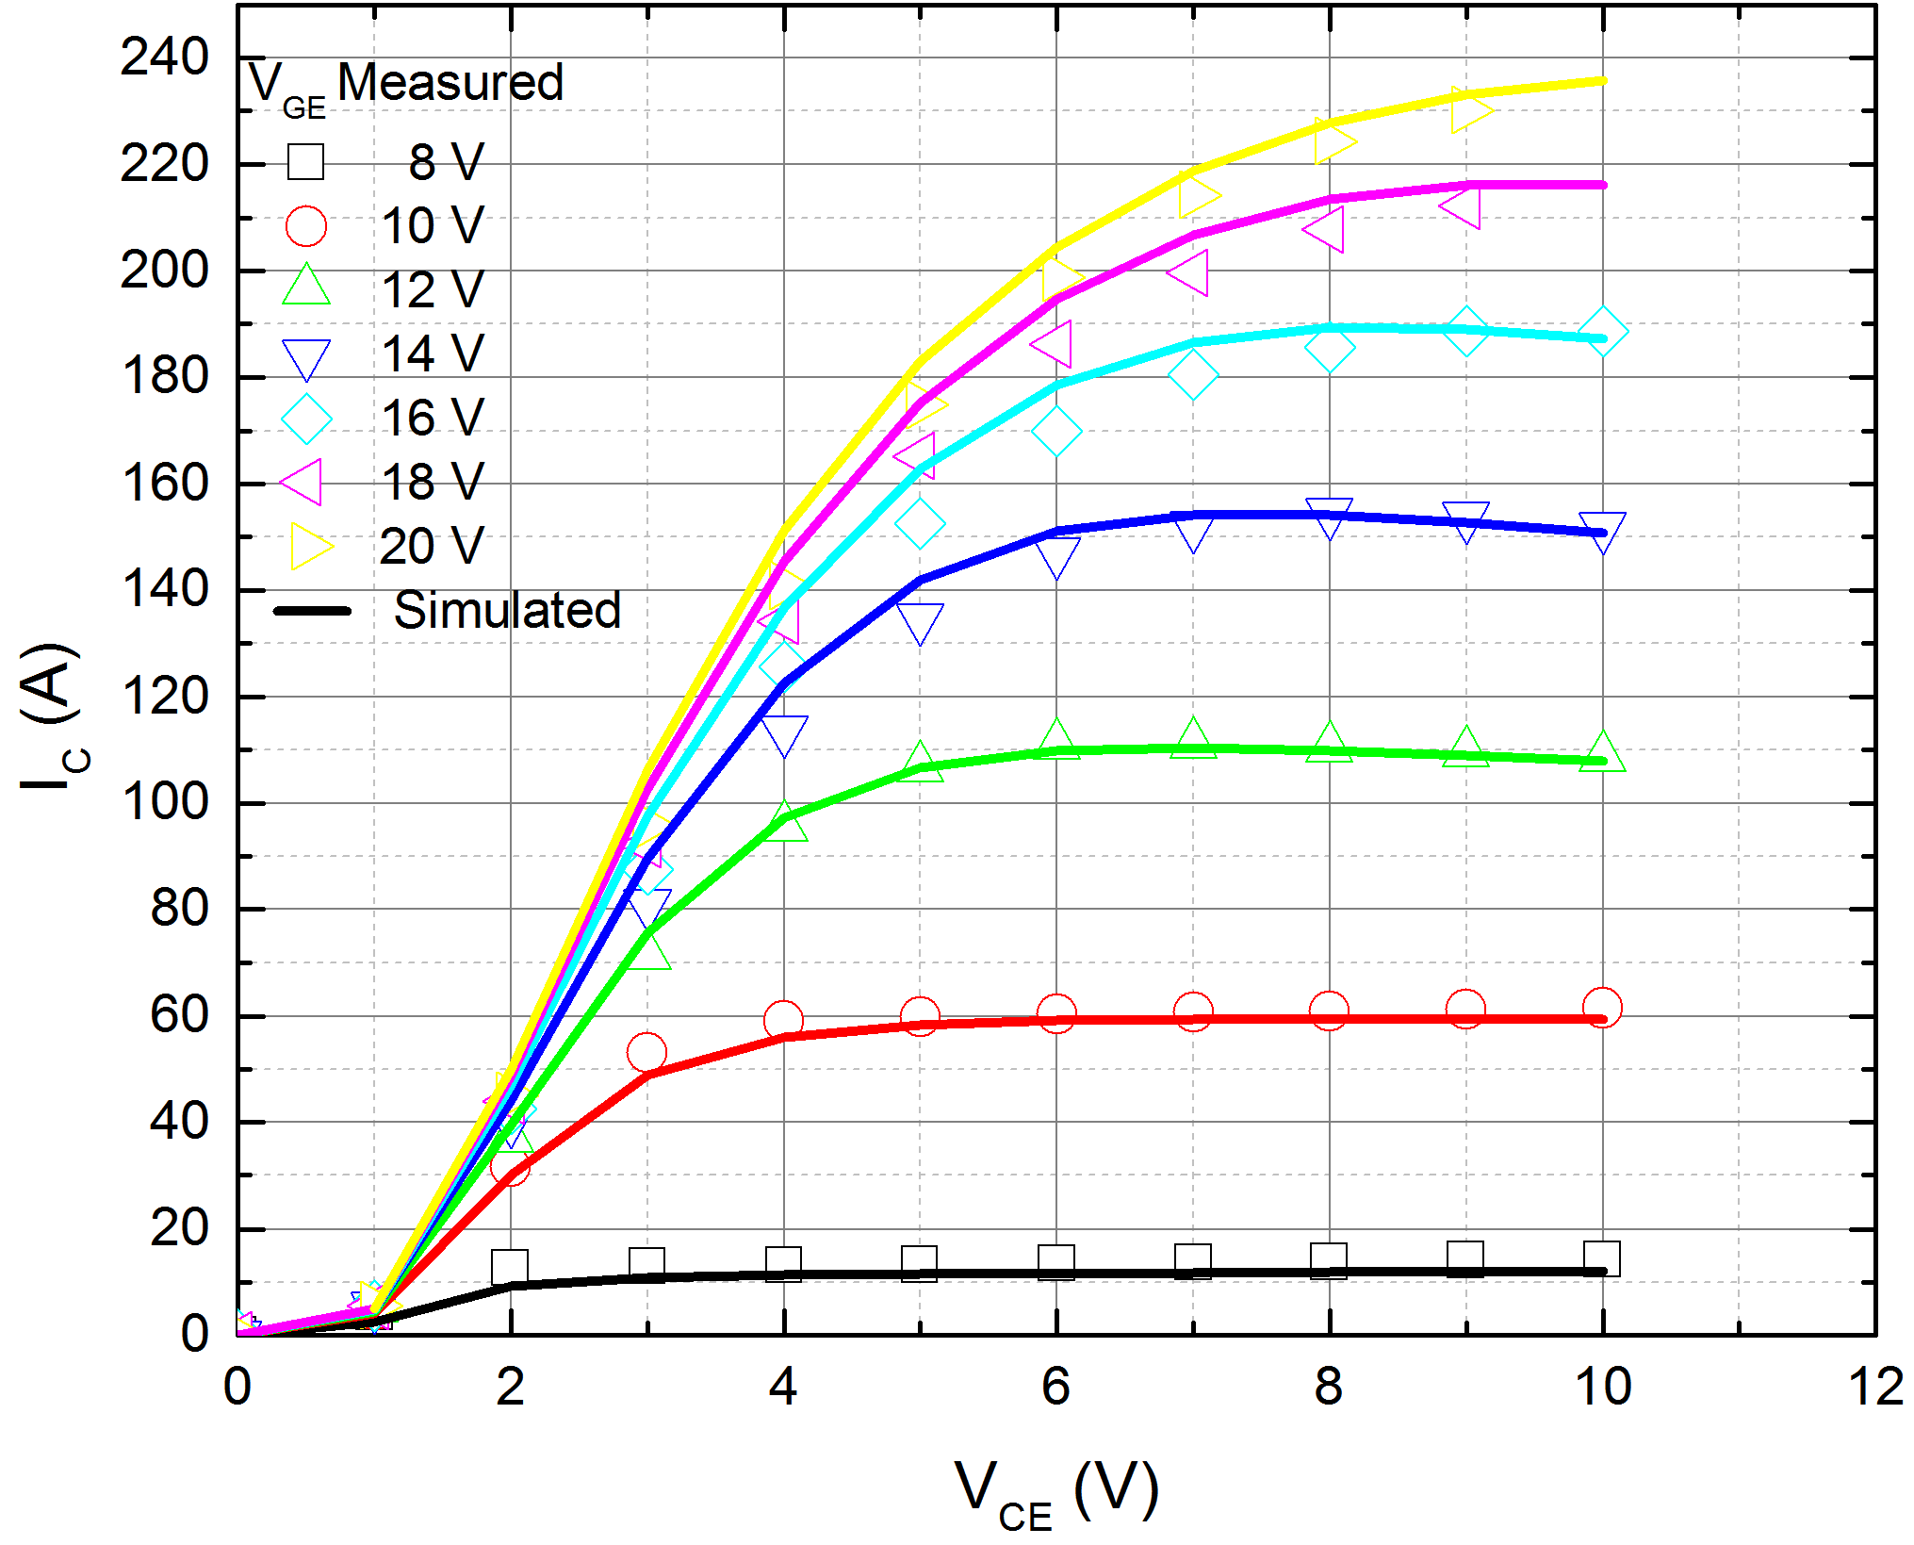
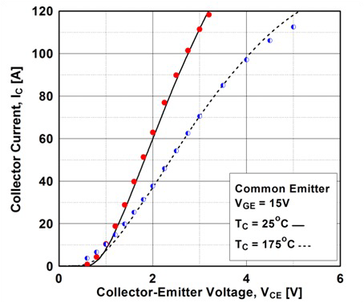
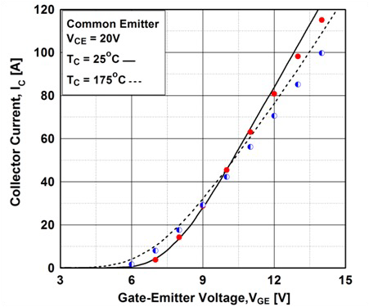
IGBT Model Verification – Current/Voltage
ICVC
ICVC @ Temp
ICVG @ Temp

Slide 32
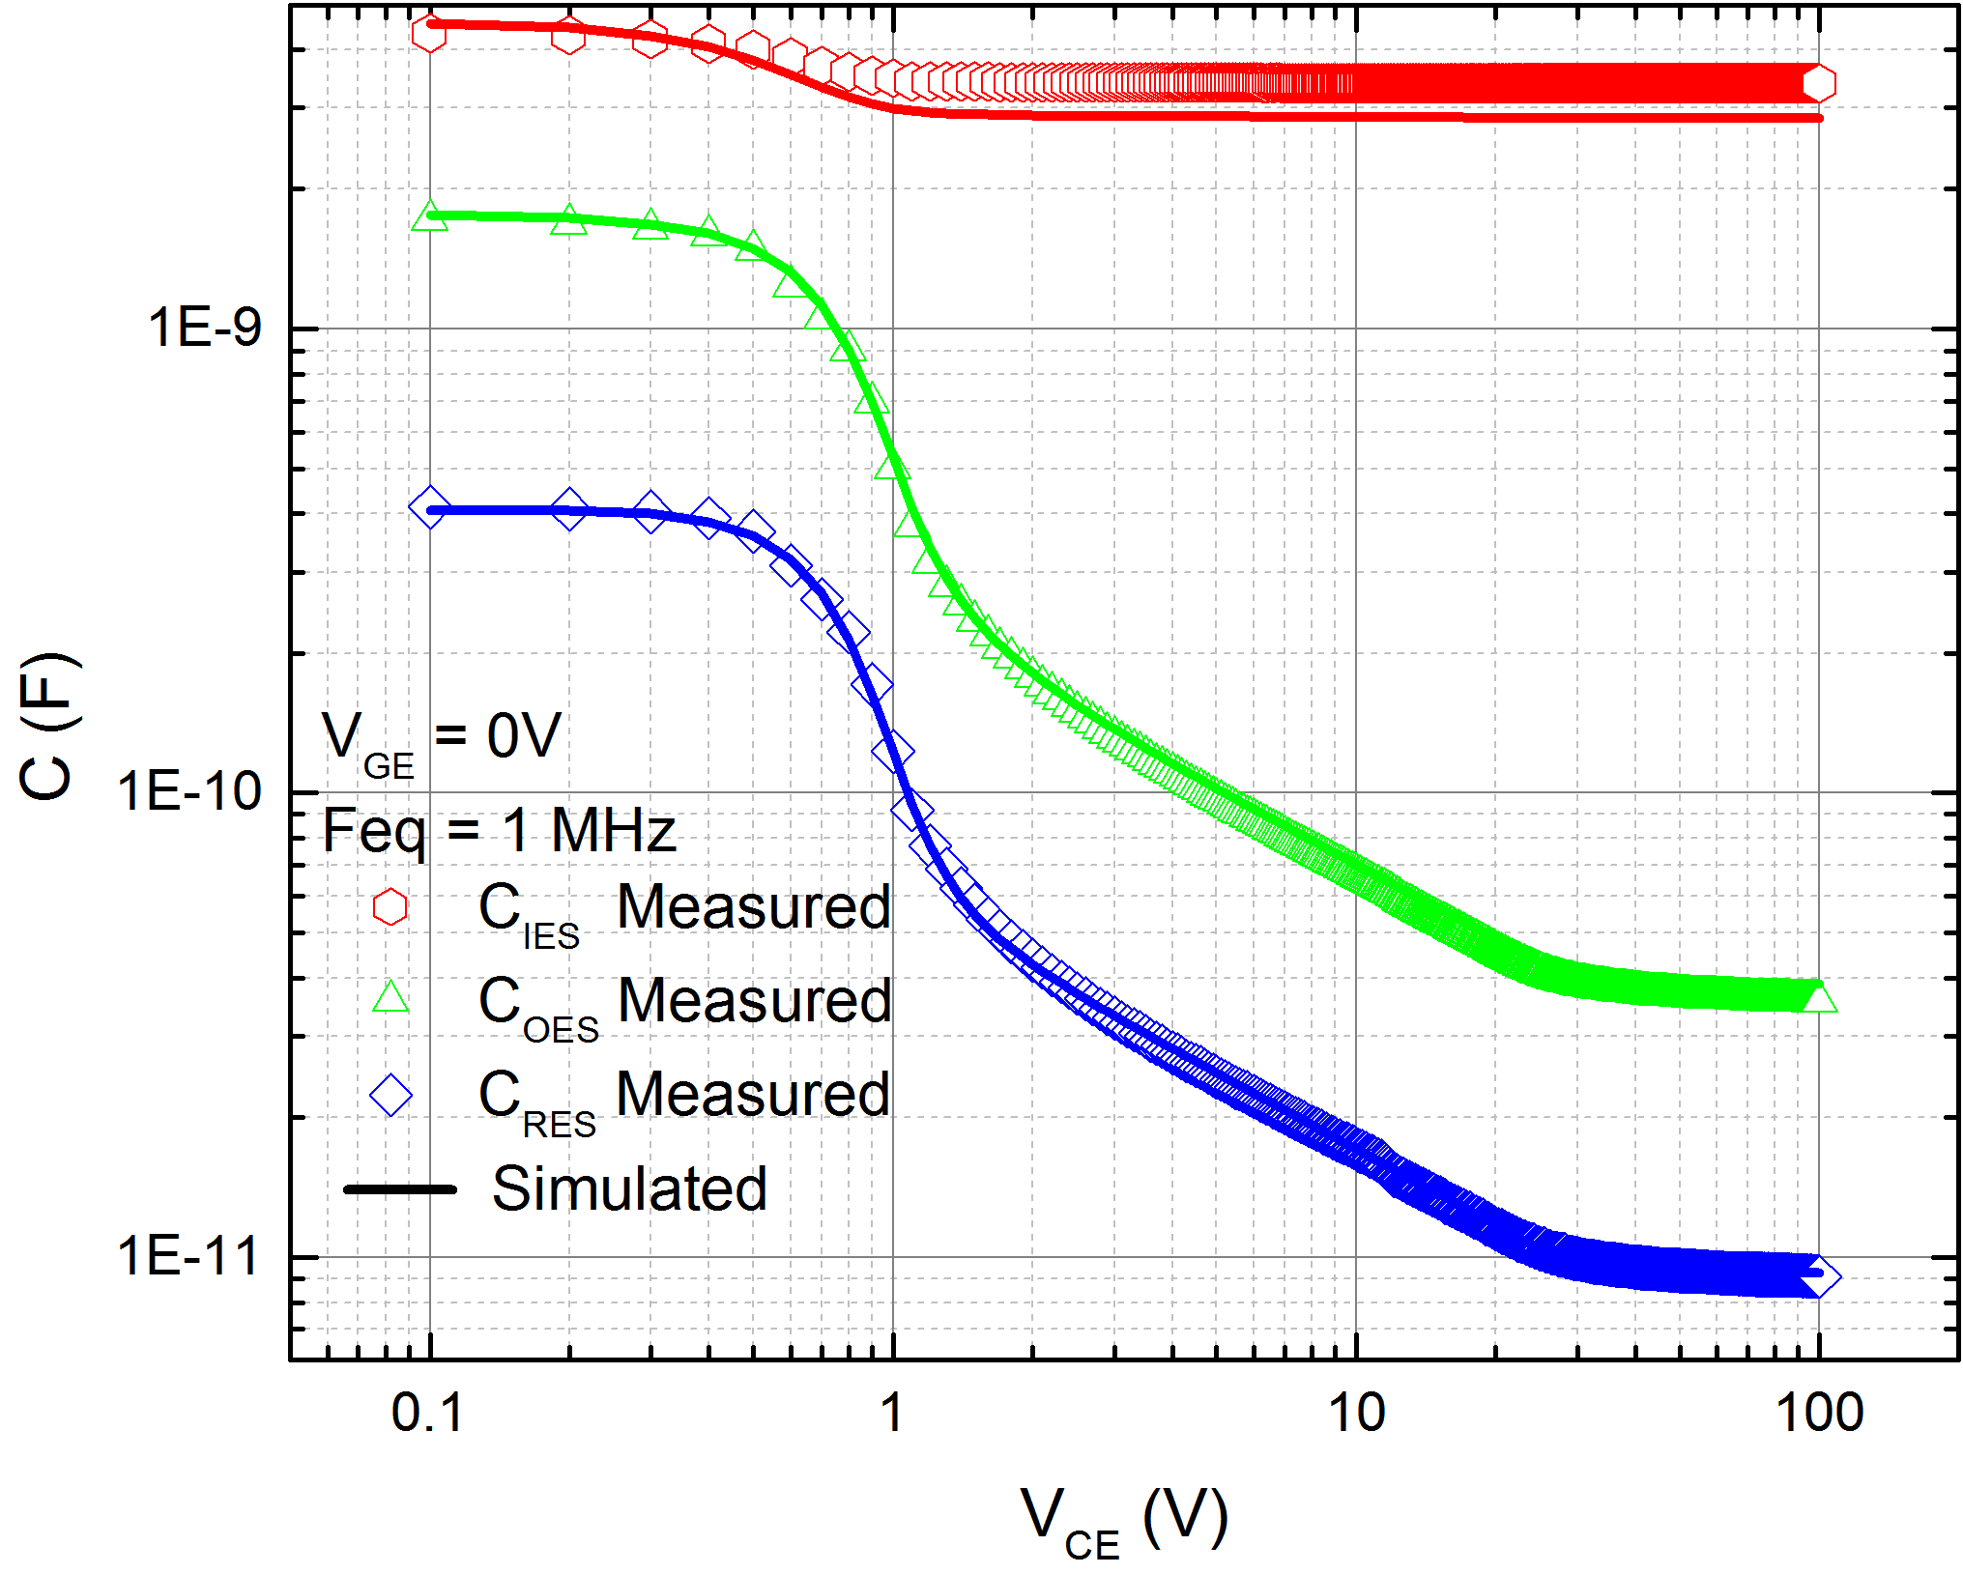
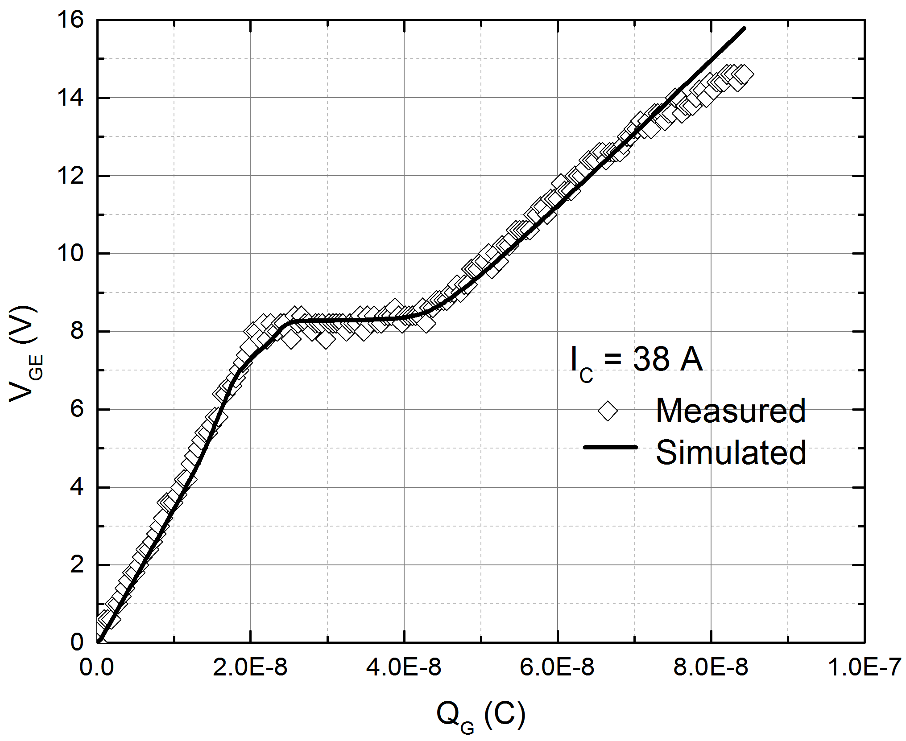
IGBT Model Verification – Capacitance/Voltage and Gate Charge
Capacitance
Gate Charge

Slide 33
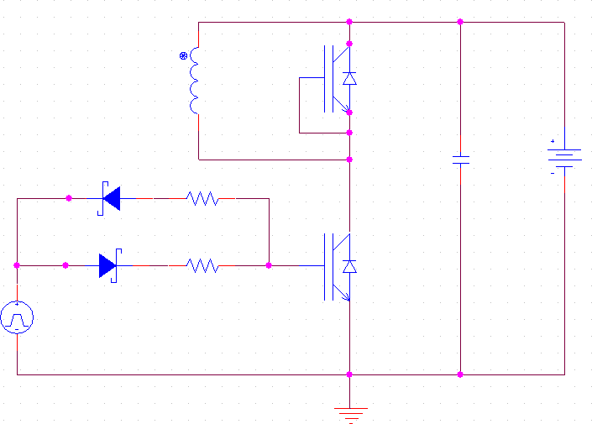
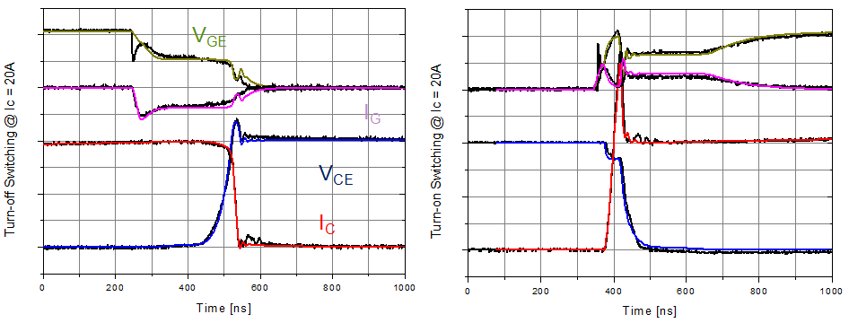
IGBT Model Verification – Double Pulse
Data: black lines Model: color lines

Slide 34
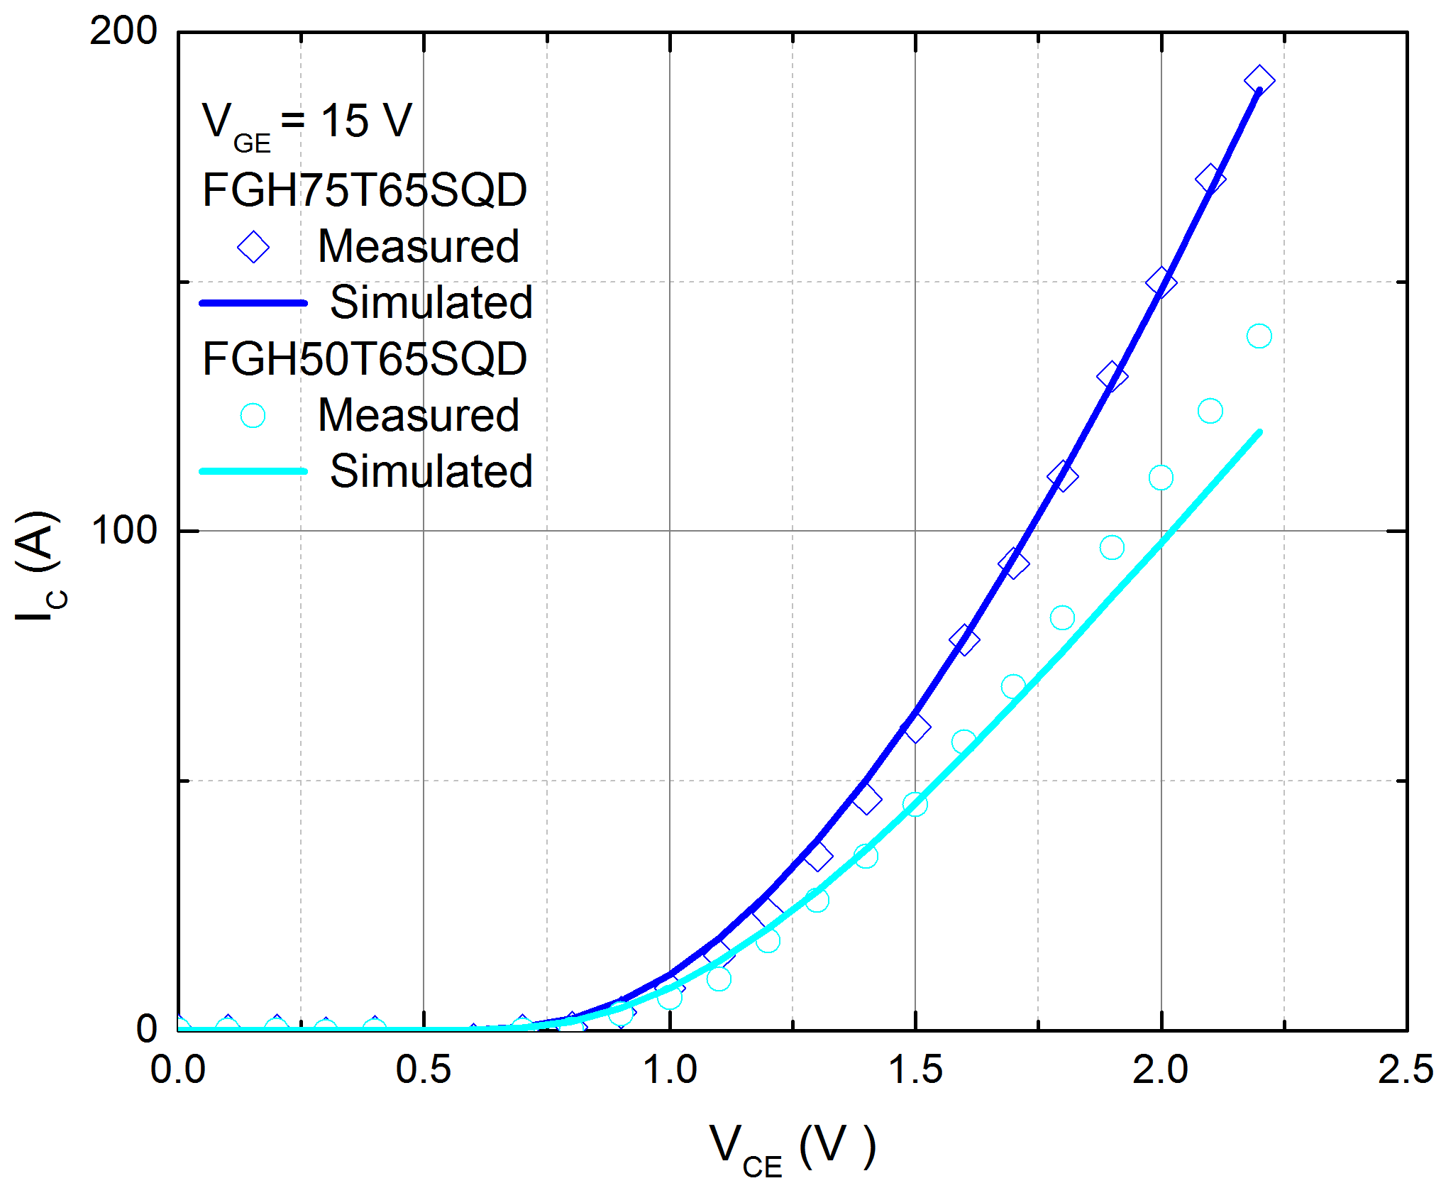
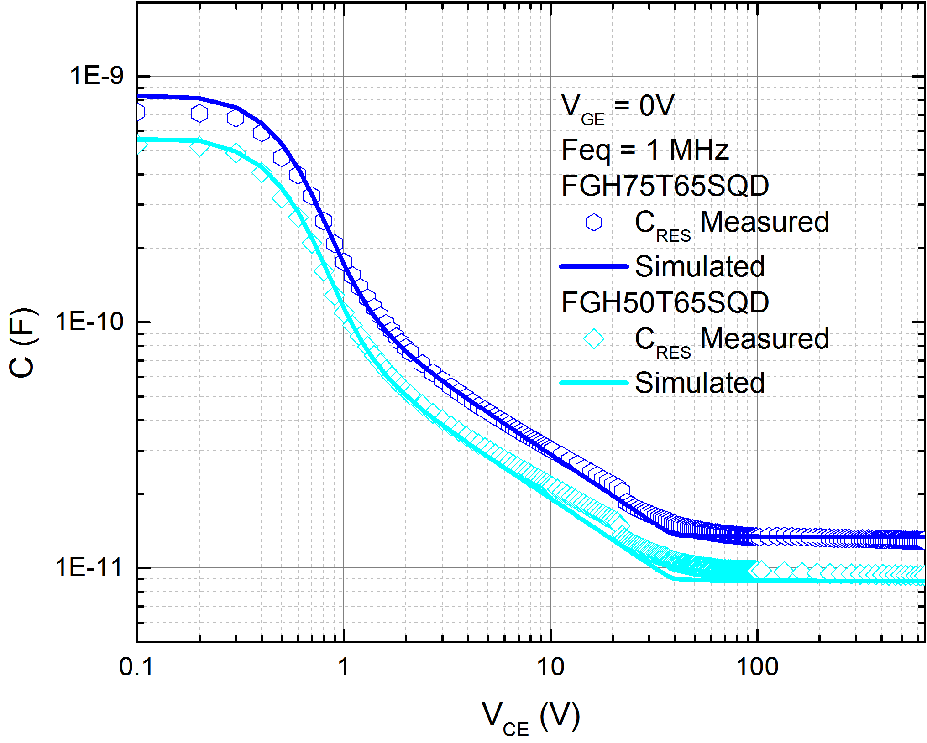
IGBT Layout Scaling
50 A device predicted directly from 75 A model with only layout parameters changed in model, no tuning

Slide 35
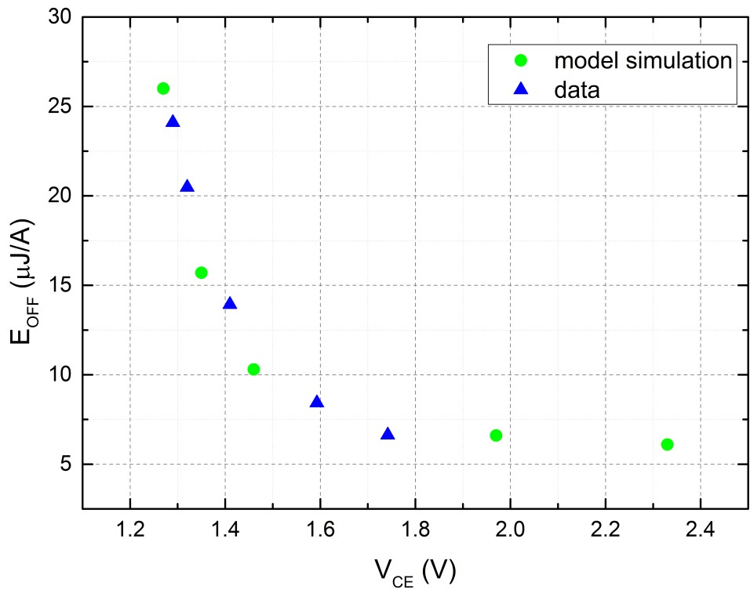
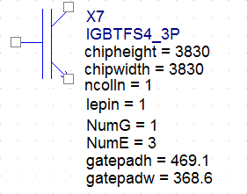
IGBT E_{OFF} vs. V_{CEsat} with Anode Doping
Model input parameter ncolln stands for normalized collector (anode) doping.
Sweeping this parameter enables designers to walk the technology E_{OFF} vs. V_{CE} trade-off curve

Slide 36
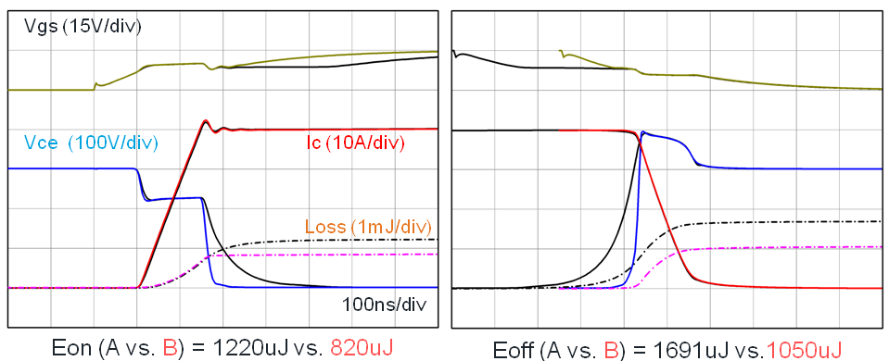
Technology Derivative Evaluation based on IGBT SPICE Model
Device | Pwell Depth | Trench Depth | GT:ET | GOX
A | POR | POR | POR | POR
B | POR |  | POR | POR
C |  |  | POR | POR
D | POR | POR |  | POR
E | POR | POR | POR
Goal is to isolate highest process parameter sensitivity for EON improvement from a POR device.
SPICE model captures all the process parameter
sensitivity and enables fast result determination. (compared to impractical TCAD and/or fabrication trials)
2.50
Normalized by A (POR)
2.00
Eoff [uJ]
1.50
1.00
Eon [uJ]
0.97
1.41
0.90
1.00
0.62
0.50
1.00
0.74
0.92
1.02
0.67
0.00
A (POR)
B
(Cres Decrease)
C
(Cies Decreas
D
(G-E Ratio Decreas
E
(Gox Increase)
A (POR)
B (Cres decrease)
C (Cies decrease)
_{e)} D (G-E ratio 1:4) E (
_{e)} Gox=2000A)

Slide 37
Conclusion
Public Information © onsemi 2022

Slide 38
Conclusion
ON Semiconductor provides industry leading physical, scalable SPICE models.
Models have been developed for all discrete technology types.
Models enable simulations of beyond the datasheet conditions with confidence.
The introduction of scalable SPICE modeling of the chip layout and process variation enables designers to optimize device and system performance in a fast and predictive simulation environment.
ON Semiconductor’s power device SPICE models drive our customer’s success

Slide 39
Follow Us @onsemi
www.onsemi.com

